Slide 1
The Right to Vote for All How the German Constitutional Court decided people that under guardianship cannot be denied the right to vote
Europe in Action 2019:
Everyone can live by the river: Everyone has the right to be independent and included
Jeanne Nicklas-Faust
Lebenshilfe Germany

Slide 2
Content
The former law
The political fight
The fight in court
Over time
The results
Copyright: Reinhild Kassing

Slide 3
The former law
People under full guardianship had no right to vote
People in forensic psychiatry had no right to vote
These rules applied to all elections at the national level as well as at the european elections.
At the local and regional level there were some counties („Länder“) that allowed the right to vote for people in forensic psychiatry.

Slide 4
The political fight
For years, Lebenshilfe has demanded that:
Exclusion from the right to vote must be ended.
This exclusion is not justified.
The UN-CRPD not allow such an exclusion.
Other organisations joined in and there was a strong voice.
There was also support from the German Institute for Human Rights and some politicians.

Slide 5
The political fight
Lebenshilfe held discussions on this issue with politicians on many occasions:
In small settings with members of the federal parliaments in the area of disability
In meetings and hearings
At the parliamentary evenings, where members of parliament are invited to discuss political demands (in 2014 around 100 members were involved in the discussion on the right to vote)

Slide 6
The fight in court
Lebenshilfe felt that the political fight is not enough:
She supported people with learning disabilities by filing an objection against the election for german parliament in 2013
This objection was then submitted to the constitutional court in 2014
Then the waiting started …. and the political fight went on.

Slide 7
2013 - 2017
The German federal parliament discussed changes to the law on elections, but did not come to an agreement
Lebenshilfe and other organisations put the topic on the agenda in the political field and media
Nothing changed for the election of 2017 – and the objection against the election was renewed after the election

Slide 8
2018
The agreement of the coalition included the removal of the exclusion from elections
But again: The German parliament discussed changes to the law on elections, but did not come to an agreement
Lebenshilfe and other organisations put the topic on the agenda in the political field and media – and found wide interest

Slide 9
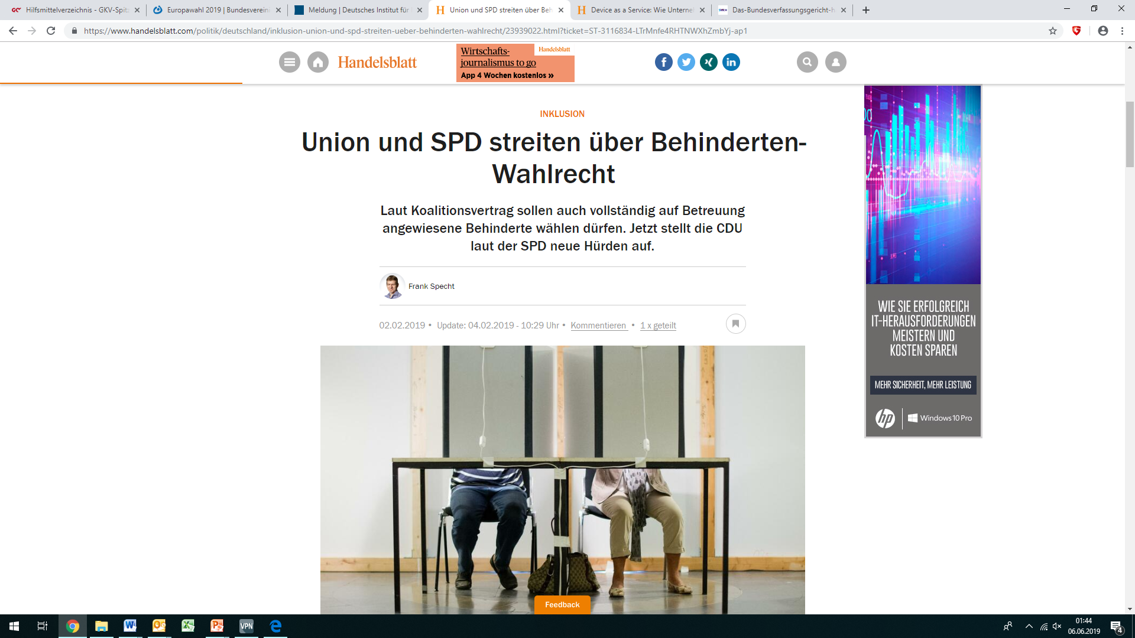

Slide 10
2019
In mid-February the coalition postponed the discussions on proposals of the opposition to change the law once again.
The following day the constitutional court finally revealed his ruling: The exclusion from the election to the Federal House of Parliament is not concordant with the German constitution. It violates the principle of the general election as an outstanding right of citizens and is discriminatory.
Many media outlets were active in telling the story of people with disabilities.

Slide 12
And the European election?
The German parliament did not agree to change the law immediately, since there was the fear that such a late change might unduly interfere with the election.
The opposition pledged the Constitutional Court again in March 2019 to also decide on the exclusion to vote for the European Parliament as an urgent decison.
On15 April the Court decided, the ruling was also to apply to the European elections and persons under guardianship could vote at the european election if requested so ten days before the election.

Slide 15
And the european election?
Lebenshilfe provided a form for this request in an Easy-to-read format on the website and communicated the new possibility widely.
Lebenshilfe enjoyed with many people with disability the new right to vote at the European election.
Information on the accessibility of the election and explanations how to vote in Easy-to-read was also provided, as the five established parties had their programmes …

Slide 16
And the local and regional elections?
Most (10 out of 16) counties („Länder“) have already taken action and also changed their right to vote for the regional and local parliaments.
The remaining 6 will have to follow, since the constitutions of the counties have to be in line with the federal constitution.
Four counties only grant the right to vote and keep the exclusion concerning the right to be elected. This can also be questioned at court, it would need an affected candidate though.

Slide 17
The results
The political fight and discussions did not bring the success, even with the high coverage in the media.
Fighting for the rights at the Constitutional Court was the way to the final success – and the CRPD was an important part of the explanatory statement.
The heroes are the 9 persons with disabilities that went all this way over seven years!
The winners are the 84.000 Persons with disabilities that had been excluded until now.

Slide 18
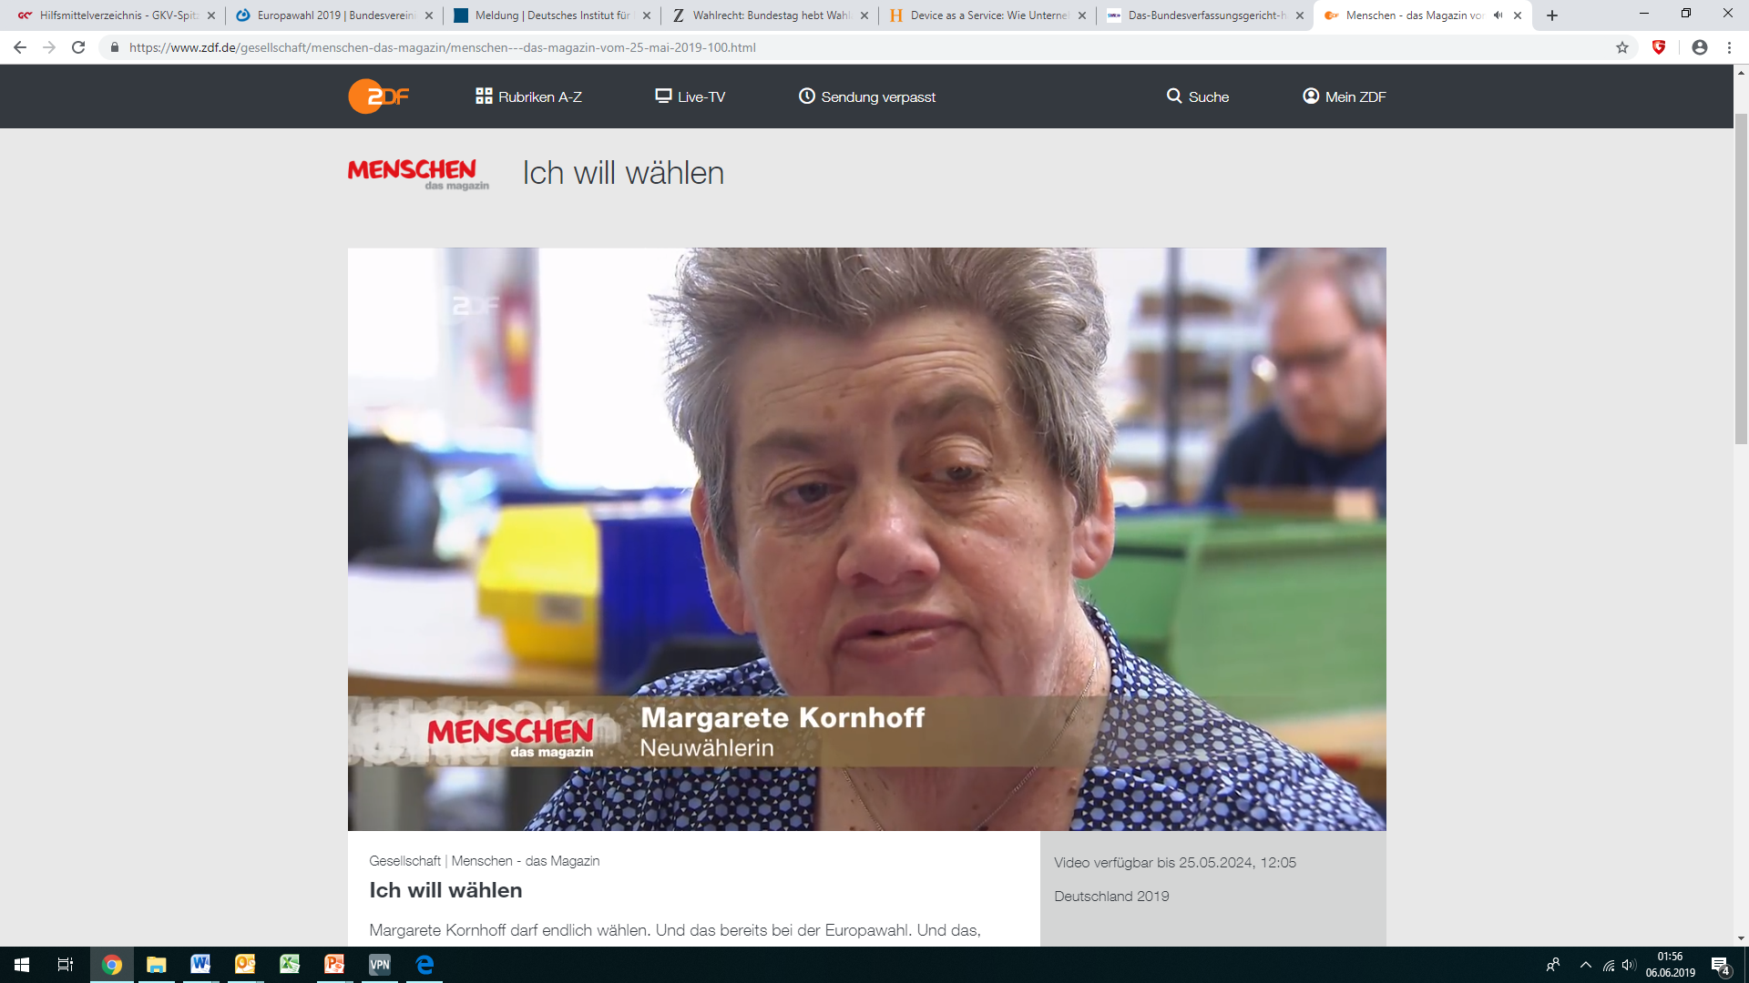

Slide 19
Thank you for your attention – let‘s discuss the situation in your countries!

