Slide 1
All-Ukrainian NGO Coalition for Persons with Intellectual Disabilities
Vilnius 2019

Slide 2
NGO "Coalition"
from 2004 it promotes equal rights and community inclusion of persons with intellectual disabilities (ID) in Ukraine:
- advocates for the rights
- represents interests of persons with ID and families on national and local levels (about 90,000 Ukrainians are awarded disability status due to intellectual disabilities)
- promotes community based services: supported living, day care, supported employment, supported decision maling, individual support networks

Slide 3
NGO Coalition
umbrella NGO for 116 grass root NGOs and agencies
14 000 families from 22 regions
over 1000 professionals
over 1000 volunteers

Slide 4
Coalition – is the net of organizations of parents and specialists for persons with ID

Slide 5
Ukraine
persons with disabilities – about 2,7 millions (up to 7% population)
disability due to psychiatric diagnoses – more than 261,000 persons (more than 10% of those with disabilities)
about 90 thousand persons with ID

Slide 6
Institutialization
10 000 children out of schools (2015 UPO)
about 60000 adults in care institutions (welfare system and mental hospitals)

Slide 7
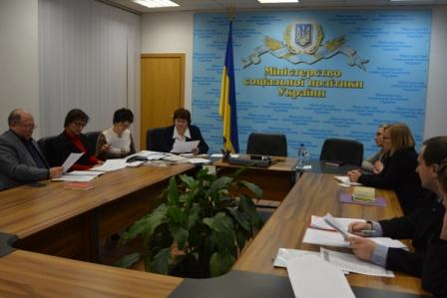
Activities
Representation of the rights and interests of people with intellectual disabilities (ID), their mothers (fathers), professionals and care givers at national authorities
promotion of equal gender distribution of care over persons with ID,
negotiations with national authorities through participation in the Advisory Boards– the Cabinet of Ministers and three ministers.

Slide 8
Activities
4. Lobbying re-orientation of institutionally based care into the community based one researches - campaigns
5. publication of reports on analyses
6. best practices of community based support,
7. public events, Media involvement.

Slide 9
Activities
8. Participation on the monitoring on the rights of persons with ID (Ombudsman+)
9. Monitoring of the drafts laws and sub-laws (CRPD 4.3 mechanism)
10. Promotion reform of the state guardianship system over legally incapable adults

Slide 10
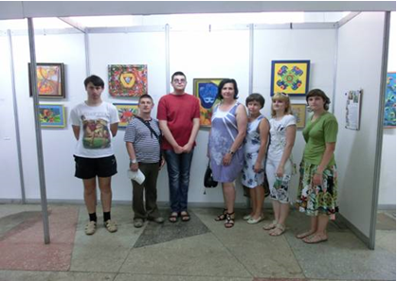
Activities
11. Coordination of the day care program implemented in the 42 grass-root NGOs covering 360 persons with ID supported by the national budget
NGO «Parostok», Vinnytsia

Slide 11
Activities
12. Provision space for exchange experiences, supervision, capacity building among grass-root NGOs: national conferences, seminars, thematic meetings, study visits

Slide 12
Public events, e.g. roundtable discussions “The right to love” – national / regional

Slide 13
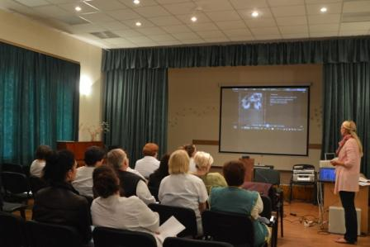
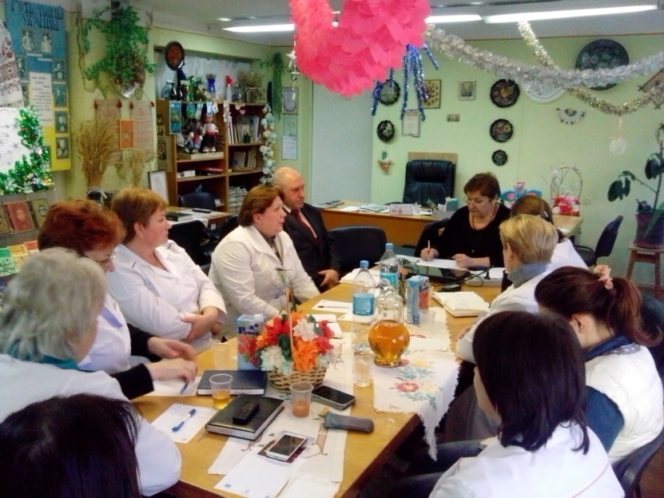
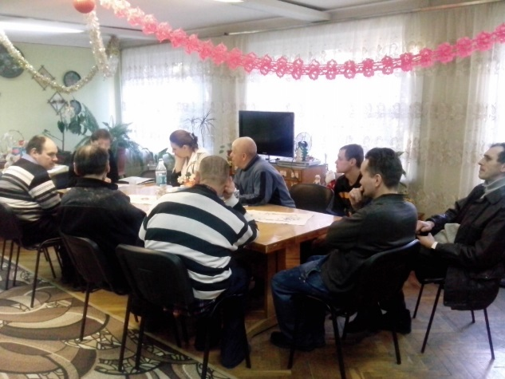
Supervision in boarding homes

Slide 14
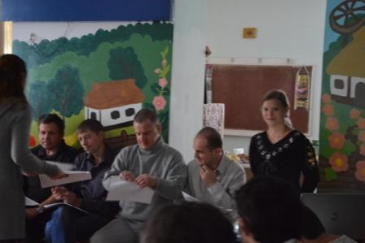
Training events, incl. peer trainings and self-advocacy network
“Djerela” Association, peer training on advocating access to services

Slide 15
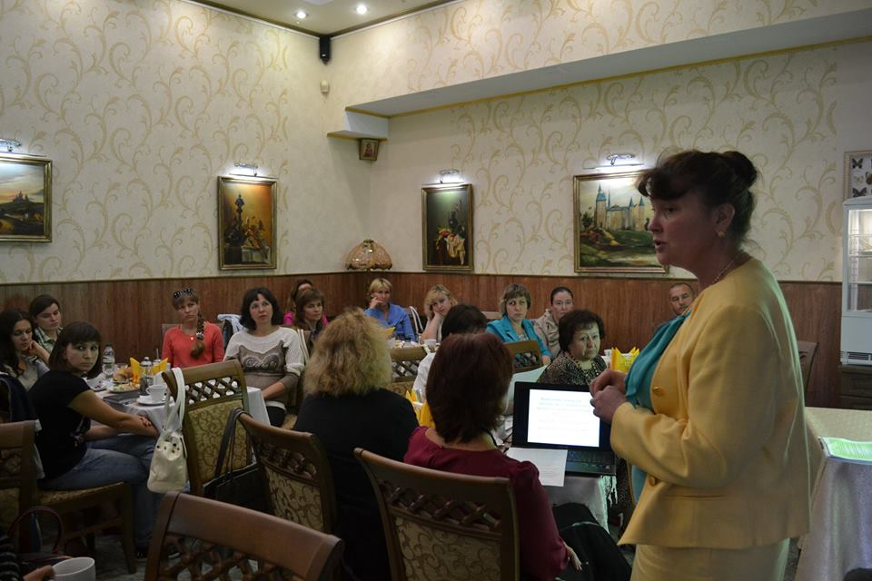
Info seminars for parents and family members
2019 – 40 seminars
Town rehab center, Poltava

Slide 16
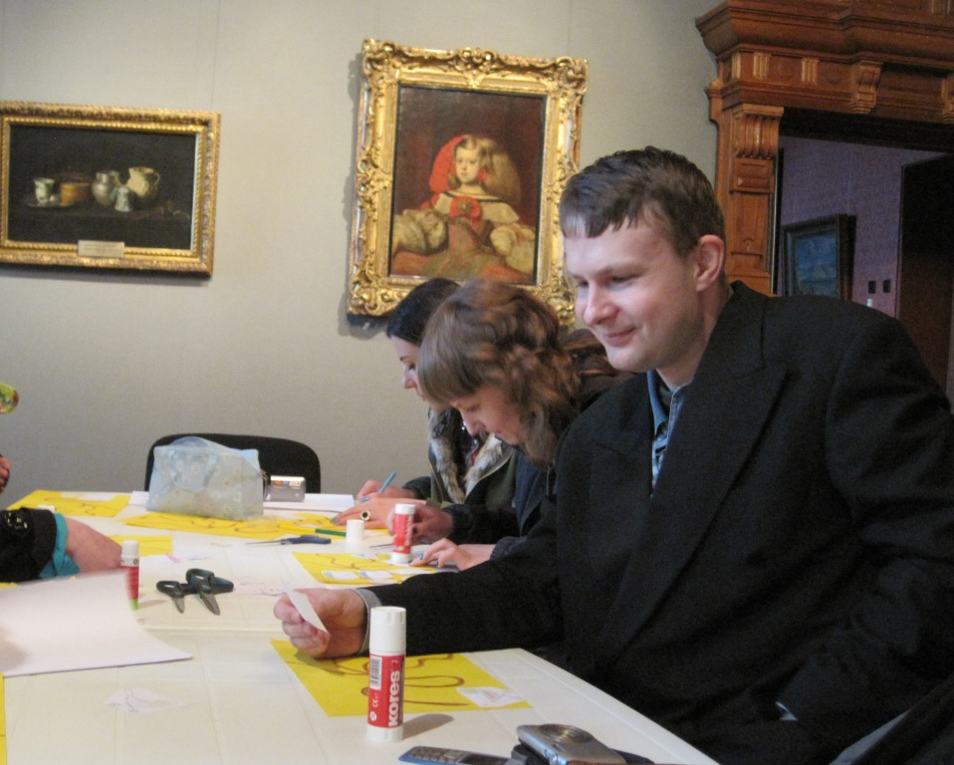
Museum inclusion program

Slide 17
CRPD in Ukraine
2007 – signed
2009 – ratified
2010 – ratification valid
2012 – initial report / parallel report
2015 – considered by UN (NGO Coalition participated)
2019 – report planned / simplified procedure

Slide 18
Parallel reports foci – 2012, 2019
CRPD Articles
Quardianship vs. supported decision
making
Placement into institution based on
diagnosis (detention)
19 Community based support
23 Opportunity for the child to be cared in
the family and for adults - to marry
27 Supported employment
29 The right to vote (Constitution of Ukraine)

Slide 19
All-Ukrainian NGO Coalition for persons with intellectual disabilities
Postal/actual Address: office 77, 50B Vyshgorodska Str., Kyiv, Ukraine, 04044
+38-067-659-29-36
Vgo.Coalition@gmail.Com
Www.Inteldisabilities-coalition.Kiev.Ua
Executive director: Julia Klepets

Slide 20
THANK YOU!!!

