Slide 1
The right to independend living as UN CRPD‘s response in tackling discrimination of persons with intellectual disabilities
EUROPE IN ACTION CONFERENCE
Everyone can live by the river: Everyone has the right to be independent and included
5-7 June 2019 | Vilnius, Lithuania
Jonas Ruškus
Professor at Vytautas Magnus University, Lithuania
Expert-member, vice-chair of the Committee on the Rights of Persons with Disabilities of the United Nations
Chair of the UNESCO National Commission

Slide 2
Introduction
My lived experience

Slide 3
Structural discrimination
Removal of legal capacity of a person on the grounds of disability, denial of civil and political human rights, substitute-decision making
Institutionalisation and reinstitutionalisation of persons with disability, denial of the social rigth of being included in society
Parallel (special) education system for children with disability
Lack of provisions for an employment at open labor market, denial of economic right
Family as last resort of support
Barriers to independent living

Slide 4
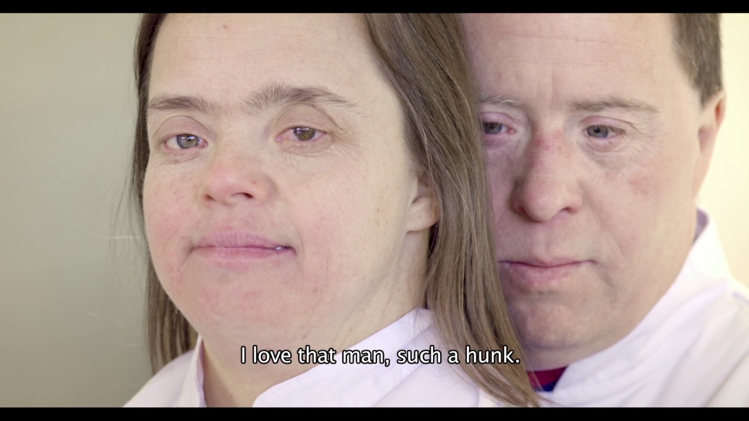
Structural discrimination
THE CRITICAL CINEMA
The Grown-Ups“ by Maite Alberdi
Chile/The Netherlands/France, 2016
Barriers to independent living

Slide 5
Origins of discrimination
Charity model – pity-based paternalistic model
Medical model – impairment-based assessment of (in)capacity to understand and to act, leading to the denial of fundamental human rights, through deprivation of legal capacity of a personand substitute-decision making regime
Discriminatory models of disability

Slide 6
The Convention on the Rights of Persons with Disabilities of the United Nations
Obligations of the States Parties
Dignity of a person regardless type and severity of impairment
Independent living and being included in society as human right
Equality and non-discrimination
Individual autonomy including the freedom to make one's own choices
The human rights model of disability

Slide 7
The Convention on the Rights of Persons with Disabilities of the United Nations
Right to independent living and being included in society as human right (article 19):
to choose where and with whom to live, not being obliged to live in a particular living arrangement
to have access to a range of in-home, community support services, including personal assistance
Services and facilities for the general population are available on an equal basis with others
The human rights model of disability

Slide 8
The right to independend living as UN CRPD‘s response in tackling discrimination of persons with intellectual disabilities
EUROPE IN ACTION CONFERENCE
Everyone can live by the river: Everyone has the right to be independent and included
5-7 June 2019 | Vilnius, Lithuania
Jonas Ruškus
Professor at Vytautas Magnus University, Lithuania
Expert-member, vice-chair of the Committee on the Rights of Persons with Disabilities of the United Nations
Chair of the UNESCO National Commission

