Slide 1
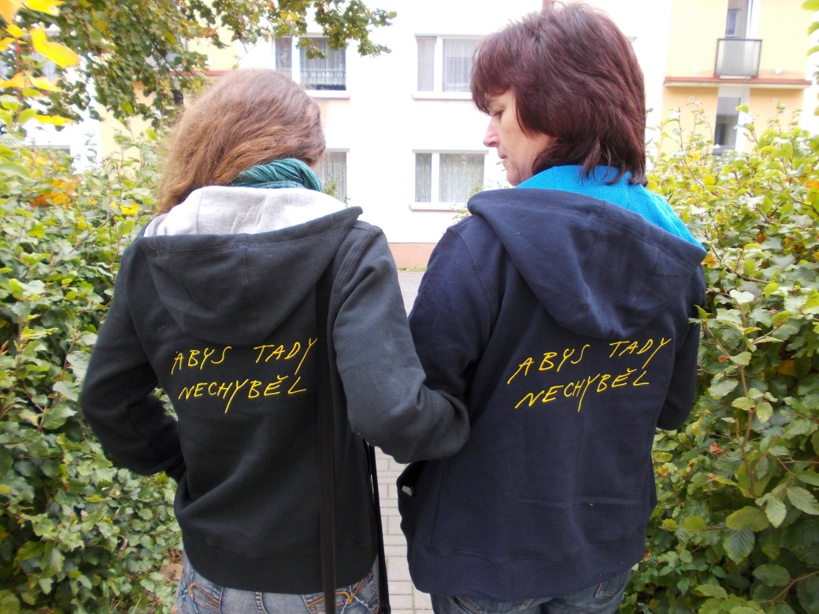

Rytmus - od klienta k občanovi
Supported living arrangement

Slide 2
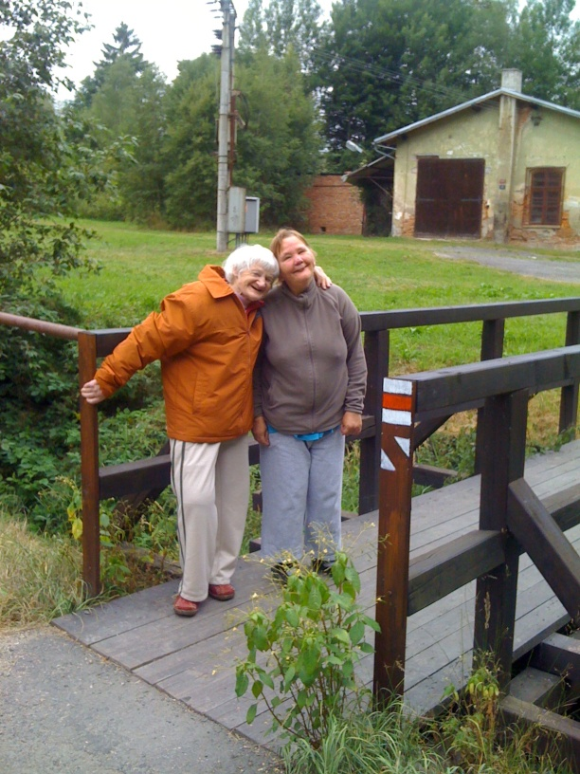
Supported living arrangement
Each person may be able to live according his/her wishes.
He/she should be able to live where and with whom he/she wants and feels well with him
We support people in the transition from the institution to independent life

Slide 3
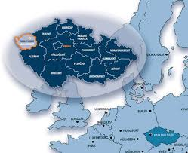
Supported living arrangement
Rytmus started to provide registered social service in 2010 in Karlovy Vary region as a part of project of transformation of residential care
today we support 45 people in 7 cities
in 2015 we started in Prague also
today we suppport 15 adults

Slide 4
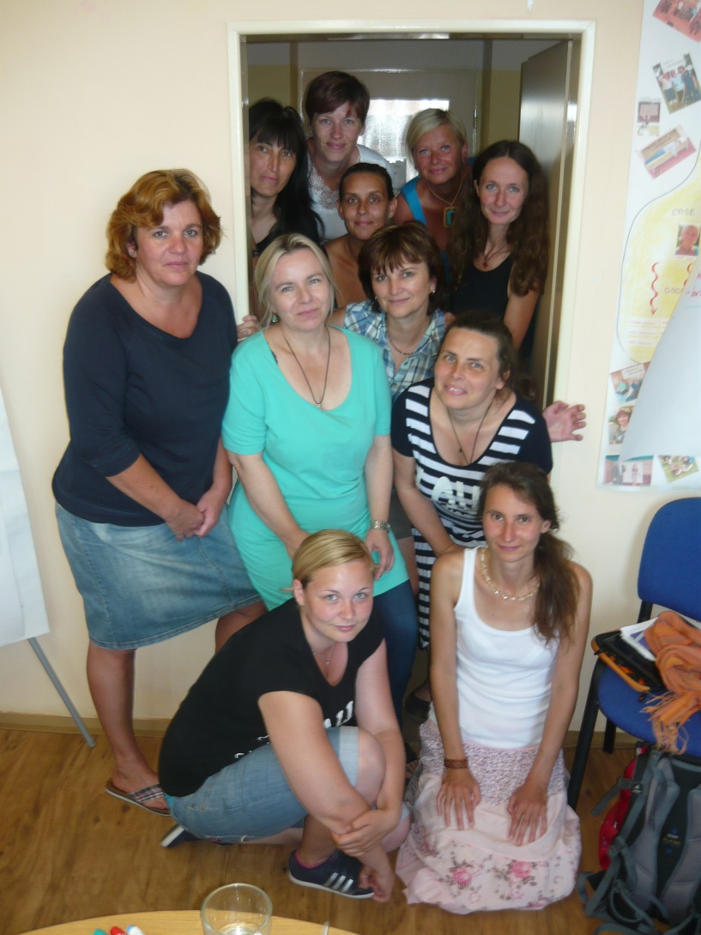
Our teams
Is devided acording to regions (cities) and accessability
8 casemanagers/support coordinators (7-8 persons)
+ 30 assistants individually chosen for every single person
+ 2 community social workers

Slide 5
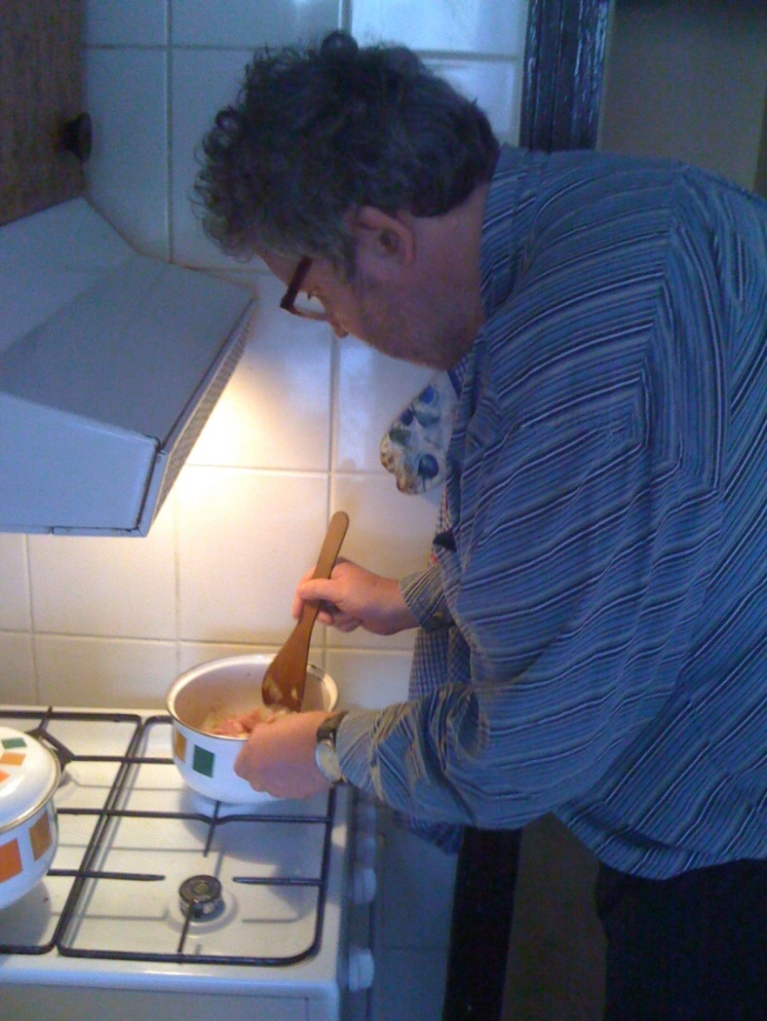
Characteristics of the service
community social service
provided to the person at home or other places according his/her needs
one of the basic service - law 108/2006 Sb, rules, quality standards
funded from the government + regional budget, project every year
payment from the clients according amount of hour of service (cofinancing)

Slide 6
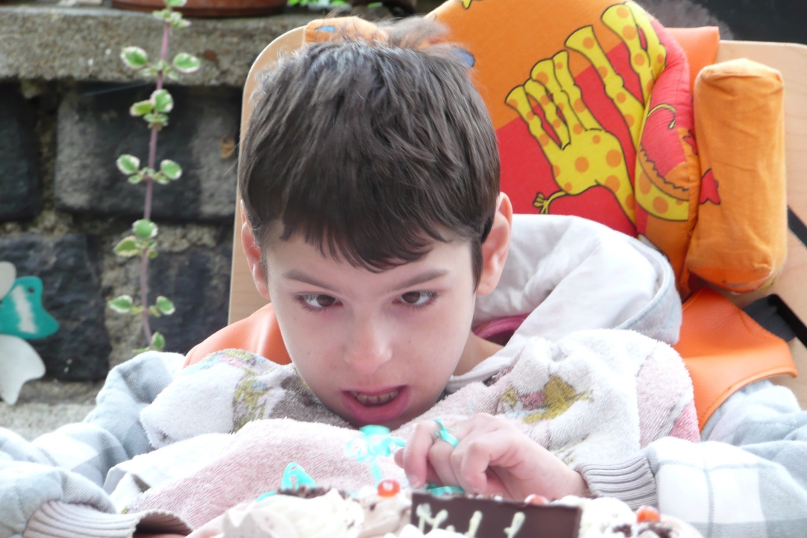
2 target groups
People with disabilities who wanted to leave the institutions
People with disabilities who do not want to live in the institution – prevention of institutionalization

Slide 7
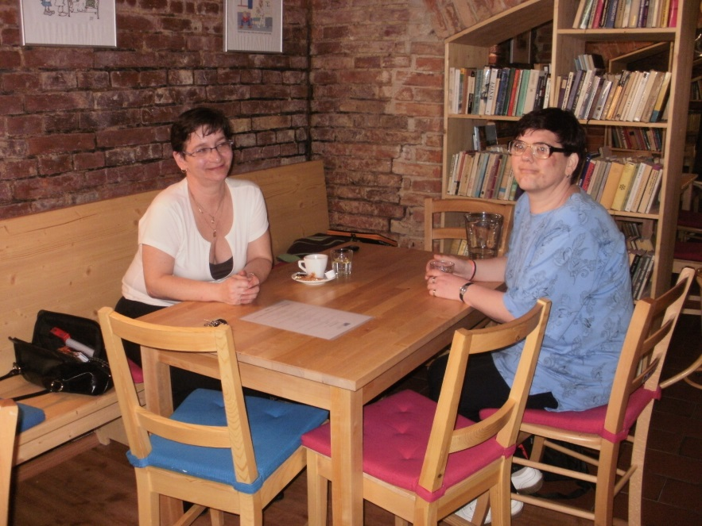
The goal of the service
to enable people to live as much independent as possible, take care about the household, health and safety
to help people to have possibility to plan own life, be able to ask for support
to enable people to live in natural relationships with family , neighbours , partners, friends
To be part of local community
To use the local public services

Slide 8
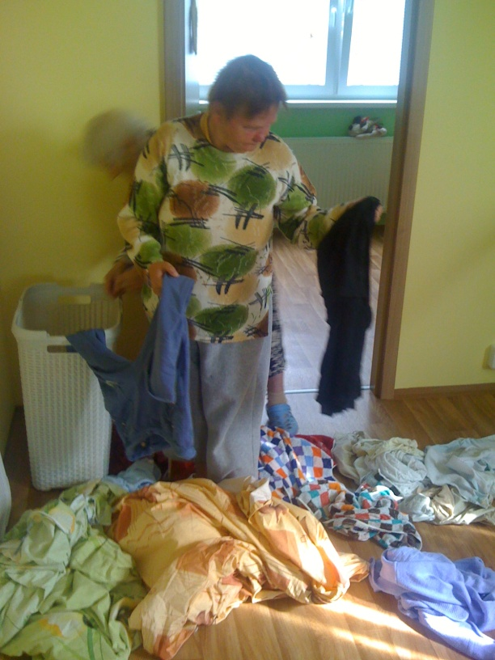
Fields of support
household keepping, cleaning, cooking, purchasing
health care
time planning, scheduling
travelling
money management
dealing with offices
use of local public services
risk management

Slide 9
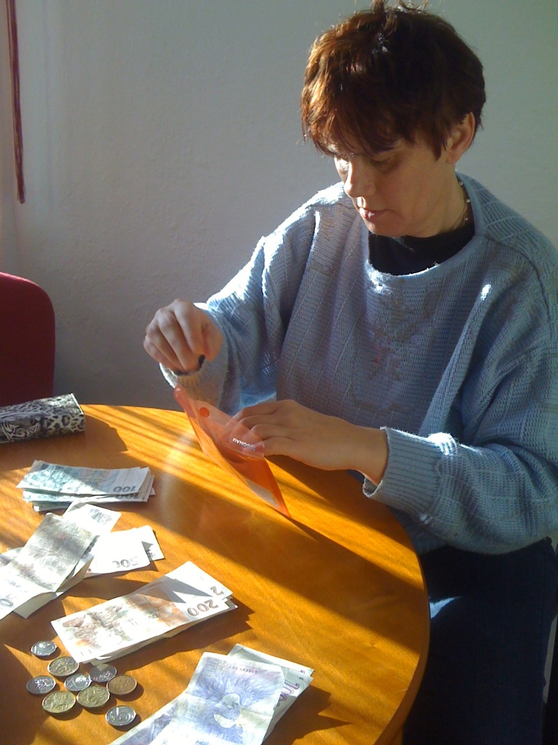
What do we have to know
to recognise what and what kind of support person needs from the servise
think about health and safety
what is important for the person and what must be respected all the time
to find the strenghts of the person and build the strategy on them

Slide 10
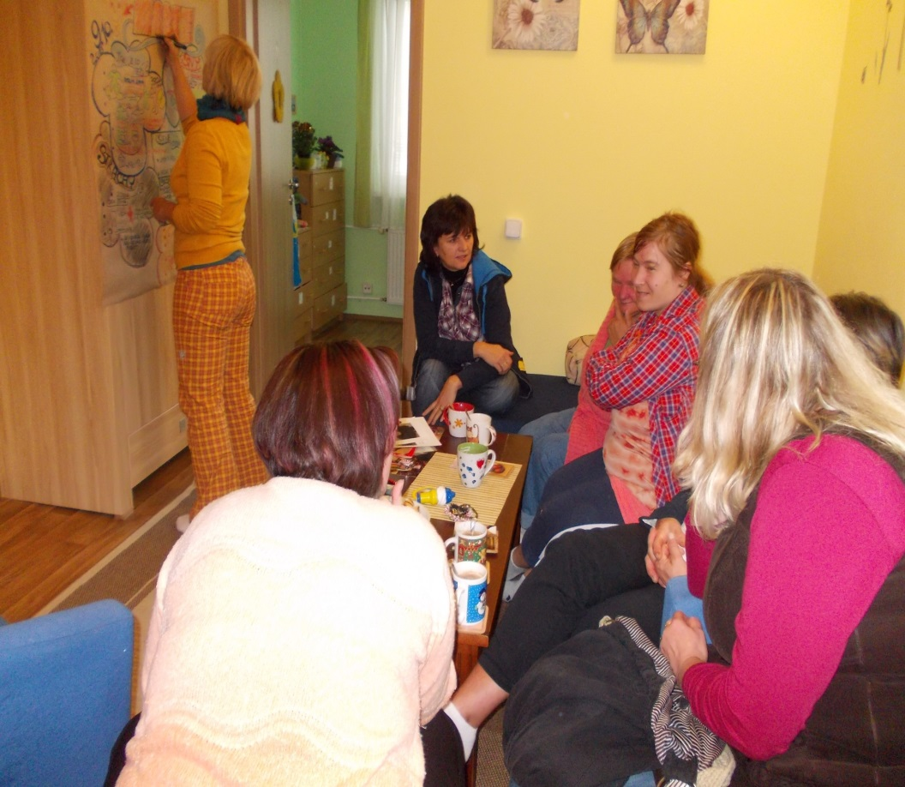
How do we work?
we use
Person centered approach
Helps us to recognise:
what kind of person he or she is
gifts and strenghts
dreams
what he/she likes
what is he/she used to
what is important for her/him
what he/she would
like to change
think about the future

Slide 11
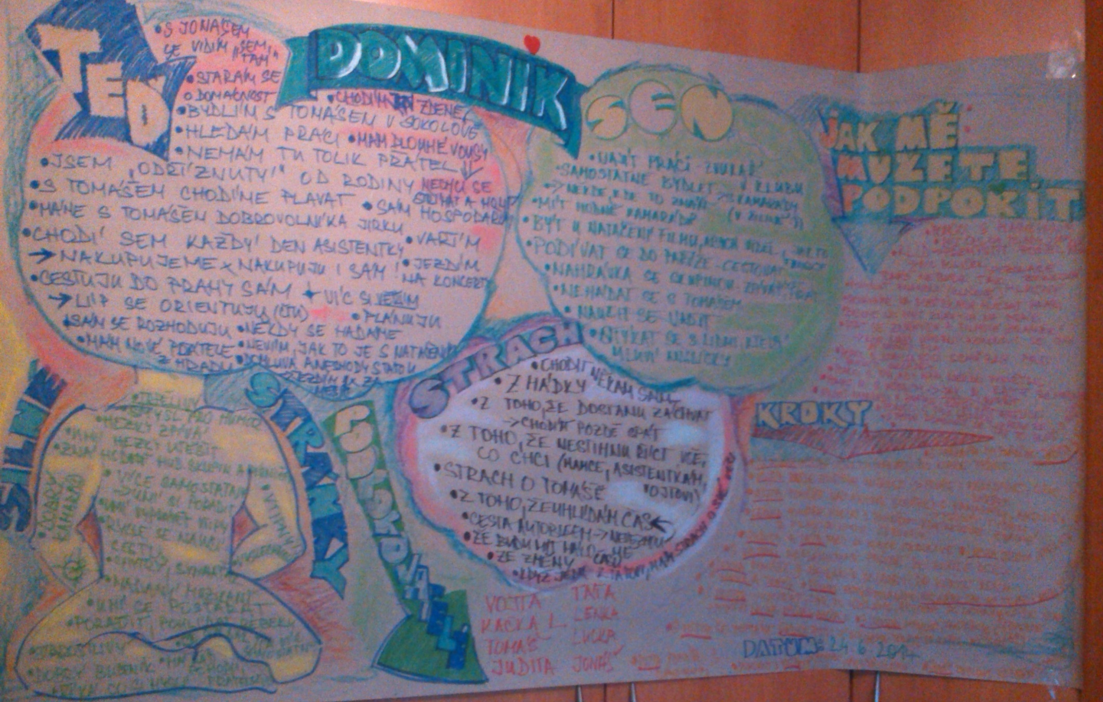

Slide 12
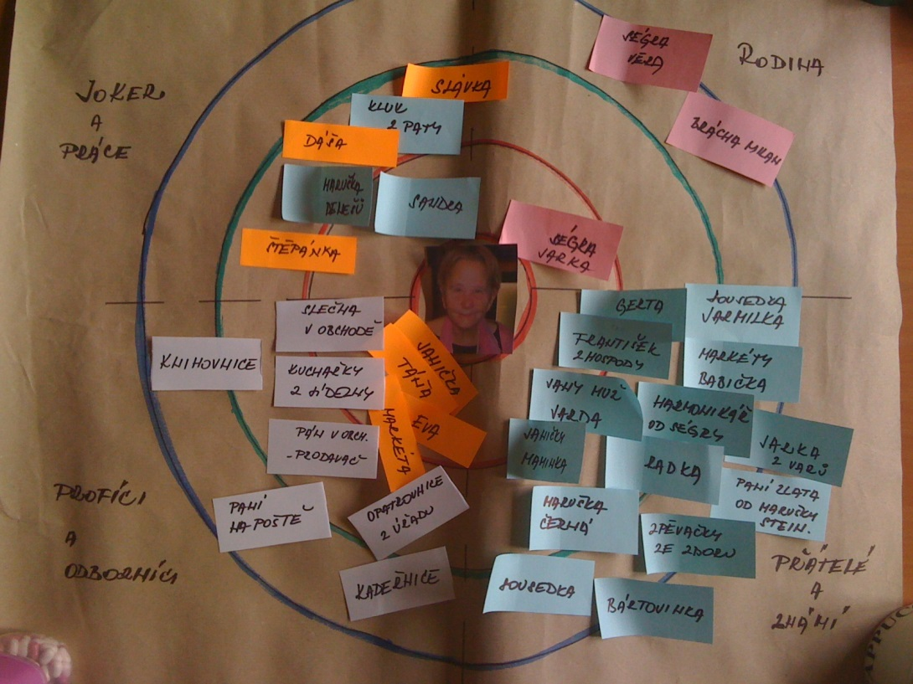
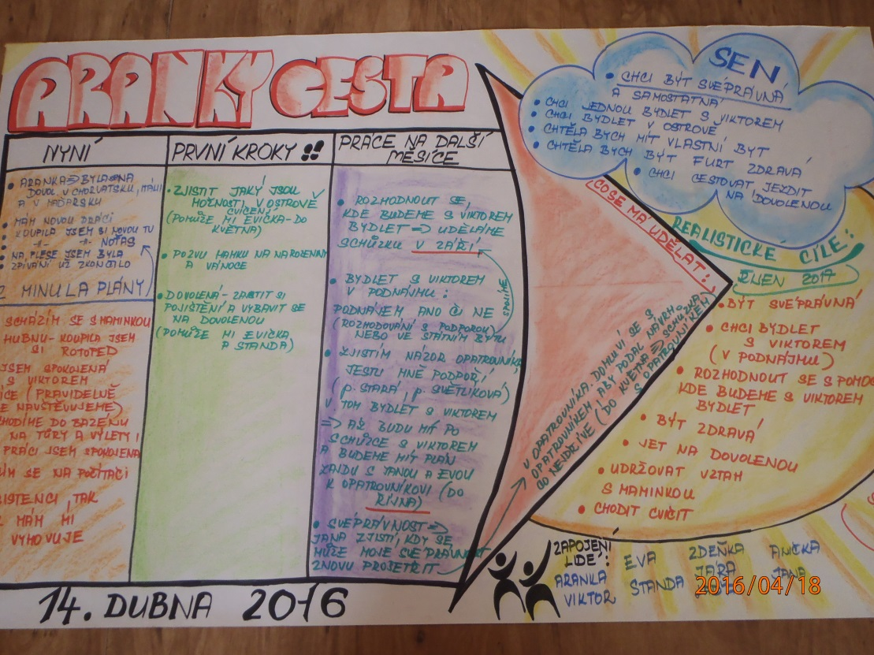

Slide 13
Cont.
we recognise the needs
– intensity for support (SIS)
we use individual approach
we find suitable staff
we cooperate with natural support
we are trying to find volunteers
we use the supported employment service
we are trying to reduce intensity of assistance gradually
we work with risk management
we trust people

Slide 14
Community work – part of the service
social inclusion
we created this position two years ago because it was always important but we had never time to do it
we focus on finding the role in the community for the person
by defining the gifts and strenghts of her/him
- and matching them with accesible places in the community

Slide 15
Useful role in the community
cooperation with other organizations (Trash heroes, Brontosaurus movement)
participation in neighborhood events
help our organization as a Advisor of Rytmus
(audit/ evaluation of the services, presentation of the services throught their stories)
the use of volunteers

