Slide 1
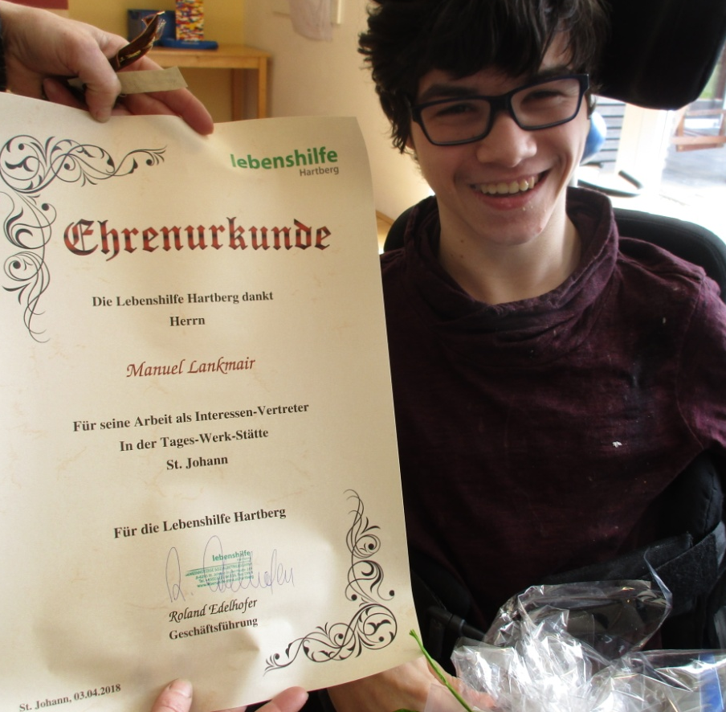
Manuel Lankmair
self advocate
from Austria

Slide 2
My Person
I am born on the 04.05.1997 in Graz.
I am a preterm baby.
I have crumped muscles and therefore it is very hard for me to move my arms and fingers.
I cannot move my legs at all.
For me it´s difficult to read - despite of the use of glasses.

Slide 3
I need help
using the wheelchair
using a toilet
dressing myself
with eating and drinking
with reading and writing
using a computer

Slide 4
I am good at
learning
remembering
standing up for my rights
always being in a good mood

Slide 5
For me is important
not having a legal guardian
to decide for myself
the total accessibility
being good supported
being good connected
being taken seriously
being busy

Slide 6
My career so far
Inclusive kindergarten
9 years regular school
since 2013 Lebenshilfe Hartberg
since 2015 self advocate

Slide 7
I stand up for
my rights
accessibility
self determination
taking part in political events
taking part in self advocate events
being able to take part here in Lithuania

Slide 8
My work is
organising
communication with peers
communication with responsible persons
connecting with other self advocates
learning and thinking about the world

Slide 9
I need
a lot of support
an easy to understand language
a lot of time and support to be well prepared
accessibility

Slide 10
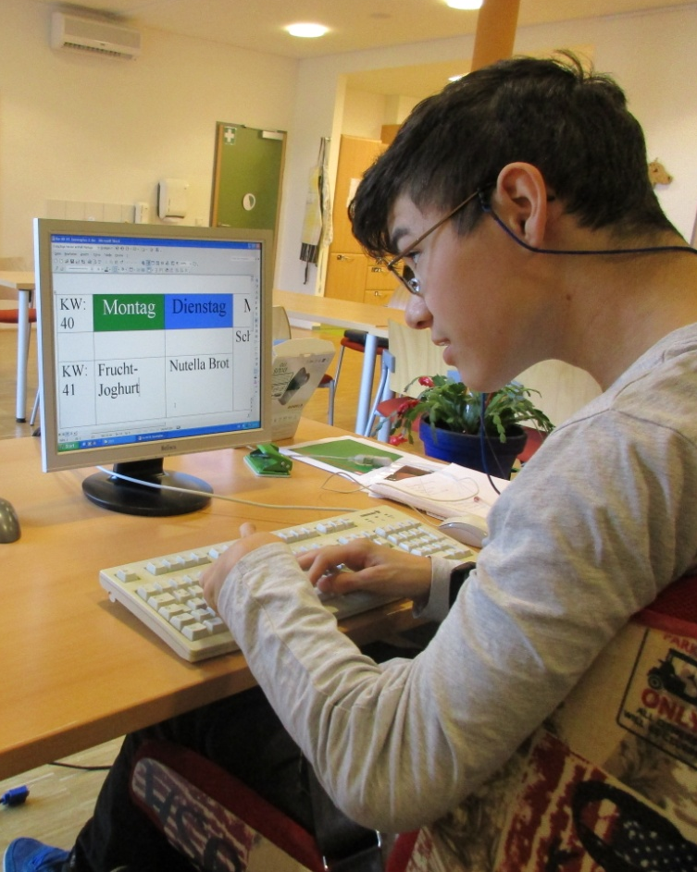
Me at work

Slide 11
I thank you for your attention
I am very happy to be allowed speaking here to you in Lithuania.
Thank you

