Slide 1
Circles of support Supporting people in making
decisions and living independently
Example of Poland
Europe in Action
Vilnius, 5 June 2019
Adam Zawisny, PSONI
adam.zawisny@psoni.org.pl

Slide 3
Workshop plan
Presentation of the Circles of Support (Canadian) model used in Poland
Questions and discussions
→ Sharing of experiences and knowledge from other countries
Presentation of TIM – a tool for AAC (Augmentative and Alternative Communication)

Slide 4
PSONI
Polish Association for Persons with Intellectual Disability
Created in 1963 and lead by parents of persons with intellectual disabilities
12 500 members
120 regional associations/circles of PSONI in Poland
Inclusion Europe member
415 agencies and other organised forms of support, including early intervention, education, rehabilitation, daily support, personal assistance, housing, self-advocacy, supported employment
Over 8000 persons working in PSONI
Support for about 30 000 persons on a daily basis

Slide 5
UN Convention on the rights of persons with Disabilities in Poland

Slide 6
Circle of support?

Slide 7
Circles of relations
1. Circle of Intimacy Relationships based on love and closeness. People without whom we cannot imagine life, the closest family, the closest friend, the children 2. Circle of Friendship Friends, allies. Who are you calling when you receive good news? Who do you regret when you get to your partner? Who do you laugh together with? 3. Circle of participation Sharing common interests and related activities, also neighbors. People from clubs, groups of interests, work, sports groups, artistic activities, trips to theater cinema, etc. 4. Exchange Circle Includes paid relationships. Personal assistant, social worker, doctor, dentist, salesperson, lawyer etc.

Slide 8
Situation of persons with intellectual disability in Poland
The need for support in everyday life Support is mostly provided to the family and institutions, the absence or limited circle of social contacts (ex. friends, neighbors, colleagues from work, circles of interest) When parents can no longer support you - when there is no plan for the future - a person with intellectual disabilities is most often transferred to institutions (lack of individual support, vast impact on quality of life)
> > Deterioration of quality of life, shock, sadness, isolation

Slide 9
Community support Model - Circles of support
Enabling a person with a disability to function properly in his/her existing community and improve the quality of life Broadening the group of people involved in the support of a person with disabilities in her community Give skills/education for a person with disabilities to function independently (as far as possible) Develop legal, housing, financial, health solutions Maintaining the quality of life of a person with disabilities after losing their closest relatives

Slide 10
Community support model Circles of support
The environmental Model of adult support with intellectual disability „Safe Future„/Circles of support is a comprehensive concept of support for these people in the local community, where these people and their families can live in dignity and have independent lives The aim is to develop solutions for (1) The legal-financial, residential and social security of a person with intellectual disabilities on a time when, for natural reasons, it already loses its reliance on the family, and (2) the preparation of community support enabling them to continue to function in their local community.

Slide 11
Circles of support
Circles are an environmental support system that comprises persons and agencies/authorities involved in the daily life of a person with disabilities and who have impact on the quality of her present and future life:
Family members and friends Neighbors, friends, local volunteers Doctors, nurses, rehabilitans Lawyers, Local Service Providers Social welfare centres and staff Religious groups Other families in a similar situation
Together they work to develop the skills and passion of a person with a disability, create opportunities for active participation in the local community, care for them and create a safeguard for the future independent functioning

Slide 12
Circles of support
Informal relations
Formal relations
Health services
Family
Person with a disability
Friends
Social services
Neighbors
Personal assistance and etc.
Legal arrangements
Financial arrangements
Housing
Health

Slide 13
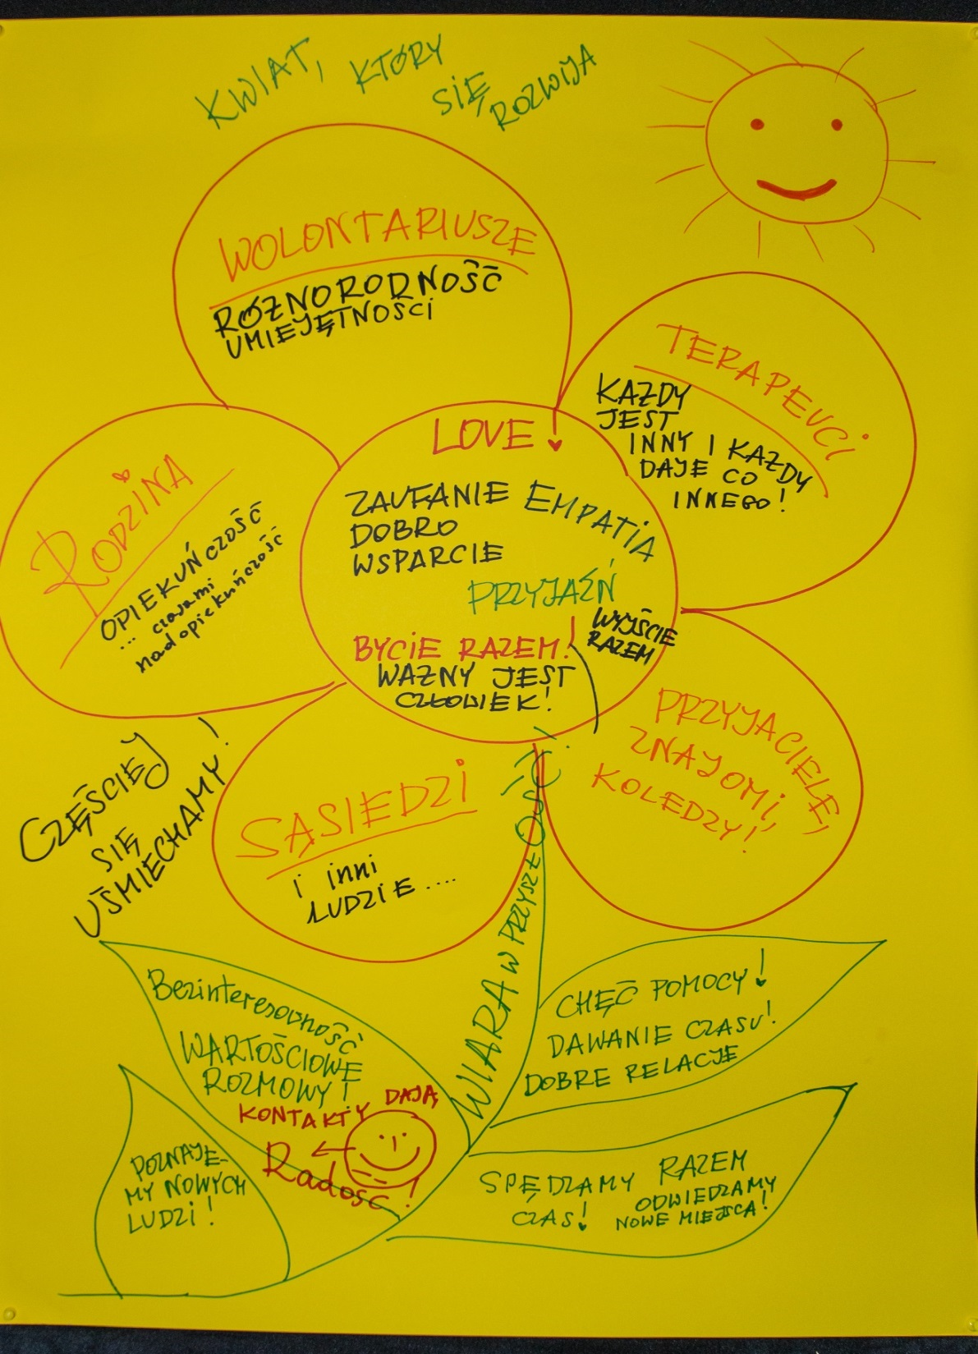
-The circle is based on positive emotions, resources, common interests -To create a circle you need a vision/belief that "the glass is half full" -Circles of support is not yet another project, it’s a process of social change

Slide 14
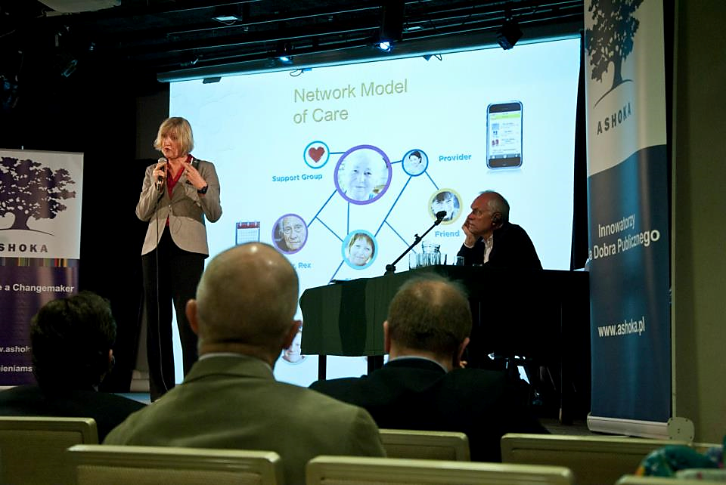
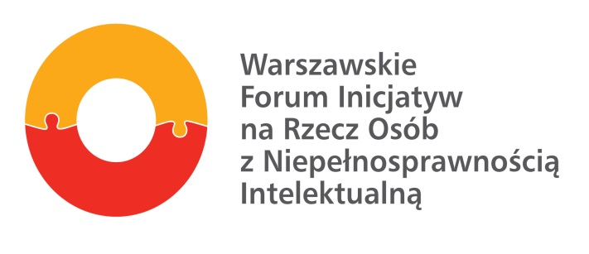
Start of Circles of support in Poland
2013 – Seminar "The future begins Today" in Warsaw Guests: Al Etmanski and Vickie Cammack, from Canada, the founders of the PLAN (Planned Lifetime Advocacy Network), presented a comprehensive system to safeguard the future of people with intellectual disabilities successfully implemented in Canada, Scotland, currently being implemented in Poland. Work on the Circles began in the Warsaw Forum of initiatives for the people with ID The Forum made a project with ESF funds It also launched a nationwide project in the framework of innovation in ESF

Slide 15
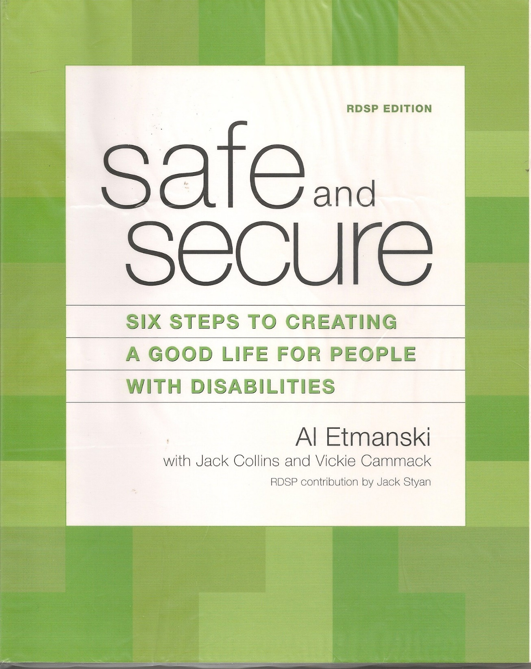
6 steps to creating a plan for the future: Concretization of your vision, cultivate friendship, housing, make the right decisions, achieve financial security, safeguard your plan Worksheets of exercises to help you create a plan and create circles

Slide 16
6 steps to creating a plan for the future: Concretization of your vision, cultivate friendship, housing, make the right decisions, achieve financial security, safeguard your plan Worksheets of exercises to help you create a plan and create circles
Experiences from Scotland and Warsaw

Slide 17
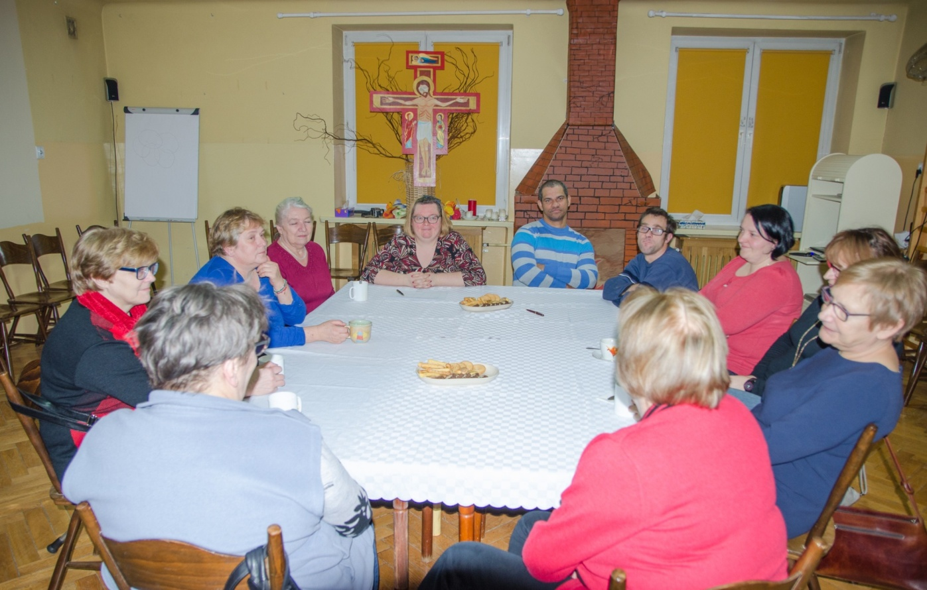
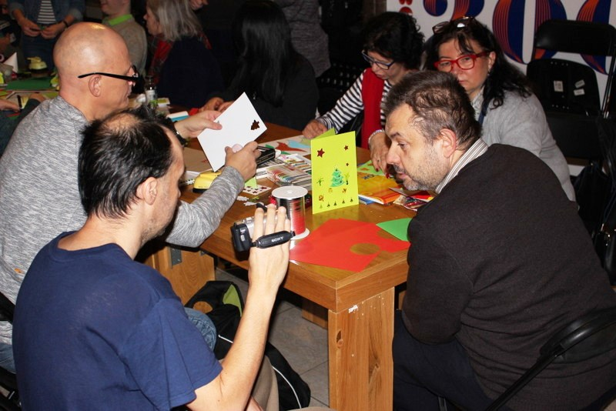
Integrative meetings Christmas meetings, cinema exits, museum... In line with the interests of the circle groups. Volunteers support the individual but also the group.
-Meetings and trainings for parents, siblings, volunteers, ex. the idea of circles, sexuality Training for parents with a lawyer on legal and financial security, Training for specialists to expand your work with new circles

Slide 18
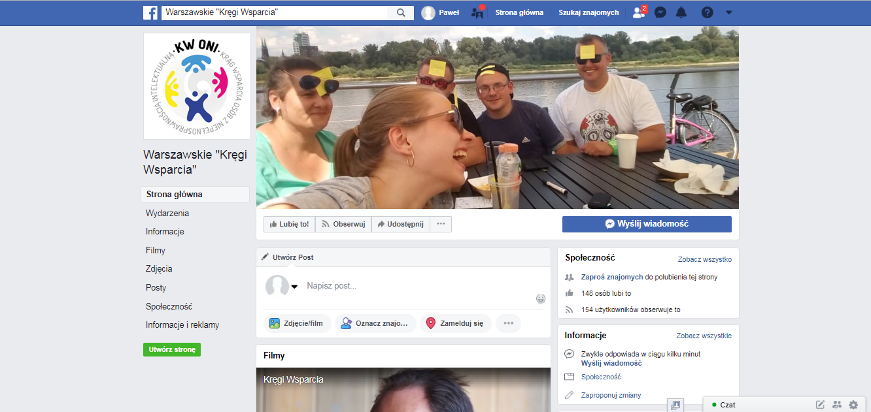

Slide 19
Circle of support for Christopher
The creation of the circle around Mr. Christopher was accelerated by the death of his mother Previously, during camps, Mr. Christopher and his mom befriended with a group of families (self-help movement). The participants of the circle-mainly parents of other people with disabilities affiliated with an Association - began to support Mr. Christopher in the course of a mother's disease After the death of the mother, the circle of support began to work more systematically and now participates in it 10 people who shared the tasks and established the way of communication The circle prepared a broadened portrait of Mr. Christopher, which takes into account his strengths, abilities, passions but also weaknesses and fears Thanks to this, Mr. Christopher became a very socially active person, who slowly develops the skills of independent life despite the accompanying concerns and problems in this area

Slide 20
Circle of support in the case of Mr Christopher
Fixed housing situation (municipal housing) Social help center – good contact with social worker and specialised services at home (help with shopping, cleaning, cooking) Help with renovation of the bathroom Lawyer – with a friendly NGO, help in organizing documents, health briefcase, pension briefcase Bank, Finance – preparing a cashier at a nearby bank (circle element, friendly place) The religious community where Mr. Christopher walked with his mother. Environment support, inviting for joint meetings Saleswoman in the shop, help in making purchases (friendly place) Neighbor – help with turning on the washing machine Housing Training – 2 stays Rehabilitation camps – now Mr. Christopher goes as a volunteer

Slide 21
Circle of support for Karol
The circle was made by Karol, a 53-year-old man with intellectual disabilities and his father of Lucjan, now a 80-year-old who tries to take care of his son best. Karol needs high support in everyday functioning Currently, there are five people in the Charles ' support circle With each of these people, Karol has a constant contact The participants of the circle involve Charles in the events in their environment (e.g. painting activities, visiting the 3D aquarium, joint visits to cafes, cinema). The participants of the circle began planning the future of Charles in the event of death of the father

Slide 22
Problems and how to cope with them
Non-preparation, anxiety on the part of families. Fears, distrust-how to face the future? How to start thinking about it? Can I allow "strangers" to my child? Can my child be supported adequately in the „external” social world? Cooperation with family is a process most often extremely emotional, long-term. The need to accompany the family in a new situation (not imposing). Small steps in creating new solutions. Supporting the autonomy of a person (e.g. a training apartment). Mutual support of families.

Slide 23
Persons for circles, friendly places
The acquisition of volunteers, supporters is a long-lasting process requiring systematic work. It takes 1-2 years for a well-functioning support circle to be created. Need for continuous monitoring. The search for people in the circle requires overcoming social stereotypes and the need to prepare volunteers for cooperation. Permanent search for "friendly places".

Slide 24
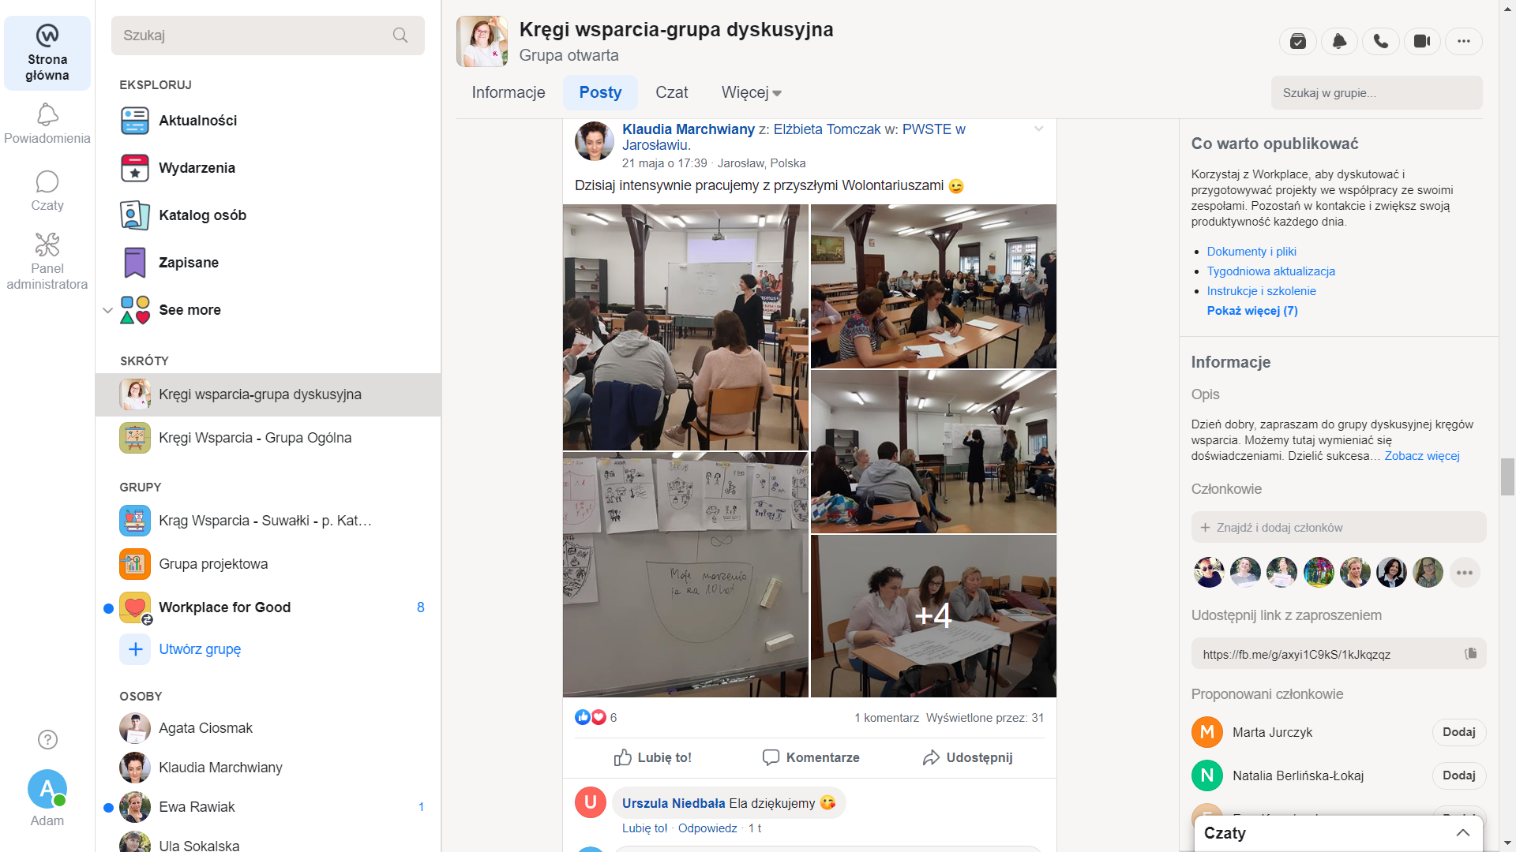
Instrument for NGO for communication for Circles
Facebook Workplace

Slide 25
Circles of support – country-wide Pilot
3 Elements of action to introduce and support the change: 1. Working with people with disabilities and their families (12 circles in 8 places, over 100 persons) 2. Organising of the local community (Coalition) 3. Education and support for the change process (central and local)

Slide 26
Key conditions for the creation of operating circles and development of Community support in Poland
Prepared organisation/institution (Section on community work) The specialists circles and work with families
Willing person with ID (also to make a portrait to help create a circle) Willing families-Plan for a decent life (specialized assistance) Recruiting and preparing people for circles (family, friends, volunteers, specialists, other families.......) Monitor work Working with families Building a local partnership around people with ID and families Working with the community on different places of activity for people with ID (friendly places) Family self-help movement Favour and commitment of local governments

Slide 27
Questions?

Slide 28
Questions for discussions

Slide 29
Do Circles of support work in your country?
How do they work?

Slide 30
Would Circles of support be helpful in your life/work/community?

Slide 31
Would Circles of support be helpful in your country?

Slide 32
How to achieve financial security (as a/for a person with ID)?

Slide 33
How to achieve social inclusion?

Slide 34
How to start work on a Circle of support?

Slide 35
Thank you for your attention!
Adam Zawisny
adam.zawisny@psoni.org.pl
PSONI
Polish Association for Persons with Intellectual Disability

Slide 36
Circles of support Supporting people in making
decisions and living independently
Poland
Europe in Action
Vilnius, 5 June 2019
Adam Zawisny, PSONI

