Slide 1
Moving from an institution
into the community
5 June 2019
Anne Marie Duffy and Kathleen McTigue
IRELAND

Slide 2
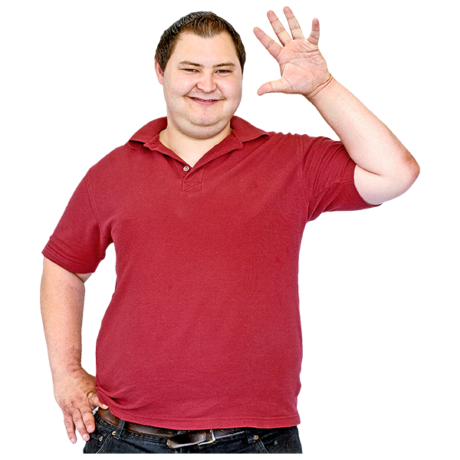
Say hi to someone you do not know
Move a little or
have a dance with someone new
‘Get up, stand up, stand up for your rights’

Slide 3
Our story
ANNE MARIE
KATHLEEN

Slide 4
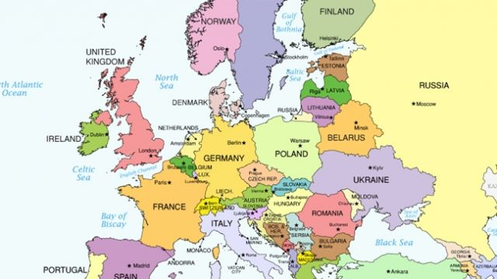
We are from Ireland

Slide 5
Training to move to the community
We lived in an institution and moved out in 1995.
Before moving we got training
We learned about money, where the shops are, the post office etc.

Slide 6
We have freedom now
We live in our own house now
with 3 other women

Slide 7
We have freedom to do things
Cook our own food
Do our own shopping
Go to bed when we want or stay up and watch TV
We have privacy – people must knock first

Slide 8
Neighbours
We have good
neighbours who look
after our cat when
we are away

Slide 9
WORK
One Day a week at Dustbusters
Craft work at the day service

Slide 10
We are volunteers
The second-hand where we do
voluntary work

Slide 11
We went to college
We did a course about about
Our rights
Making decisions
Managing money
Relationships and sexuality
Working with other students
Going to the library
St. Angela’s College,
National University of Ireland, Galway

Slide 12
Groups we go to in the community
We go to an Active Retirement Group that is for everybody
We like meeting other people in the community
We knit squares for blankets for the hospice

Slide 13
Advocacy Group
We go to our advocacy group called Shared Voices
We learn about speaking up
We learn about our rights
We are doing our wills

Slide 14
Working Group in Dublin
We were on a Working Group for about 3 years
There were people from different organisations.
There were people from the Government on this Group

Slide 15
Working Group
We talked about barriers for people with disabilities
People make decisions for us
We don’t have all the information and it is not easy to read
Meetings are not easy for us

Slide 16
We wrote a Plan
We wrote a Plan to make it easier for people with disabilities to take part in decisions
This Plan is about making sure our voices are heard and we are listened to

Slide 17
The Plan says
The Plan says that we need the right supports to
Be included in decisions that are about our lives
Take part in meetings

Slide 18
Local Elections 2019
We met candidates
We told them we want:
Easy to read information
Work in the Council
More accessible buses
Better footpaths

Slide 19
Monitoring Group
We are on this group because we have moved out
We know what it’s like to try and live independently

Slide 20
Monitoring group
This group is about making sure that people who move out of institutions
have better lives
have a say about moving to a new home

Slide 21
Monitoring Group
The Group is about making sure people
have support to speak up
have support to do things that they like
Have support so they can be happy in their new home and community

Slide 22
Asking questions about living in the community
In this Group we are working on a survey -
We are asking people living in the community how they feel about their home and living independently

Slide 23
Labai ačiū - THANK YOU!
We are still learning ...
Thank you for listening to us

Slide 24
What did you like about our talk?
Was there 1 thing you liked about our talk?
Any question you would like to ask?

Slide 25
What is your experience ?
Your experience of living in the community or in an institution?
What is good?
Is there anything you would like to change?
What things would help you?

Slide 26
Feedback
Anyone like to share
their thoughts
1-2 things you would like to change?

Slide 27
Labai ačiū
THANK YOU

