Slide 1
UN Convention on the Rights of Persons with Disabilities and Social Assistance for Persons with Intellectual Disabilities
Dovilė Juodkaitė
Inclusion Europe conference, Vilnius
6 June, 2019

Slide 2
Equality before the law (Art. 12 of the Convention)
One of the major paradigm shifts and new standard for full pledge realisation of equality and realisation of all the rights of persons with disabilities.
Main idea
Legal capacity and mental capacity are separate institutes
A new formula for legal capacity is based on will and preferences for individual decision making and support provided if needed
Supported decision making instead of substituted decision making

Slide 3
4 important bits
everyone has legal capacity in all areas of life
Everyone can realize legal capacity without restrictions based on mental capacity
obligation to provide supports (where needed) to help someone exercise legal capacity
Protection against exploitation, violence and abuse
Notes:
Article 12 to the UN Convention is based on two propositions. First, that everyone has legal capacity in all areas of life. This is not linked to type or severity of disability.

Slide 4
Legal reform on legal capacity in Lithuania
Legal reform on legal capacity in Lithuania, changing provisions on legal capacity in Civil Code and Code of civil procedure to comply with CRPD requirements.
Adopted on 26 March, 2015. In force since January 1, 2016.
The biggest legal reform of Civil code (since 2000, and even before).
Still, the law provides the possibility of restriction or denial of legal capacity for persons due to their psychosocial disability.

Slide 5
Key principles of the legal capacity reform
person's capacity must be restricted to minimum,
measures restricting person's capacity, when they need to be applied, must be individualised, adjusted for the situation of every person and reasonable in all aspects.
all doubts must be considered in favour of the person, who is requested to be declared incapable in certain field.
person's capacity restriction as the last resort
the goal should be preservation of person's full capacity, creating conditions for a person to receive necessary assistance in order to exercise his/her rights.

Slide 6
New legal institutes introduced
Assistance in decision-making agreements
to be sign by the persons in need of support in decision making, including, but not limiting to mental disabilities;
subject to notary's certification;
registration in the Register.
Advanced directives
define how matters should be dealt regarding implementation of person’s property and non-property rights in case his/her capacity would be restricted or he/she would be declared incapable in the future;
subject to notary's certification;
registration in the Register;
come into effect by a court decision, declaring the person incapable or restricting his/her capacity and become binding for all persons and institutions

Slide 7
Amended legal institutes
Restricted capacity in certain areas
when full understanding of the meaning of their action and to control them, which is caused by the psychic disorder ;
Court indicate the final list of fields, in which the person is declared having restricted capacity, in its decision;
Curator is introduced to act together with the person
Incapacity in certain areas
is expected to be applied in exceptional cases only;
the court draw the final list of fields in which the person is recognised incapable;
Guardian act on behalf of the person in the fields, where the person is declared incapable;
Legal representation is mandatory in the court proceedings;
Commission for Reviewing Incapable Persons' Condition
review the condition of an incapable person and decide on the need to apply to court for the revision of the court decision declaring the person in question incapable in a certain field
every year, if there is no application in the court for cancellation of the court decision declaring the person incapable in a certain field.

Slide 8
Gaps and challenges of the reform
Still remaining total guardianship as substituted decision making model, limiting person’s rights in particular areas of life (possibility for restricting legal capacity in specific areas of life (sometimes even in all areas of life);
No proper preparation for the reform:
short time (delayed trainings)
Not enough trainings for the judges, social workers, medical professionals;
Medical, functional assessment versus human rights based approach;
no information and awareness raising about alternatives as support in decision making
Assessment of person’s capacities to decide only for the purpose of legal procedures in court, rather then for practical support provision

Slide 9
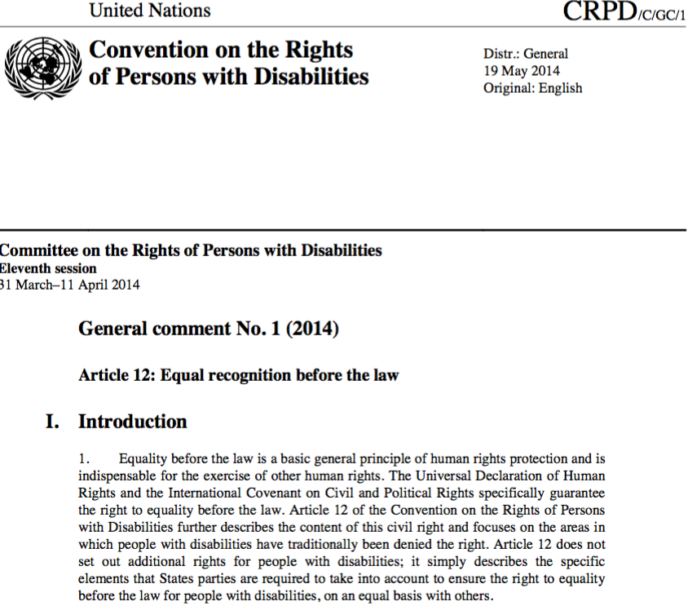

Slide 10
Conclusions
Lithuanian review by the UN Committee:
The Committee is deeply concerned at the legal provisions permitting the denial or restriction of the legal capacity of persons with disabilities and thereby limiting their right to free and informed consent for treatment, right to marry, found a family, adopt and raise children.
And recommends to repeal laws, policies and practices permitting guardianship and trusteeship for adults with disabilities and replace regimes of substituted decision-making by supported decision making.
Despite the fact that it was the biggest reform of Civil code, it failed to comply and meet CRPD art. 12 requirements.

Slide 11
Linkage of legal capacity to other rights
Legal capacity is a crosscutting right which is closely linked to other rights embodied in CRPD: to give and withdraw informed consent for medical treatment, to access justice, to vote, to marry, to work, and to choose a place of residence.
With respect to the personal rights, such as the right to vote, it is inscribed even in the Constitution of the Lithuania, that persons being declared as incapable cannot vote.
Civil Code indicate that persons being declared as incapable cannot marry, cannot raise children or become foster parents.

Slide 12
Data on legal incapacity in Lithuania
Data on legally incapable persons are in the Registry
Data is not publicly available, but notaries, courts, police and other authorities do have access to the Registry
Data is used by CEC when preparing the list of voters

Slide 13
Data: persons declared as legally incapable
Number of incapacitated people whose capacity is restricted in all areas or in areas specifically related to voting |  | Number of incapacitated people who are not restricted in the voting rights
 | Men | Women | Total |  |  | Men | Women | Total
VISO: | 1917 | 1998 | 3915 |  | VISO: | 2481 | 2528 | 5009
In total of 8924 incapacitated persons, there are 4526 women (50,7 %).
There is no critical difference between men and women with disabilities who are incapacitated.

Slide 14
Results of the reform
Restoring of voting rights:
During the 2016 elections 6 139 persons were eliminated from the list of voters.
According to the data of 2019 in total there are 8 924 persons registered in the Registry
But only 3915 were eliminated from the list of voters. Thus for 2224 the right to vote was restored.
Reviewing legal incapacity cases and restoring at least some of the rights to persons with intellectual and psychosocial disabilities
Despite legal institute (support agreement, advanced directives) plans for developing model of support for the decision making services

