Slide 1
Reform of the legal capacity law in Austria
Albert Brandstätter
Andreas Zehetner
Europe in Action 2019, Vilnius
6 June 2019
www.lebenshilfe.at

Slide 2
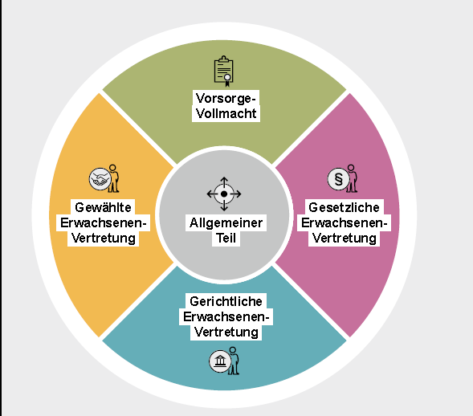
The New Adult Protection Law

Slide 3
Principles
New approach: Nothing about us without us!
New law is centred on
autonomy
self-determination and
decision-making guidance

Slide 4
History
1811 ABGB (General Civic Law)
1916 Entmündigungsordnung (Loss of Legal Capacity)
1984 Sachwalterrecht (Guardianship Law)
2006 SWRÄG (reformed law)
2008 UNCRPD – Art. 12
2018 Erwachsenenschutzgesetz – Second Adult protection Law in order since 1. Juli 2018

Slide 5
Background
Old adult guardianship system was proven but outdated; success & problems
Original intention: last resort - but this was not always the case!
Huge increase: 2003 30.000 adults
2016 55.000 adults
Not enough suitable guardians
Unfamiliar / unattractive alternatives
Implementation of UNCRPD

Slide 6
Inclusive legislative process
More than 2 years
Individuals concerned involved
Courts, lawyers and notaries, DPOs, senior citizens‘ representatives, guardians‘ associations, Ombudsman Board, employer & employees‘ associations,…
Professionally trained moderation
Scientific study

Slide 7
Key Principles of the new law
Transparency & wider range of models to choose from: solutions tailored to individual needs: 4 pillars
Representation: only to the extent necessary and as long as necessary limited term

Slide 8
Self-determination
From: Federal Ministry of Constitutional Affairs, Reforms, Deregulation and Justice, The New Adult Protection Law, 2018

Slide 9
Limited power of the courts
Clearing – process: always necessary and important
For the first 3 pillars: courts will only be involved on particularly sensitive decisions
- permanent change of residence,
- disagreements between person and representative on medical treatments, - asset management issues

Slide 10
Focus on the individual, not on the impairment - Social Model
Person‘s ability to handle his/her own affairs
Assessed by the means of a clearing- process
Responsible: adult protection associations

Slide 11
The New Adult Protection Law
4 pillars:
Enduring power of attorney
Elective representation
Statutory representation
Court appointed representation

Slide 12
Source: Federal Ministry of Constitutional Affairs, Reforms, Deregulation and Justice, The New Adult Protection Law, 2018

Slide 13
Source: Federal Ministry of Constitutional Affairs, Reforms, Deregulation and Justice, The New Adult Protection Law, 2018

Slide 15
Completely new element:
Requires entry in „Österreichisches Zentrales Vertretungsregister (ÖZVV)“
- Austrian central representation registry

Slide 17
Increase of representation
Loss of autonomy

Slide 18
Enduring power of attorny
Full ability to decide
elective representation
diminished ability to decide
Statutory representation
Ability to formulate wishes and right of objection
Court-appointed representation
„wishes“ and enduring power of attorney

Slide 19
Further aspects
Requirement for approval (court)
Strengthen autonomy of adults - only person herself can decide:
healthcare directive
enduring power of attorney
Getting married
Adopting a child
Legal professionals: max. 15 clients OR in list of specifically qualified lawyers & notaries
Supported banking
Transition period until 1.1. 2023

Slide 20
Critical points
Public financing (federal system)
courts
clearing processes
circles of support
Role of adult representations‘ association:
Clearing process + adult representation (advice & representation??)
Not complete supported decision making!
Circles of support not really mentioned (only in medical treatments)

Slide 21
Great success!
Inclusive legislative process: great step towards implementation of art. 12
Positive and pro-active role of Ministry of Justice
Full inclusion of self-advocates, senior citizens, family members, DPOs
Materials in Easy2Read

Slide 22
Further information:
Information Brochures:
https://www.justiz.gv.at/web2013/home/justiz/erwachsenenschutz/informationsbroschueren~41.de.html
Consensus Papers:
https://www.justiz.gv.at/web2013/home/justiz/erwachsenenschutz/konsenspapiere-mit-institutionen~43.de.html
Law:
https://www.justiz.gv.at/web2013/home/justiz/erwachsenenschutz/gesetzestexte~45.de.html

Slide 23
www.lebenshilfe.at

