Slide 1
Experiences and good practises in Inclusion Finland KVTL
Online support for parents of youngsters
Empowering parents with intellectual disabilities
Supporting adults' indenpendent living

Slide 2
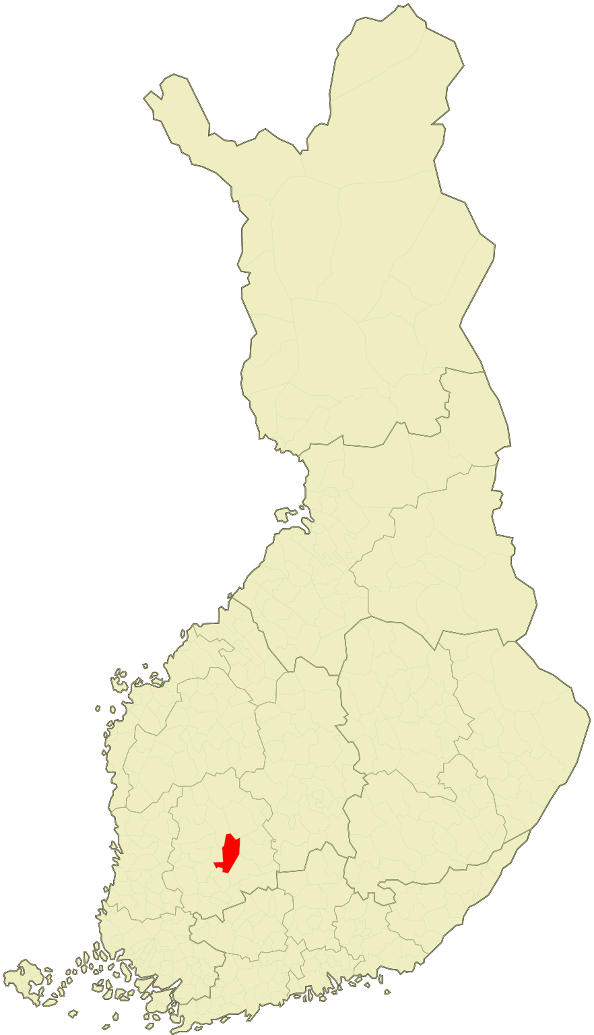
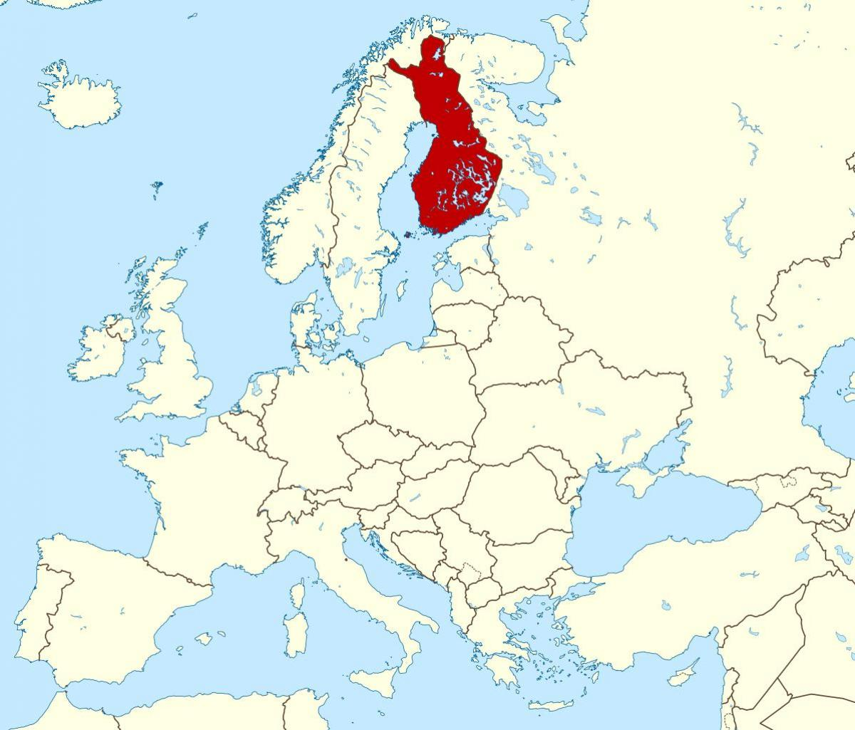
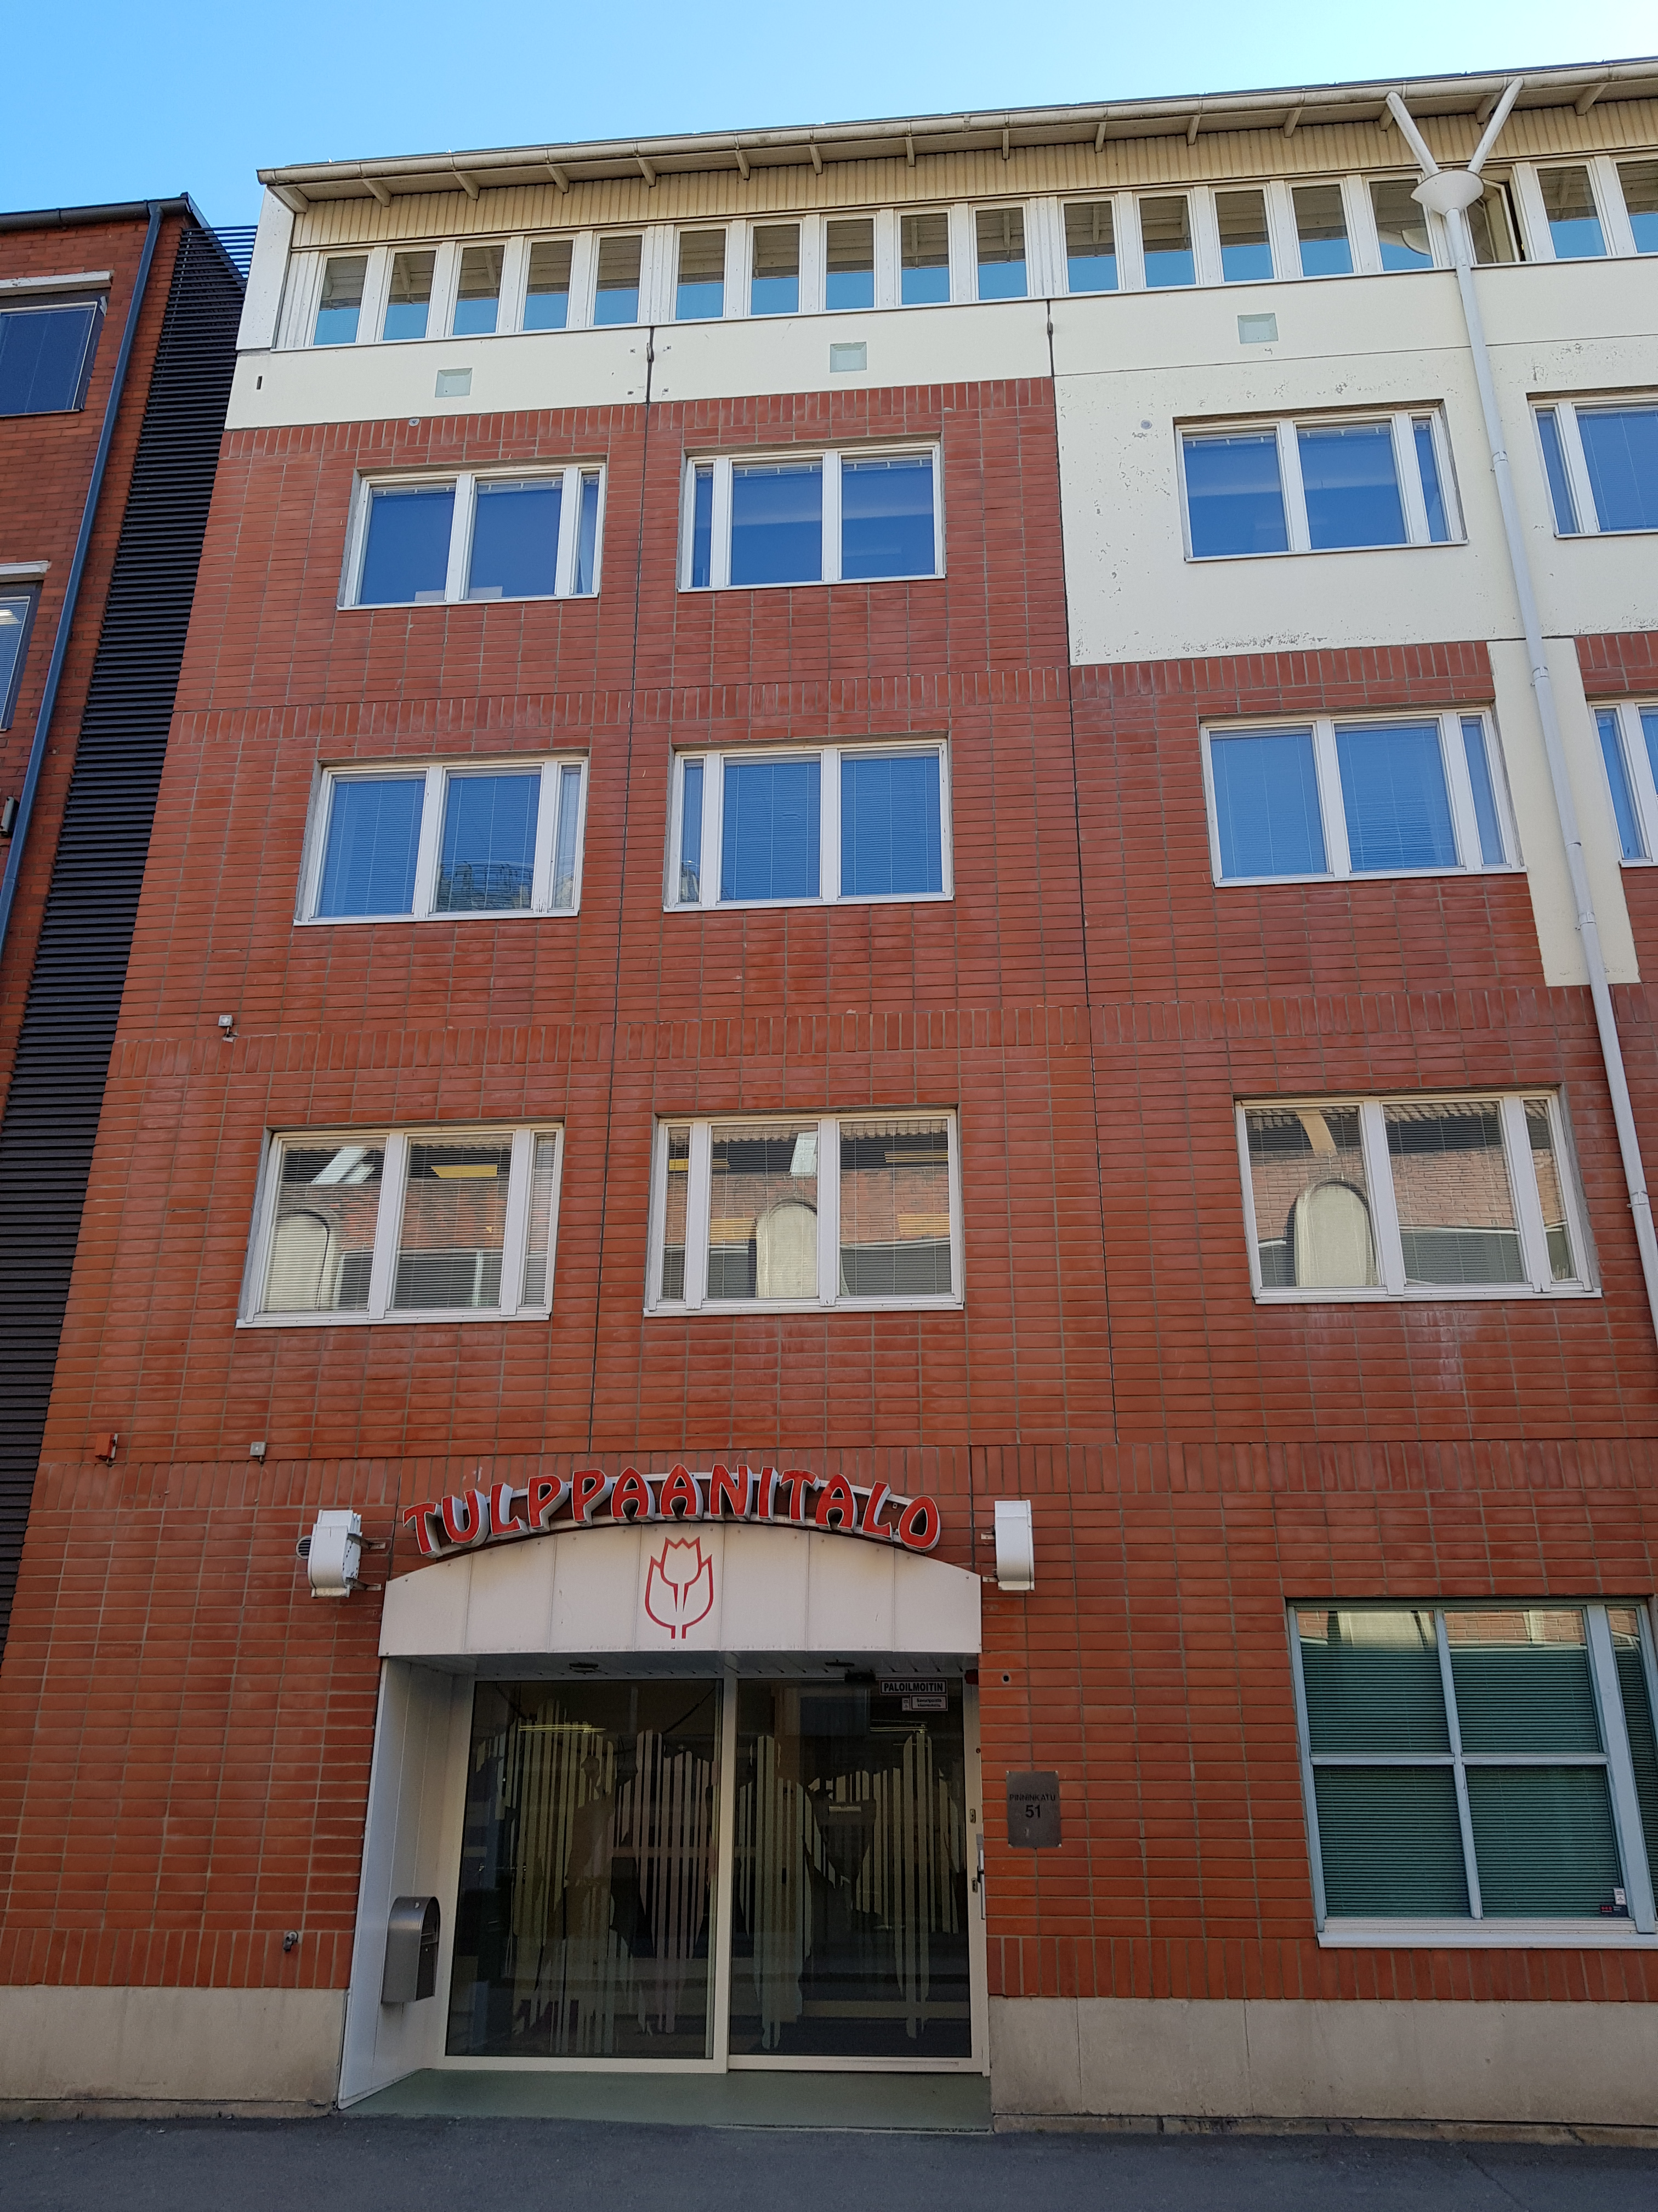
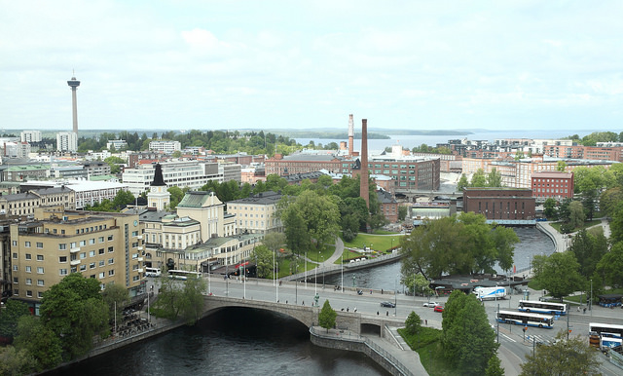
Where we come from?
Tampere, Finland
Finland has 5,5 million inhabitants
Inclusion Finland KVTL Pinninkatu 51 Tampere Finland

Slide 3
Inclusion Finland KVTL
We support persons with intellectual disability, and their families. We defend their rights and social equality. All our work leans on the UNCRPD.
I

Slide 4
Our funding
The Funding Centre for Social Welfare and Health Organisations (STEA) manages the funding granted for projects which are non-profit by nature and promote health and wellbeing, from the gaming revenue of Veikkaus Oy.
Veikkaus Oy is owned by the government. Many NGO:s get funding from STEA.
Inclusion Finland KVTL is mostly funded by STEA.

Slide 5
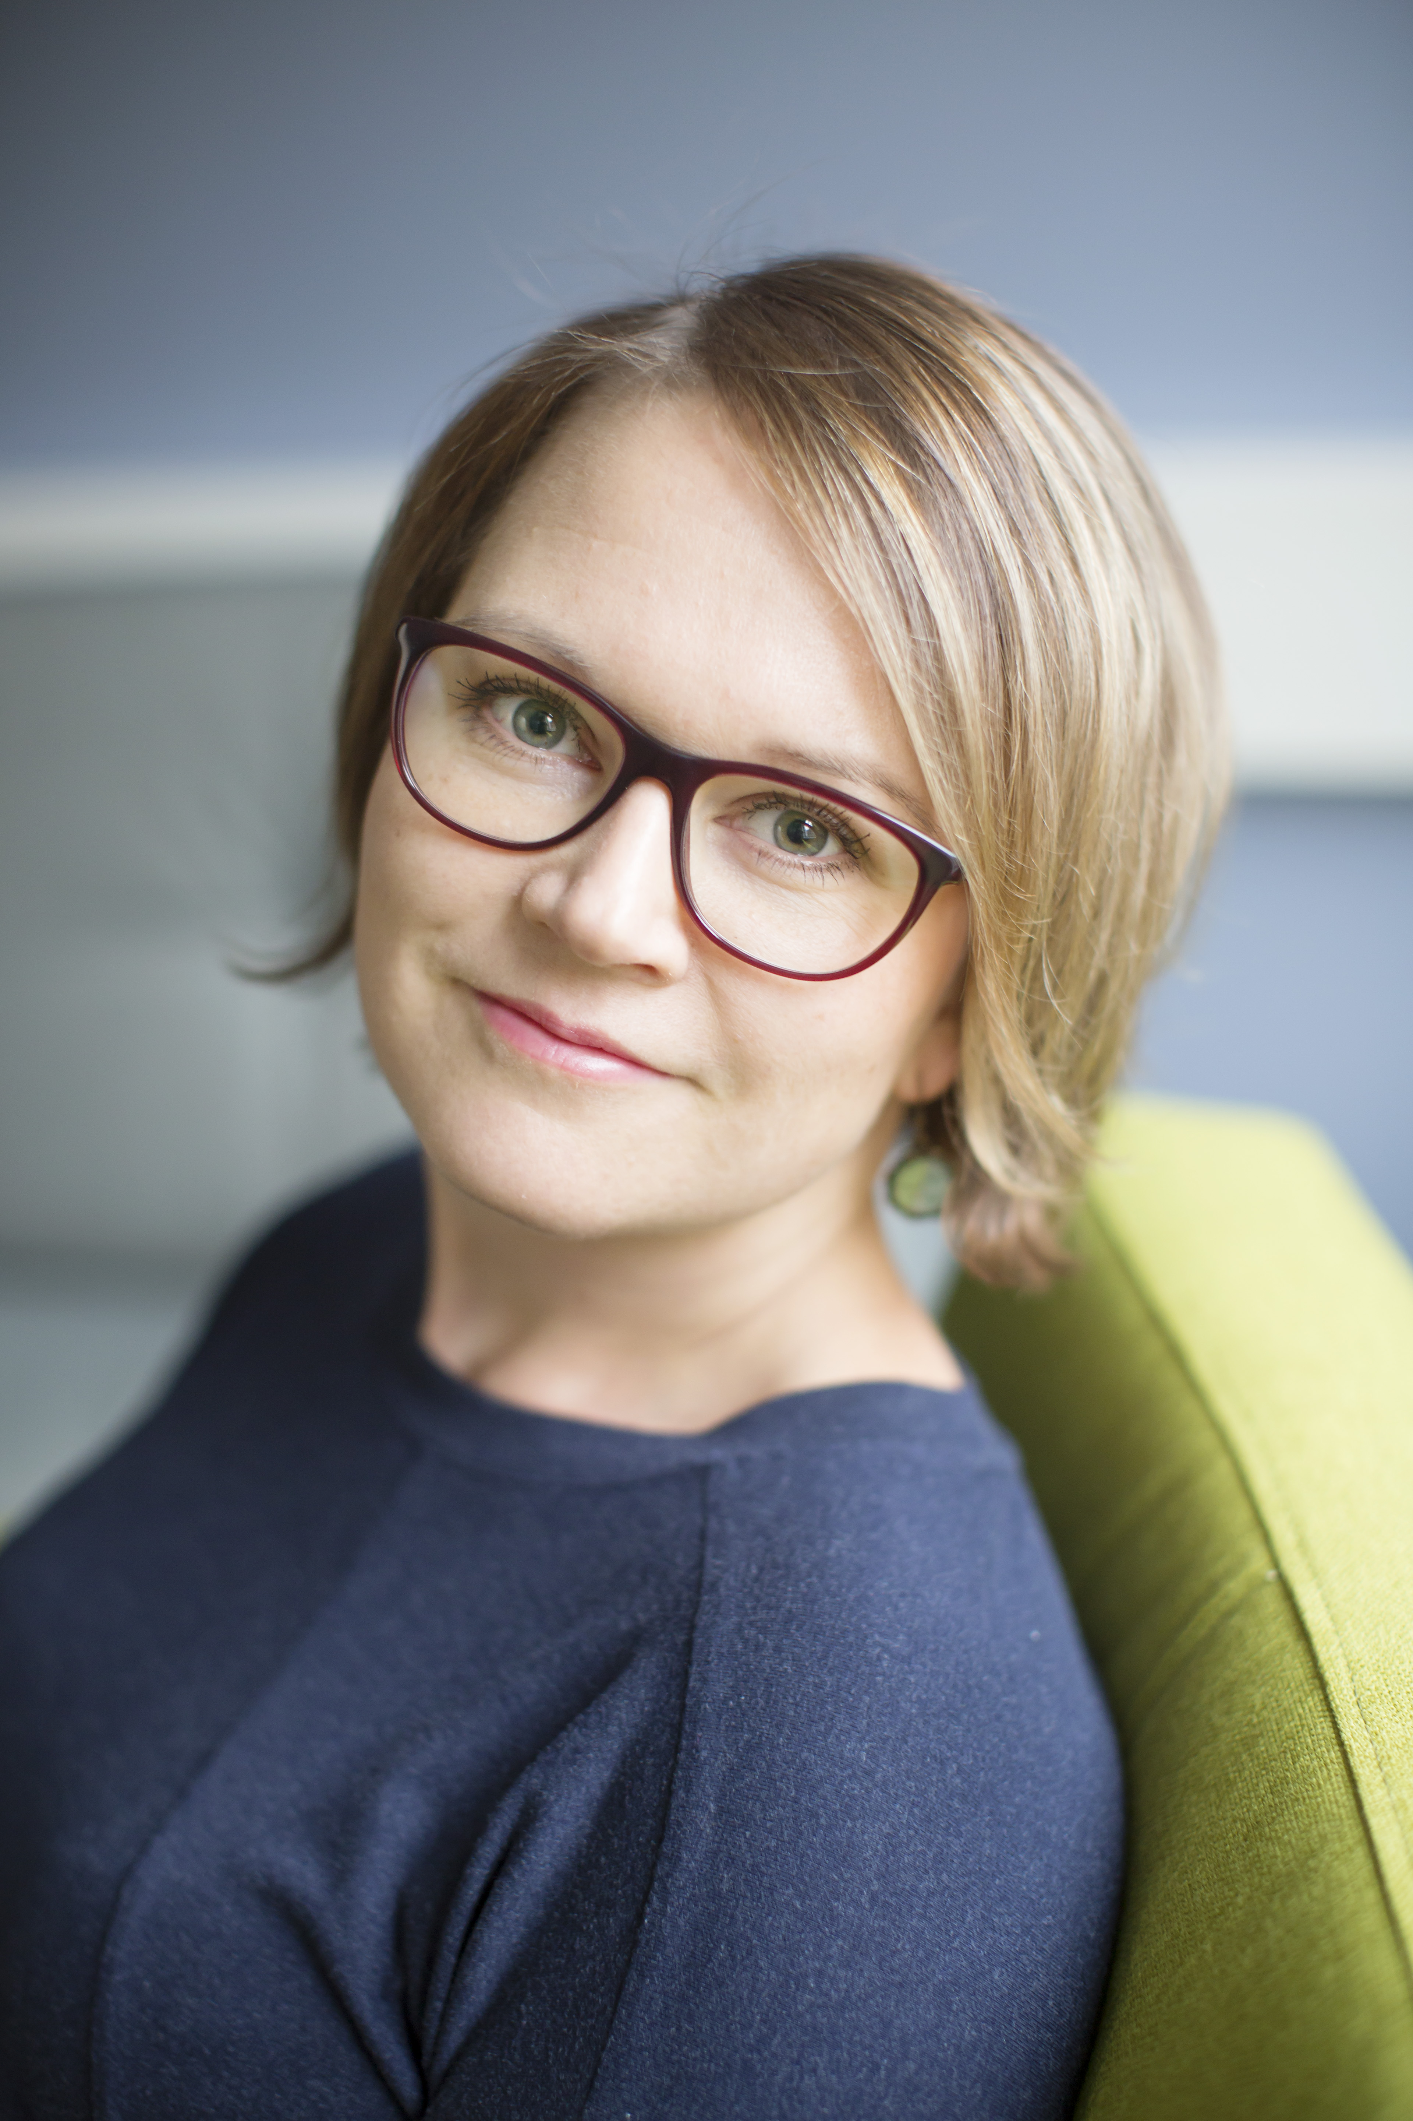
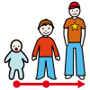
Riikka Manninen
riikka.manninen@tukiliitto.fi

Slide 6
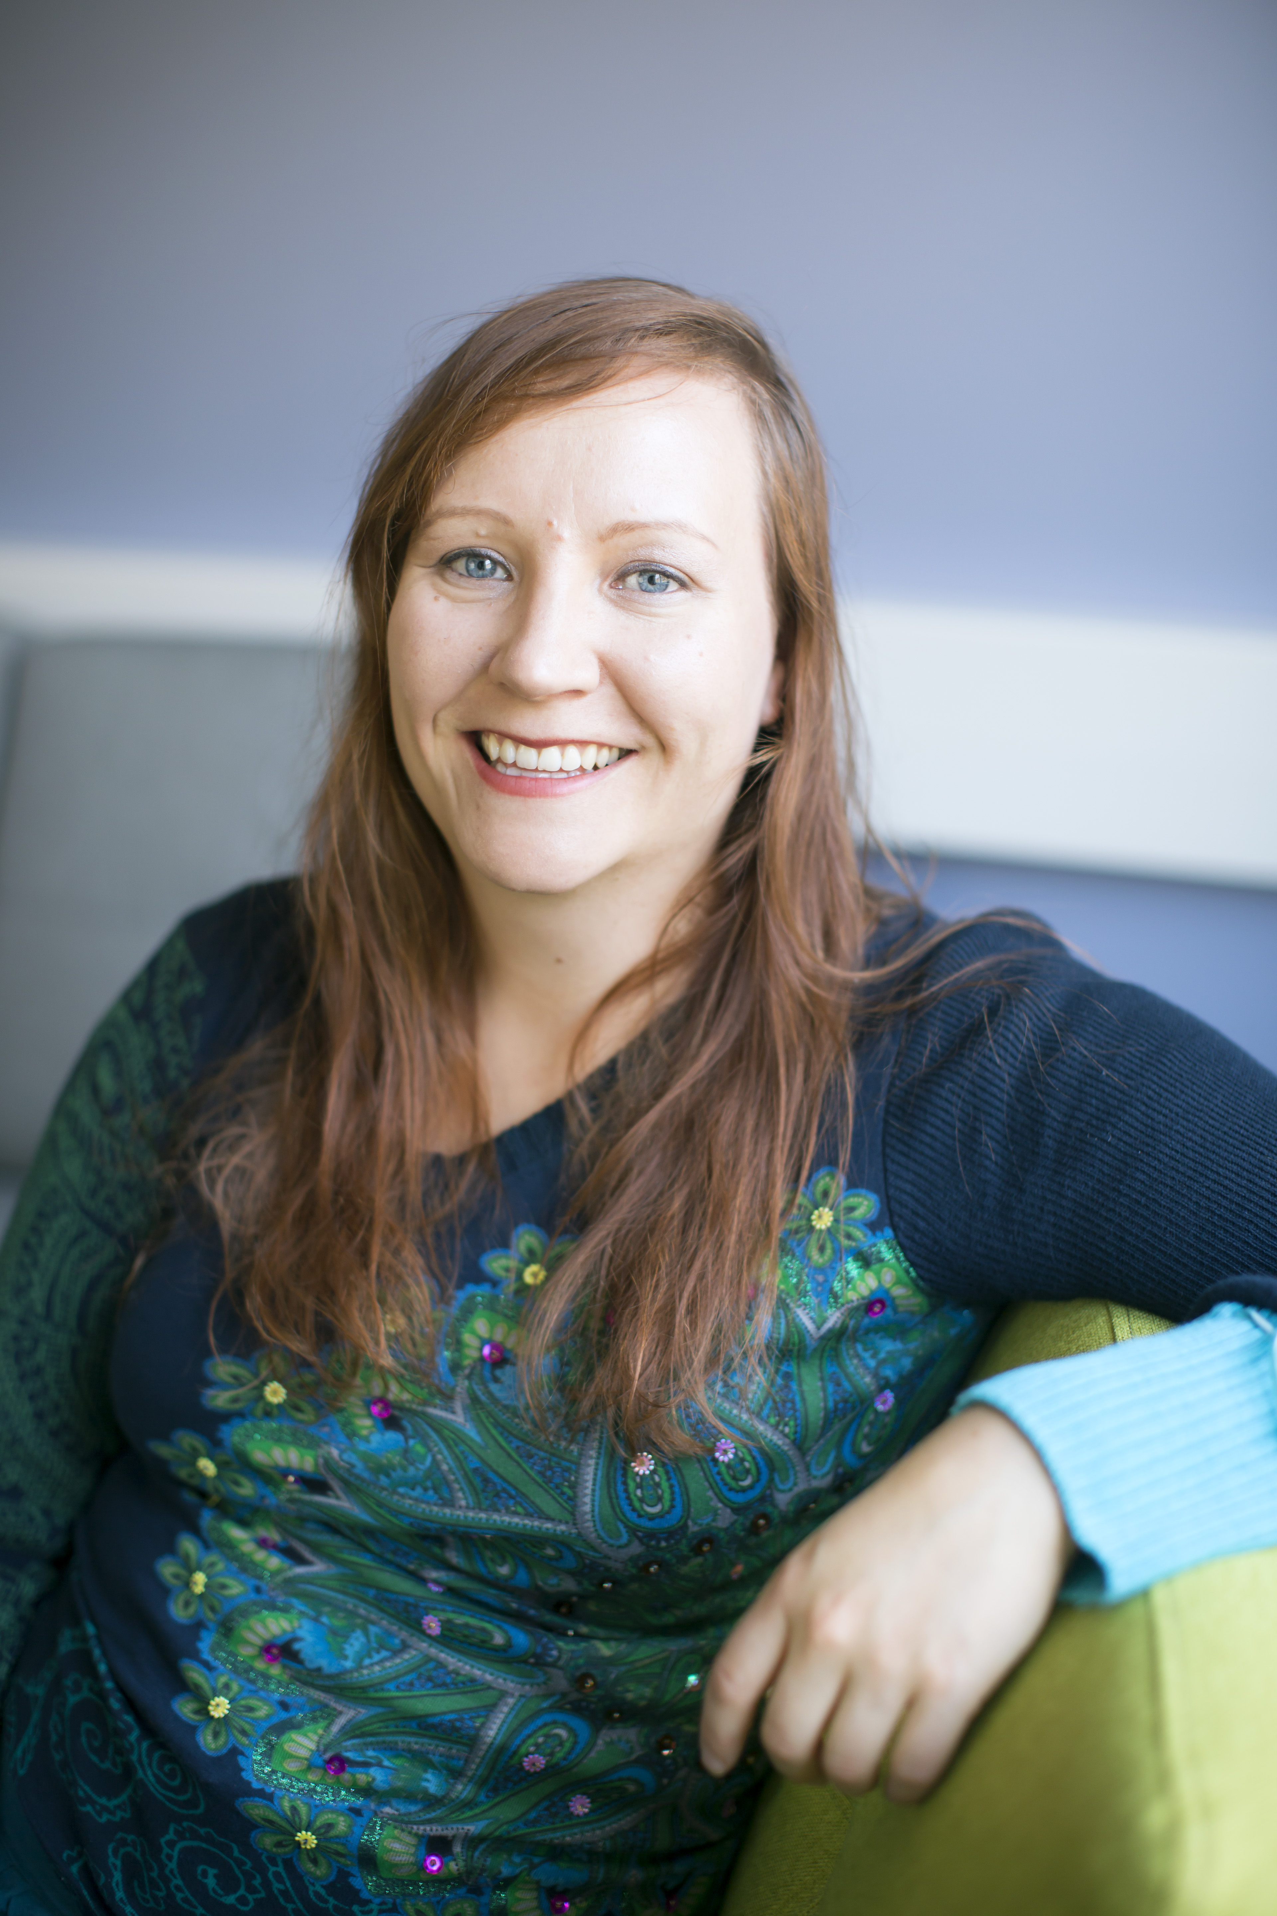
Wilma Karikko
wilma.karikko@tukiliitto.fi

Slide 7
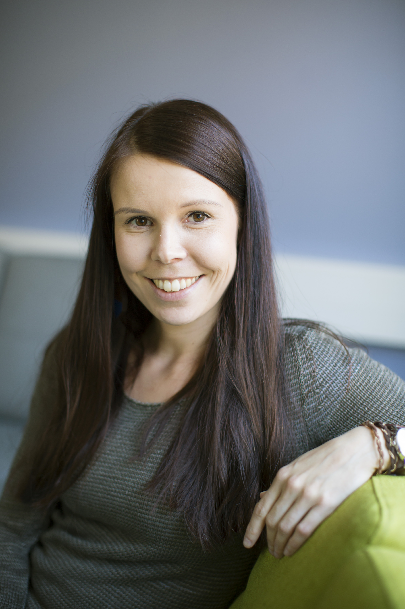
Jonna Suhonen
jonna.suhonen@tukiliitto.fi

Slide 8
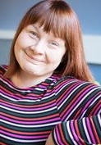
Sirpa Mäkinen
sirpa.makinen@tukiliitto.fi

Slide 9
Who are you? Introduce yourself using picture

Slide 10
With whom we work?

Slide 11
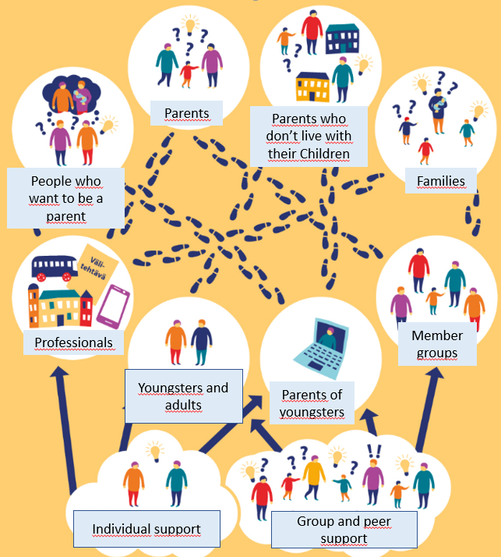

Slide 12
Why our work matters?
We have 40.000 people with intellectual disabilities in Finland.
Every year 700 children is born to parent with intellectual disability.
Inclusion Finland KVTL has 180 member associations including 17.000 persons.

Slide 13
Why our work matters?
According to feedback from participants:
Knowledge and opportunities have helped people to make their own choices in life.
Attending has made possible to reflect important issues in life.
Attending has helped to manage and enjoy everyday life.
Online support has made possible to attend from home.
Professionals of public services have learned the importance of expertise by experience.

Slide 14
Vavan video

Slide 15
What we have learned about online support
"Possibility to participate from own couch."
Considering online support as something that comes near, not something that is distant from participant
Distance or family situations are not an issue to participate
It might be easier to talk about deeper feelings, when you can write about them online rather than discuss face-to-face
Participants need to have a feeling that somebody is present
We don't have a perfect online platform yet that would serve all our communicational needs

Slide 16
What we have learned from parents
We receive a lot of information about families in different situations
We have learned that families are unequal. Some communities offer more suitable services than others.
The parents wish to discuss with other parents in similar life situations.
They get information from each others about solutions, good examples and new point of views.

Slide 17
How we work?

Slide 18
Solution focused approach
Our work is based on individual goals and strengthts.
We aim to empower families and adults.
We encourage them to cope with difficult situations.

Slide 19
Expertise by experience
We appreciate, use and share the knowledge people have based on their own experiences.
The information from expert by experiense is used to develop services and to educate professionals in public services how to treat people with intellectual disability when they need services.

Slide 20
Co-creation
We develop together with expertises by experience, other NGO workers, educational institutes and public services.
We appreciate dialogical and alternative co-working methods. Evaluation is also regular part of our work.
We do rapid experiments to find out, what works.

Slide 21
Online support
Information courses for families and professionals
Peer support groups
Online parental coaching

Slide 22
Peer support
Face to face and online peer support groups for youngsters, adults and parents.
Peer support means that people share their knowledge, experience, emotional, social or practical help to each other.

Slide 23
Face me -attitude
Face me is a requirement and a statement: inclusion is the only way, and it is possible. People with and without disabilities must and can live and work together, with equal rights and equal possibilities.

Slide 24
Experimental learning
We do rapid experiments to find out, what works.
We plan our activities with participants and partners.

Slide 25
Tell experiences from your life or work? Choose one or two of these subjects: Solution focused approach Expertice by experience Co-creation Online support Peer support Face me –attitude Experimental learning

Slide 26
We will tell you three cases from our work. After that we discuss about these cases in groups. What kind of thoughts and feelings you have? What kind of support you have for these situations in your country? What kind of support there shoud be available for these situations? How do you use expertice by experience in your country?

Slide 27
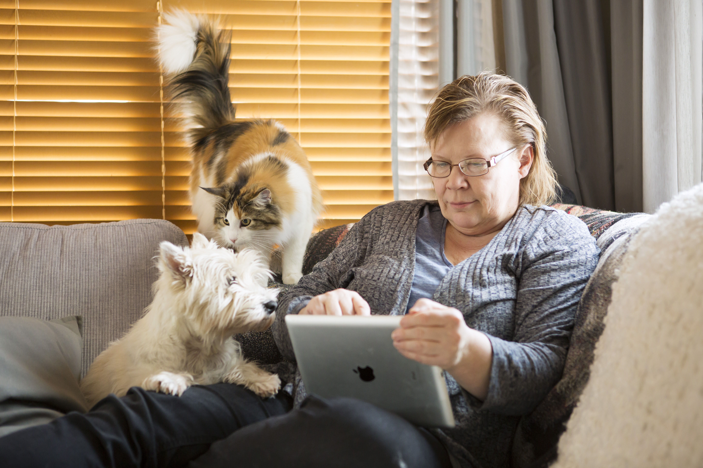
Online support for parents of youngsters

Slide 28
Tommi and his parents
Family Tuleva: mother, father and three children.
Tommi is 16 years old.
His ground school is ending.
He needs to decide what to study and where.
He needs to decide where to live while studying.

Slide 29
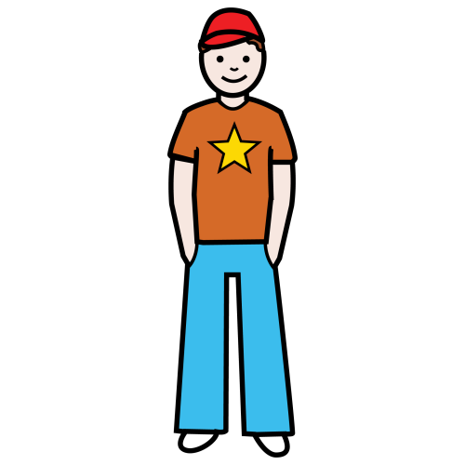
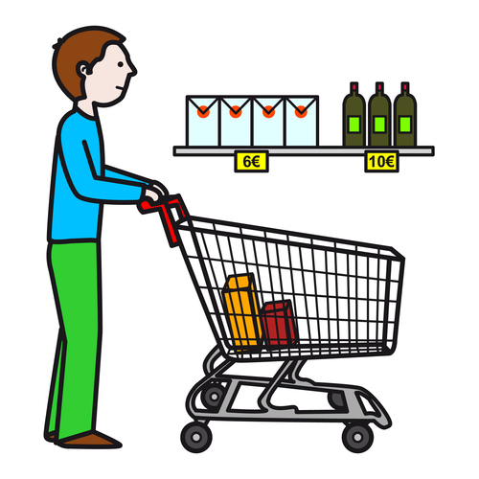
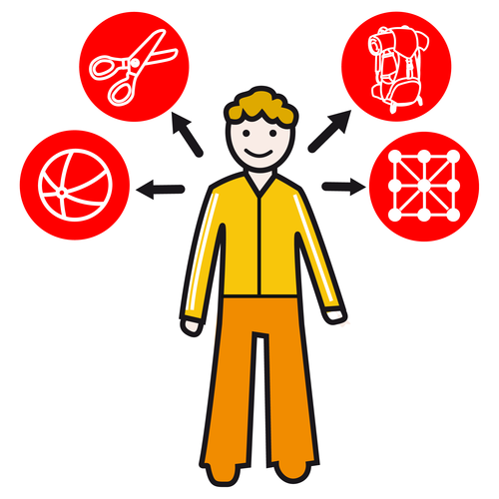
On free time Tommi wants to go to shopping
and play football with his friends.
Tommi needs support for that.
He wants to do those things without his parents.
He has a personal assistant.
With the help from his assistant he is practising decision making.
With his assistant he is free to do things he chooses to do.
Personal assistance gives Tommi an opportunity
to practise the skills he needs for the independent living.

Slide 30
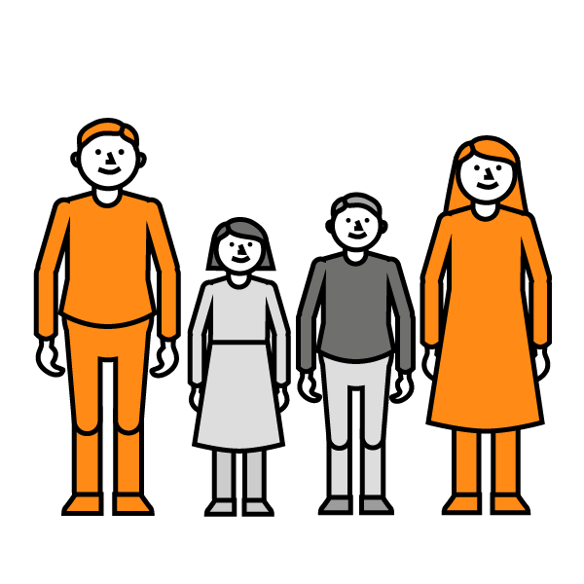
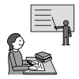
Tommi’s parents need information about studies.
They also need information about services and
rights while Tommi is studying.
Tommi’s parents want to share their thoughts
with other parents. They are worried about Tommi's future.
They want to discuss with Tommi about different options.
They want to be supportive and
let Tommi decide what he wants to study.

Slide 31
Empowering parents with intellectual disabilities

Slide 32
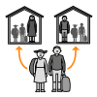
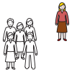
Kaisa and her three children
Kaisa has intellectual disabilities that she has found out as an adult.
She has been married and have three children with different
special needs.
Now Kaisa has divorsed.
She sees her children only few times a month.
Kaisa is now feeling depressed and a bit lonely.

Slide 33
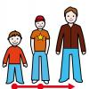
Kaisa and her three children
Kaisa is having also difficulties with social workers who do not believe she can be supportive mother to her children.
She wants to learn more about parenting and how to handle the becoming teenage.
Kaisa also hopes to get peer support.
She want to learn more about her rights
In shared custody.

Slide 34
Supporting adults' indenpendent living

Slide 35
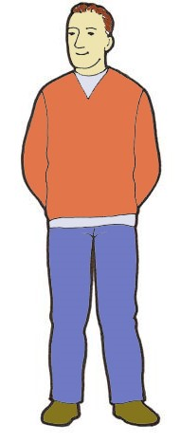
Heikki lives independently
Heikki is 45 years old.
He lives alone with light support to home from the municipality.
Four days a week Heikki goes to municipal day activity centre, because he doesn't have paid work.

Slide 36
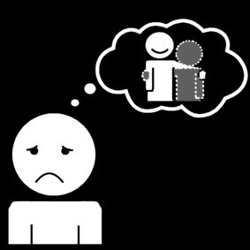
Heikki lives independently
Heikki feels lonely. He doesn't have special hobbies. He would like to find friends and some meaningful activity in his spare time.
Cooking his favourite food is Heikki's dream. He wishes to learn easy tips and to do his grocery shopping.
Heikki's income primarily consists of benefits. He has very little money to use.

Slide 37
Discussion about cases: What kind of thoughts and feelings you have? What kind of support you have for these situations in your country? What kind of support there shoud be available for these situations? How do you use expertice by experience in your country?

Slide 38
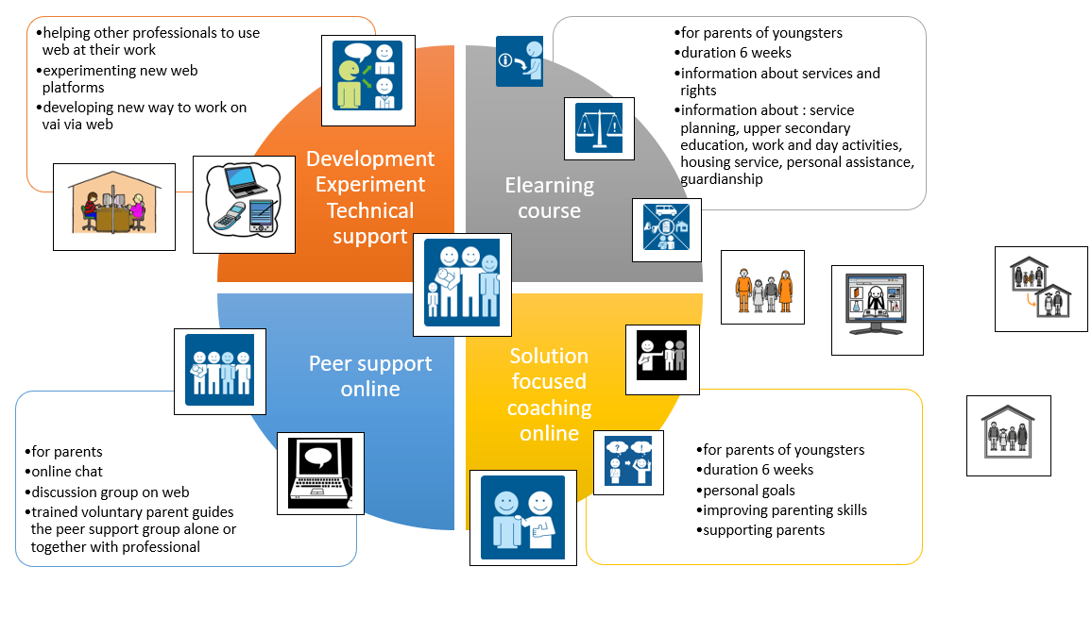

Slide 39
Online platforms
Movendos mCoach (app or website)
Online platform that allows to give tasks to participants.
We share information about services and rights. Material can be videos, texts or pictures. The task is the parents reflect their situation based on the materials and they can also make questions to our professionals.
Participants can also communicate with each other in the platform.
Tukinet.net
Online chat groups
- with the lead of professional of chosen subject ( for example housing, social benefits, education)
- with the lead of volunteer parent as a form of peer support
These platforms can be used with common net use skills.

Slide 40
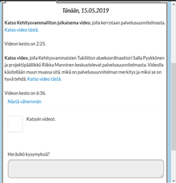
Online support
Task instructions from participants view: Watch the video about service planning. Does your service plan need updating? If you have questions, you can write them on the message box below. Tick the small box, when you have done the task.
The coaches can monitor the participants activity easily.
Korjaa parempi kuva kuvankaappaajalla

Slide 41
Empowering parents with intellectual disabilities
Support meetings (prox. 5 times)
Peer support groups
Training courses
Leisure and holiday activities
Consultations
Sharing information and experience stories
Developing supportive networks and public family services

Slide 42
Kaisa`s path at the project
Spring 2018:
Kaisa found us using Google. She send us request for support.
Weekly support meetings by phone (12) and sending information and stories by mail.
Consultation for public social workers by phone and email.
One-day meeting and working with Kaisa an her children at heir home. Social worker was there too.
Summer 2018:
Kaisa decides to take part of half-year paranting course with her youngest child.
Se needs engourafement and help for traveling. The public social services give them financial support.

Slide 43
Kaisa`s path at the project
During the course 6-12/2019
After the course sping ans summer 2019

Slide 44
What we provide to Heikki?
Aarne and Aune -group process
4–6 months, meetings prox. every second week
Support to develop skills for everyday life and increase inclusion
Possibility to individualised support to attending group and everyday life
For example taking care of own business, travelling and participating activities in own or foreign city
Can be simply confidental conversations.
Co-operation with family, the public social services, service providers and other directions needed.
Possibility to continue to Aarne and Aune -developer group
Inclusion in developing services and life environment
Role as an expert by experience

Slide 45
Heikki's path at the project
Heikki hears from us by the public social worker.
Project's designer Anne goes to meet Heikki. They talk about Heikki's life and interests. Anne suggests, that Heikki would come along the group when the theme is cooking. Heikki hesitates at first, but agrees.

Slide 46
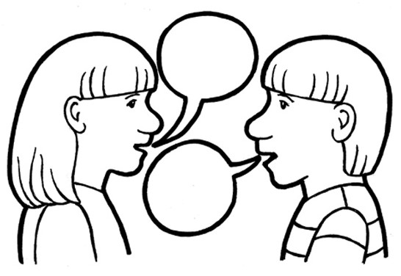
What idea or thought you take with you from this session?

Slide 47
Thank you! Ačiū!
sirpa.makinen@tukiliitto.fi
riikka.manninen@tukiliitto.fi
wilma.karikko@tukiliitto.fi
jonna.suhonen@tukiliitto.fi
Inclusion Finland KVTL www.tukiliitto.fi

