Slide 1
Self-advocacy at éfoész
László Bercse
bercse.laszlo@gmail.com

Slide 2
self-advocacy groups at éfoész
ÉFOÉSZ is a national organization
and was founded by family members in 1981.
ÉFOÉSZ has 25 local branches.
ÉFOÉSZ supports self-advocacy groups
all around the country.
I am a board member of the organization.
I represent self-advocates as co-chair.

Slide 3
In the last few years self-advocates have started
to work together more closely.
We are planning to build a national network
in the near future.

Slide 4
Self-advocacy group in Budapest
Notes:
The Self-Advocacy Group in Budapest have been working since 2016 since it’s current members.
We meet every week at the main office of ÉFOÉSZ.
We work together on many interesting topics.

Slide 5
OUR review on CRPD
We sent a review to the CRPD Committee
on how the Convention is being implemented
in Hungary.
We worked on the review from January to April,
last year.
We were happy to tell our opinion
and speak up for ourselves and for others.
Notes:
Now I would like to present you our priorities
while working on the review.
I will also tell you, how we work on these topics.

Slide 6
1. Independent living
In Hungary many people with intellectual disabilities live in institutions.
Soon, new supported living services will be built by the state to replace institutions.
We would like to achieve that the new services provide a better and more independent life
for people.

Slide 7
Notes:
We had a national self-advocates’ conference on independent living.
Self-advocates from all around the country could meet each other and learn new things.

Slide 8
Notes:
Here you can see me, doing a workshop at this conference.
My topic was easy-to-read.

Slide 9
Notes:
Last year we started a new project, founded by the European Union.
In this project we provide trainings and other support to people living with their families and also to those who live in institutions.

Slide 10
2. Guardianship
Many people in Hungary are under guardianship.
They can not make decisions on their own life.
Hungary has to work better
so people use supported decision making
instead of guardianship.
Supported decision making means,
that we can make decisions but we can get support.

Slide 11
Notes:
We provide trainings to family members and support persons.
Last year we did trainings for judges, in five different regions of Hungary.
We spoke about supported decision making and easy-to-read.

Slide 12
3. Right to vote
In Hungary most of people under guardianship
are not allowed to vote.
It is because the jury took the right to vote
away from them.
We think it is not possible
to examine someone's ability to vote.
So we want to achieve
that all people with intellectual disabilities can vote.

Slide 13
ÉFOÉSZ made easy-to-read materials about the right to vote and about the European Elections.
We wrote
What is the European Parliament?
Why are European Elections important?
How to vote?
What do we expect from candidates
when elected

Slide 14
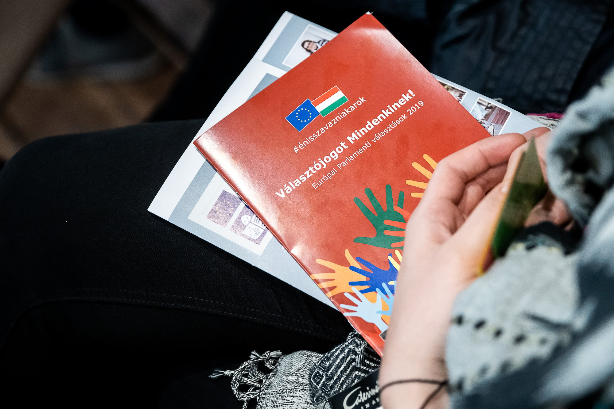

Slide 15
Notes:
We had a self-advocates’ conference about the right to vote.
The biggest Hungarian online newspaper reported about the event.

Slide 16
I feel as a secondary citizen. Others can vote, why don’t we have this right?
Notes:
This is what one of the self-advocates said.
He is under guardianship and is not allowed to vote.

Slide 17
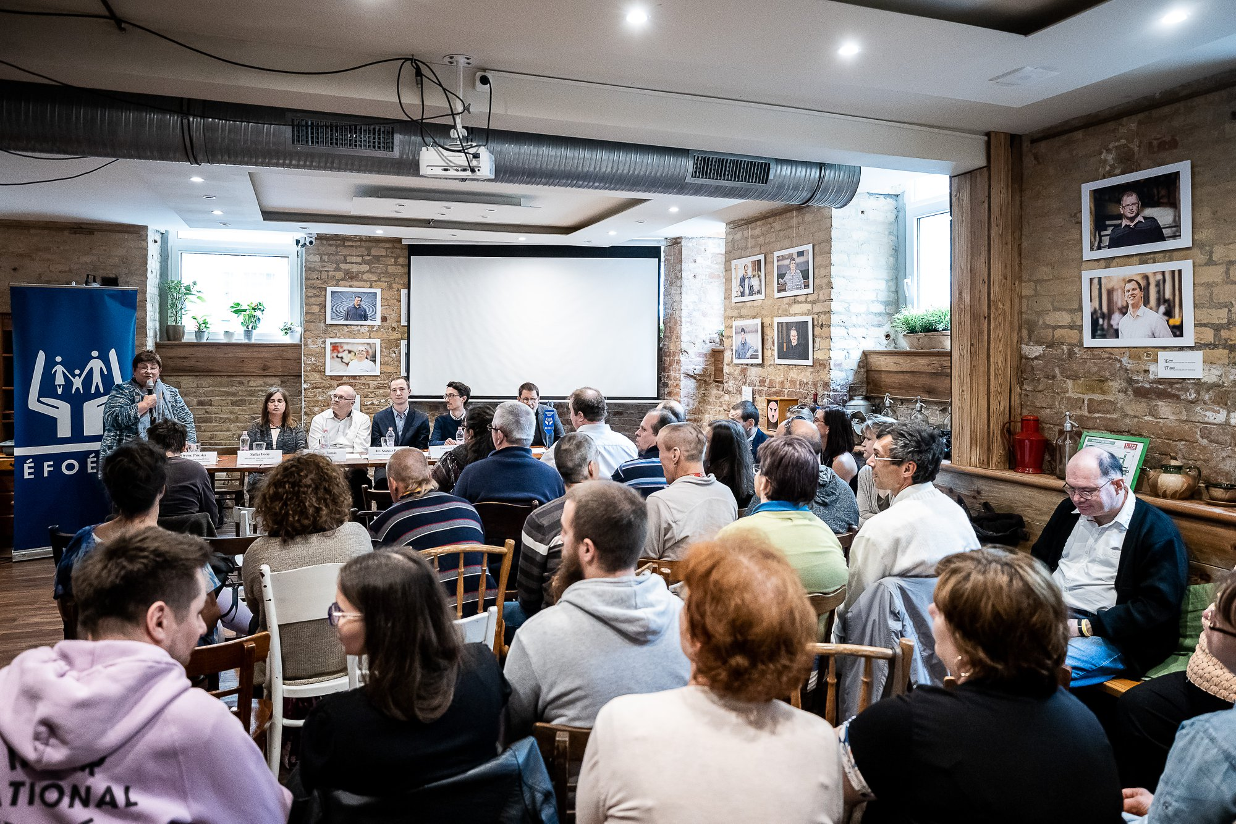
Notes:
We had a photo campaign in the community media.
We photographed an interviewed people with intellectual disabilities.
Some of them are allowed to vote and some of them are not.
We did an exhibition in a café run by people with disabilities.
W had a roundtable discussion at the opening of the exhibition.

Slide 18
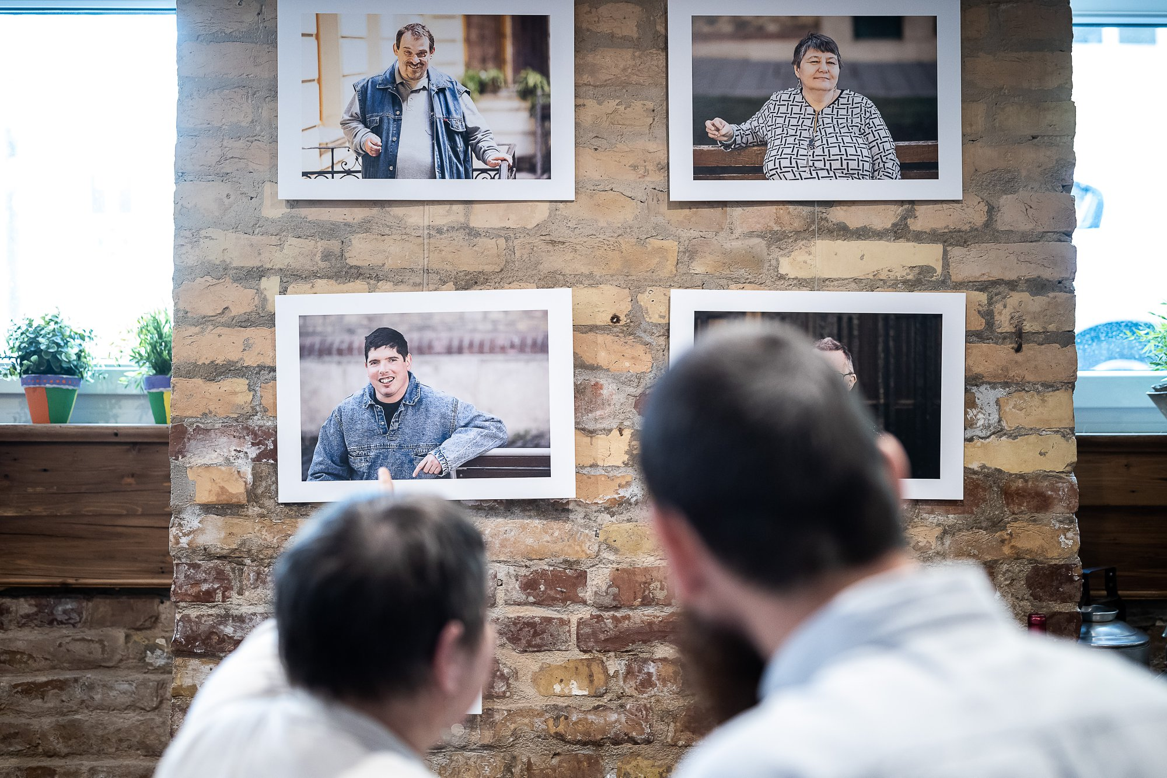

Slide 19
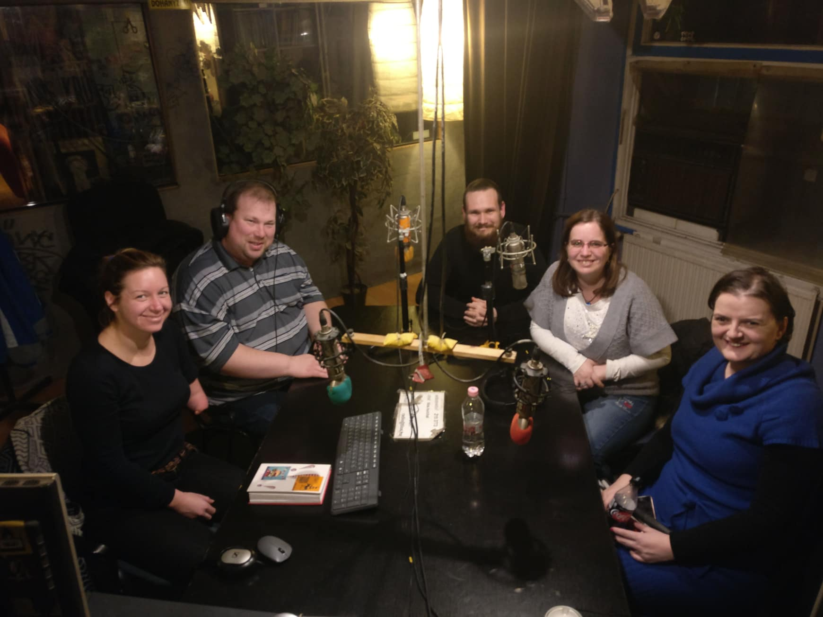
Notes:
We spoke a lot about the right to vote in the media, so many people can hear our message.
Here you can see as my colleagues and I are giving a radio interview.

Slide 20
4. Accessibility
Easy-to-read makes it easier for us
to access information,
to make decisions and to be active citizens.
We provide trainings about easy-to-read
to students in special education
and to support persons.
So they can use easy-read
when working with people with intellectual disabilities.

Slide 21
Notes:
Here we are doing a training for support persons, at one of our member organizations.

Slide 22
Notes:
In this picture we are having a university class with students in special education.

Slide 23
Thank you for your attention!

