Slide 1
Basic Income
& Disability

Slide 2
https://youtu.be/tnbdpM5aPLA

Slide 3
Basic Income is not yet a full reality anywhere…
…it is an idea.

Slide 4
Many countries have an income support system…
…benefits, tax credits, pensions, welfare etc.

Slide 5
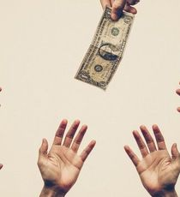

Slide 6
But these are not very generous…

Slide 7
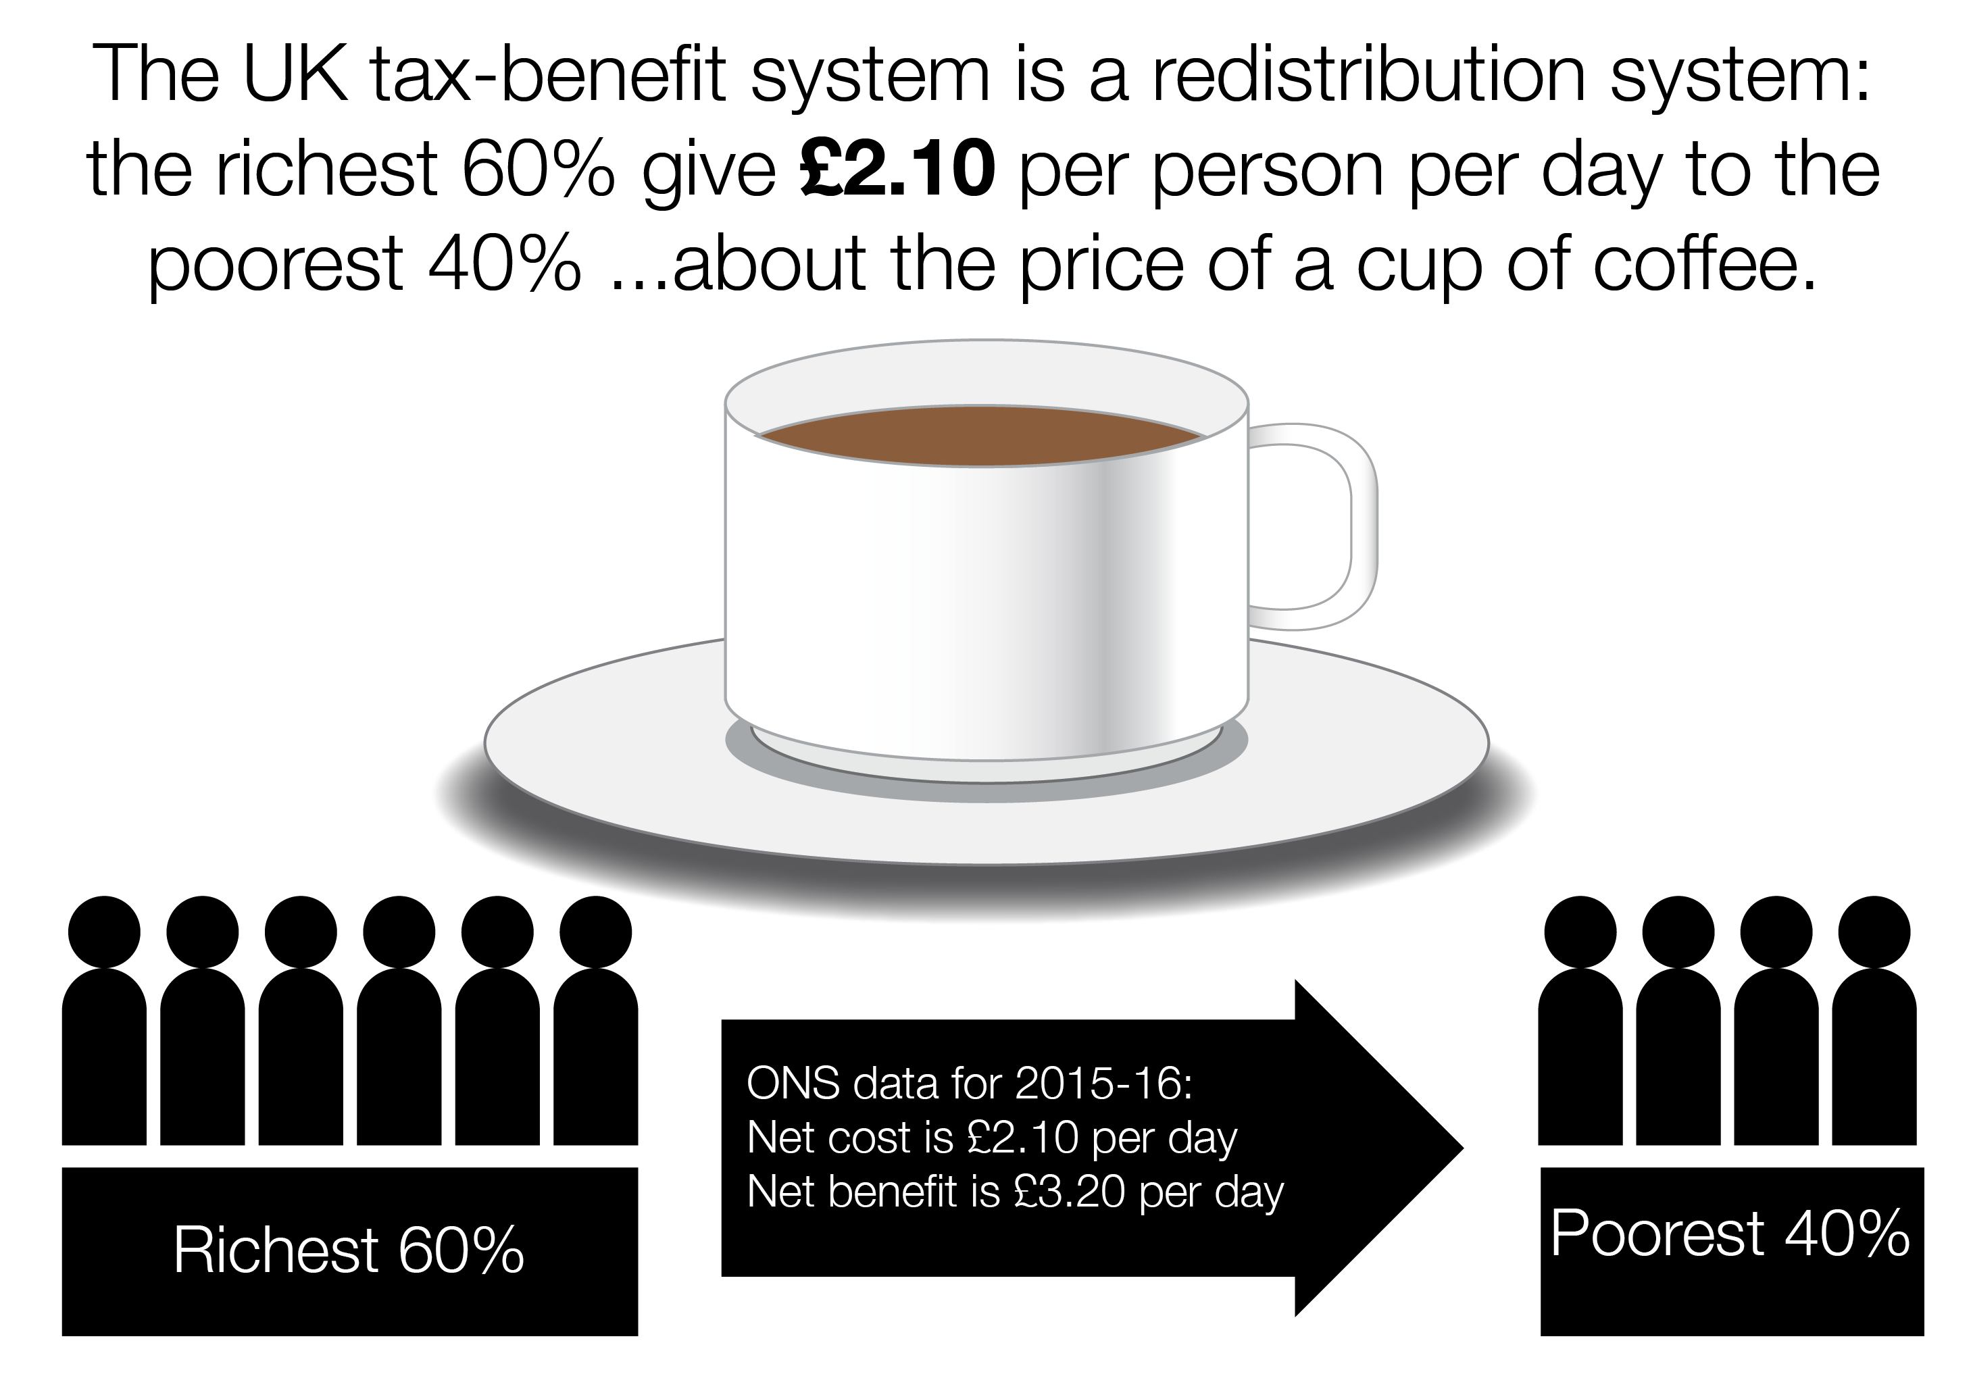

Slide 8
In many places you ONLY get benefits
1. if you have no savings and pay most of your earnings to the government
2. if no one in your family has a job or savings
3. if you look for work in the way the government tells you

Slide 9
This means people who are poor
tend to stay poor

Slide 10
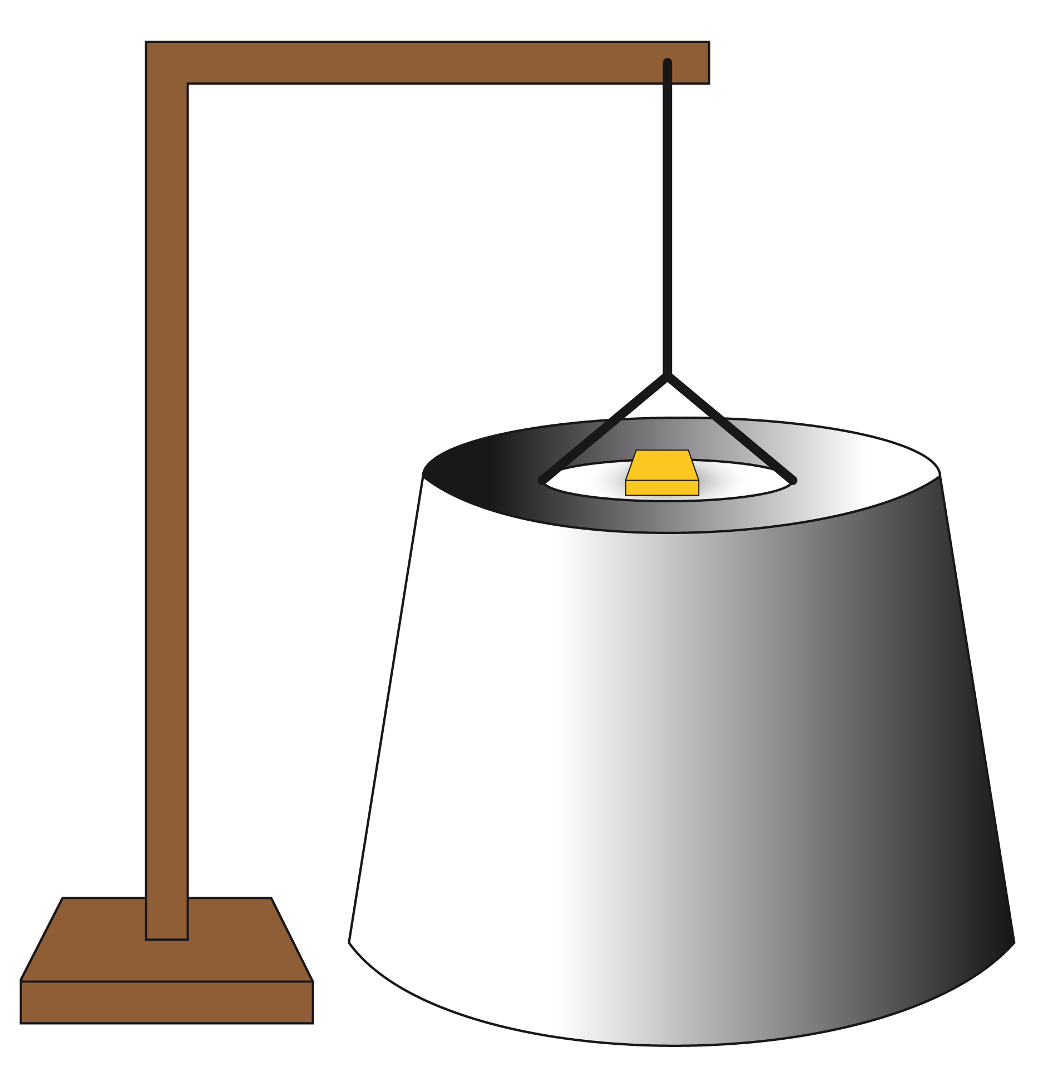

Slide 11
Many countries also have disability benefits…
…but to qualify you must show you can’t work.

Slide 13
This is quite confusing because disabled people are all different
1. Some can do paid work just like (some) non-disabled people
2. Some can do paid work, but for less time or with other changes or support
3. Some people have different gifts and can contribute in different ways

Slide 14
Basic Income is a way to improve these systems…
…to promote citizenship, freedom and rights.

Slide 15
Basic Income means every person gets…
…a regular amount of money to live on.

Slide 17
Basic Income is different because it is for EVERYONE
1. Rich people and poor people
2. Everyone in the family
3. People with and without jobs

Slide 18
Many disabled people need EXTRA money…
…so we need to work for Basic Income Plus.

Slide 19
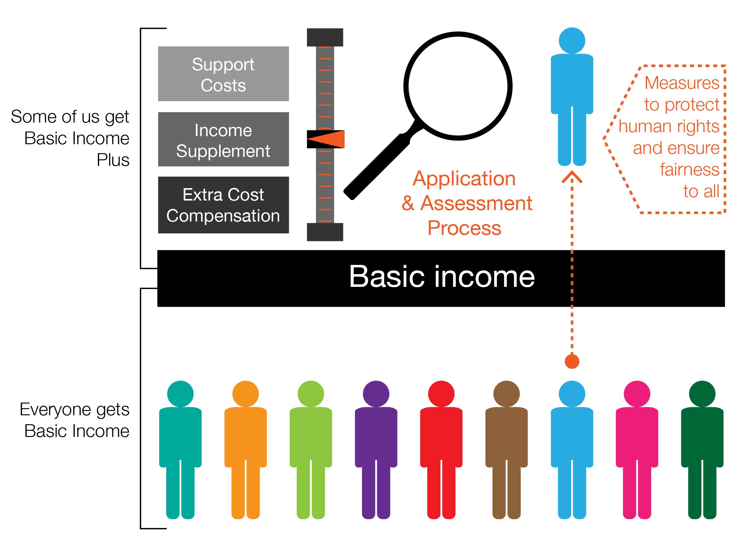

Slide 20
Basic Income Plus means that people would get EXTRA to…
1. reduce inequality
2. meet extra disability costs
3. pay for additional support

Slide 21
Basic income Plus is a system to…
…empower all disabled people to be full citizens.

Slide 22
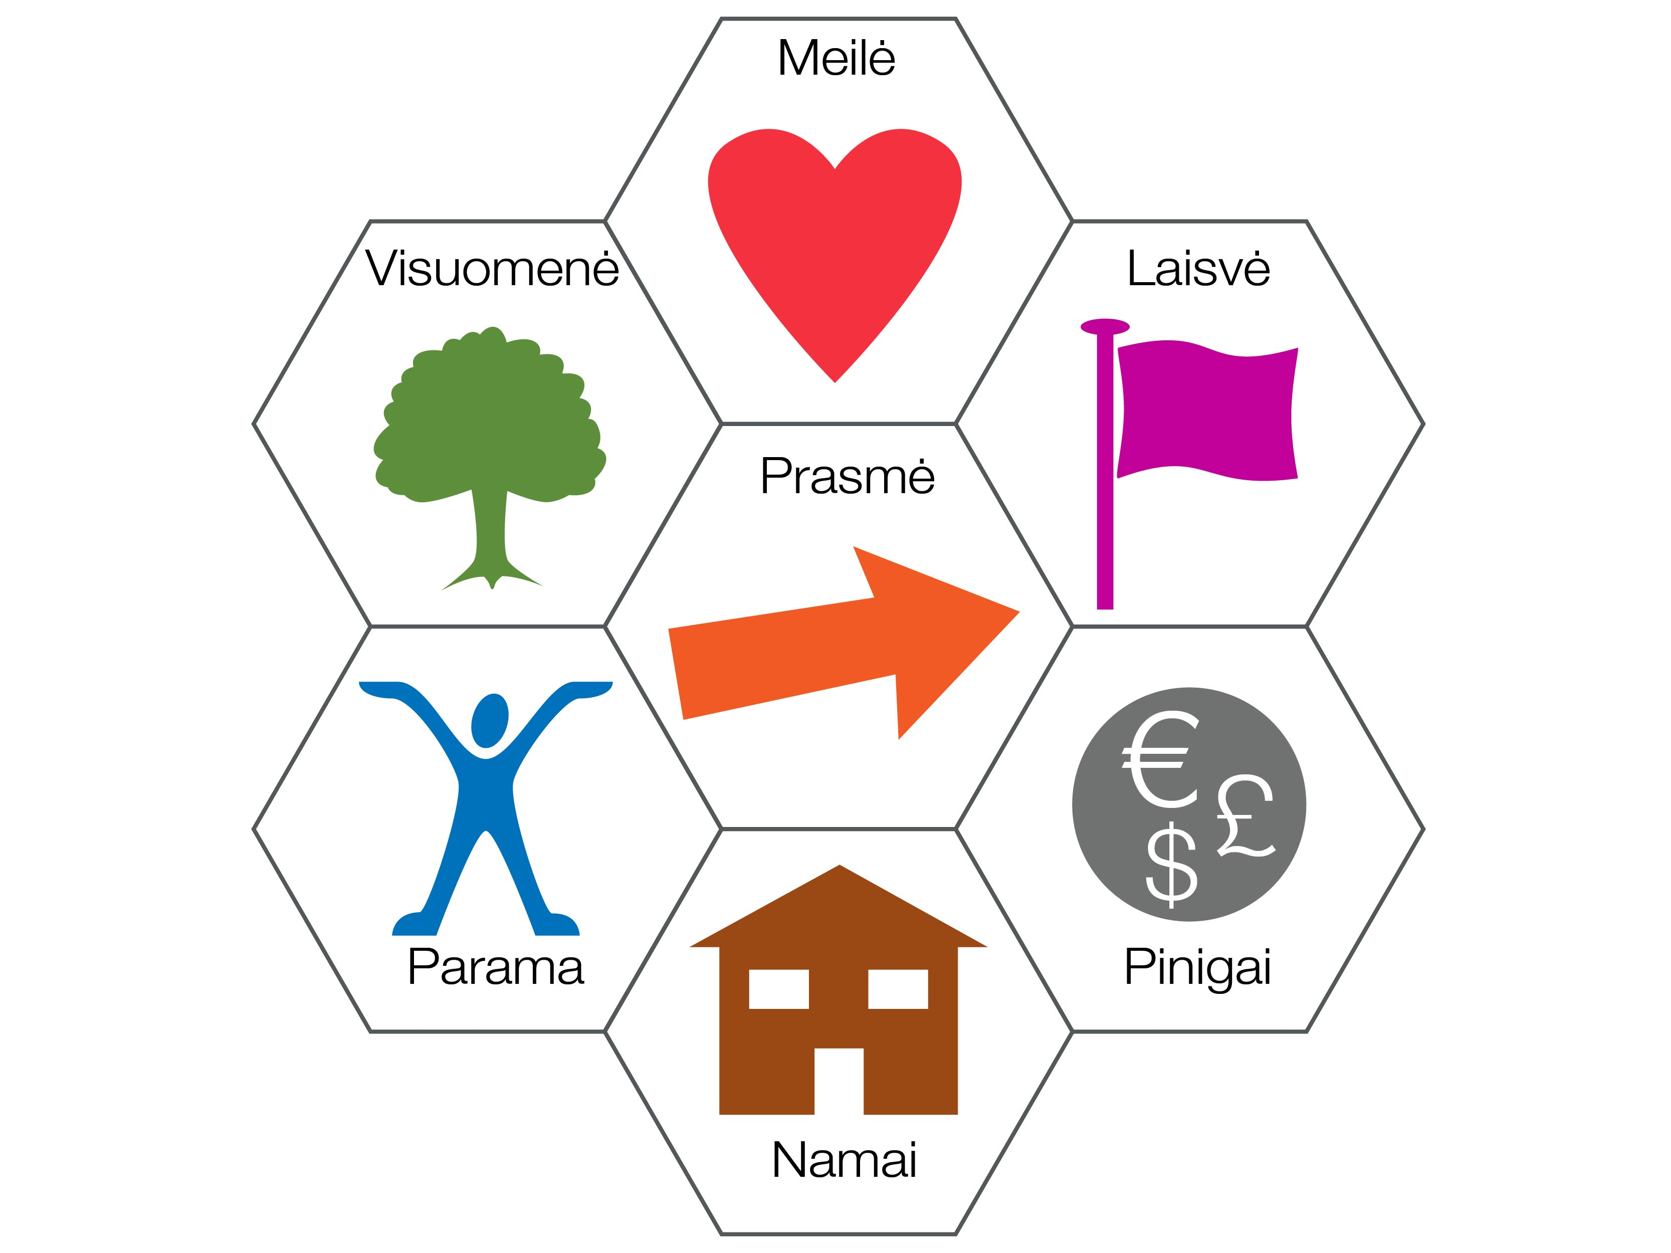

Slide 23
Basic income may seem an impossible dream…
…but lots of people are starting to take it seriously.

Slide 24
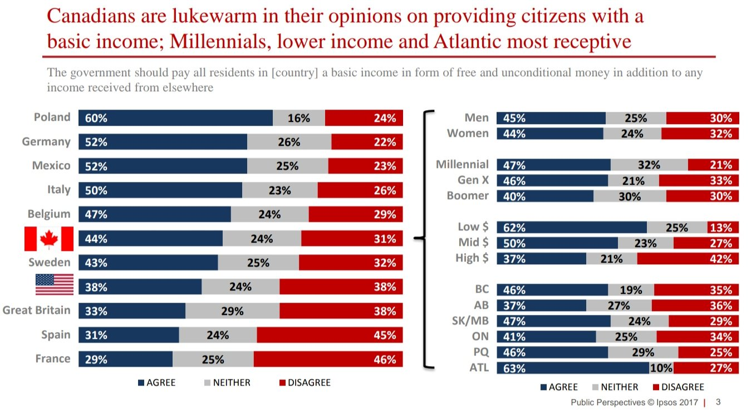

Slide 25
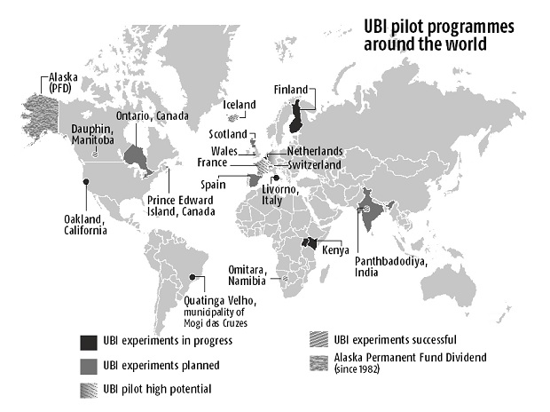
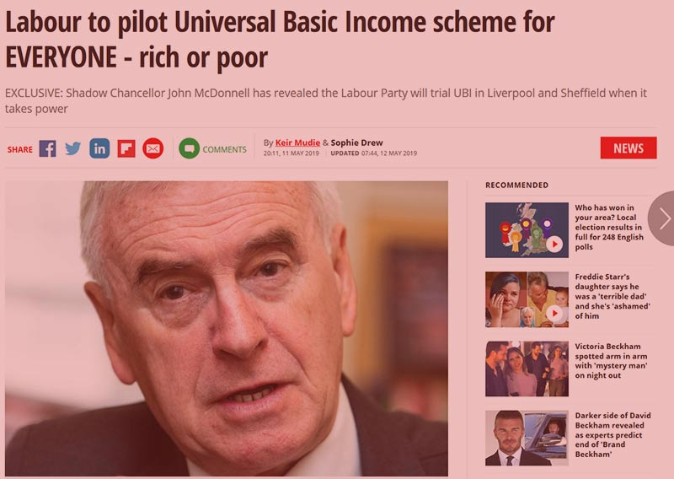
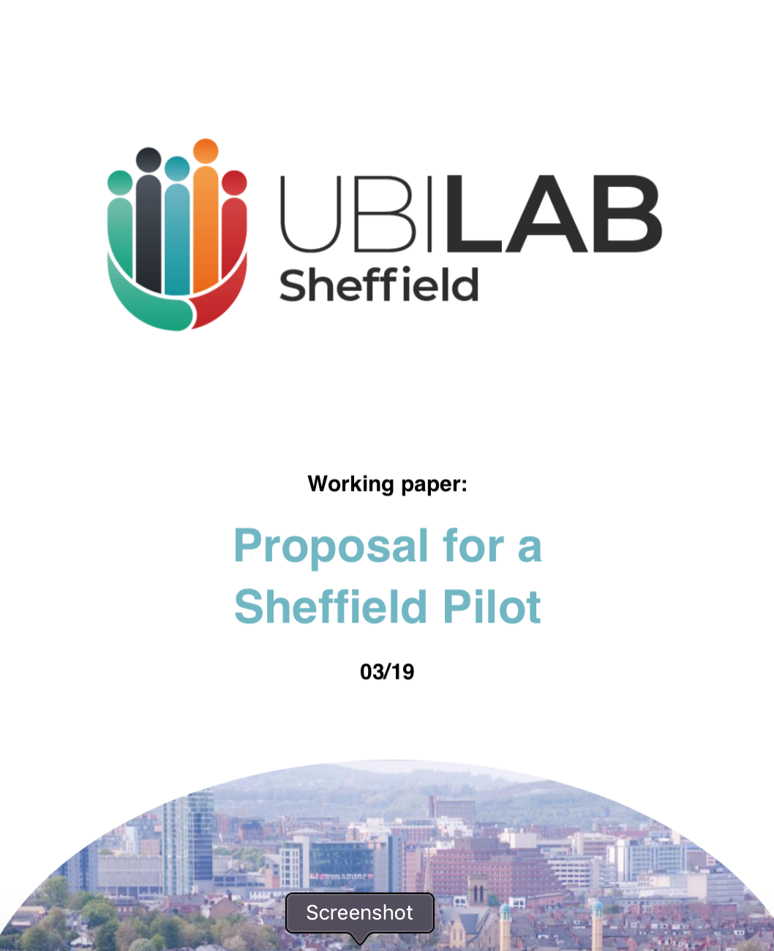
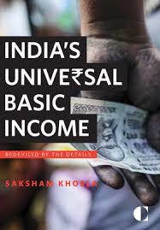
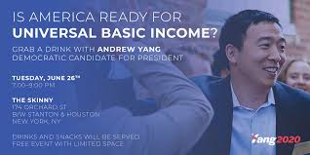

Slide 26
There is a lot of evidence that Basic Income would…
Reduce poverty
Improve health
Improve work life
End benefit stigma
Reduce suicides
Reduce bureaucracy
Increase solidarity
Increase citizen action
Improve life for carers
Reduce domestic violence
Improve learning

Slide 27
Not everybody likes the idea of Basic Income some fear
1. It is too expensive (high taxes)
2. It will make us lazy
3. It will lead to other cuts

Slide 28
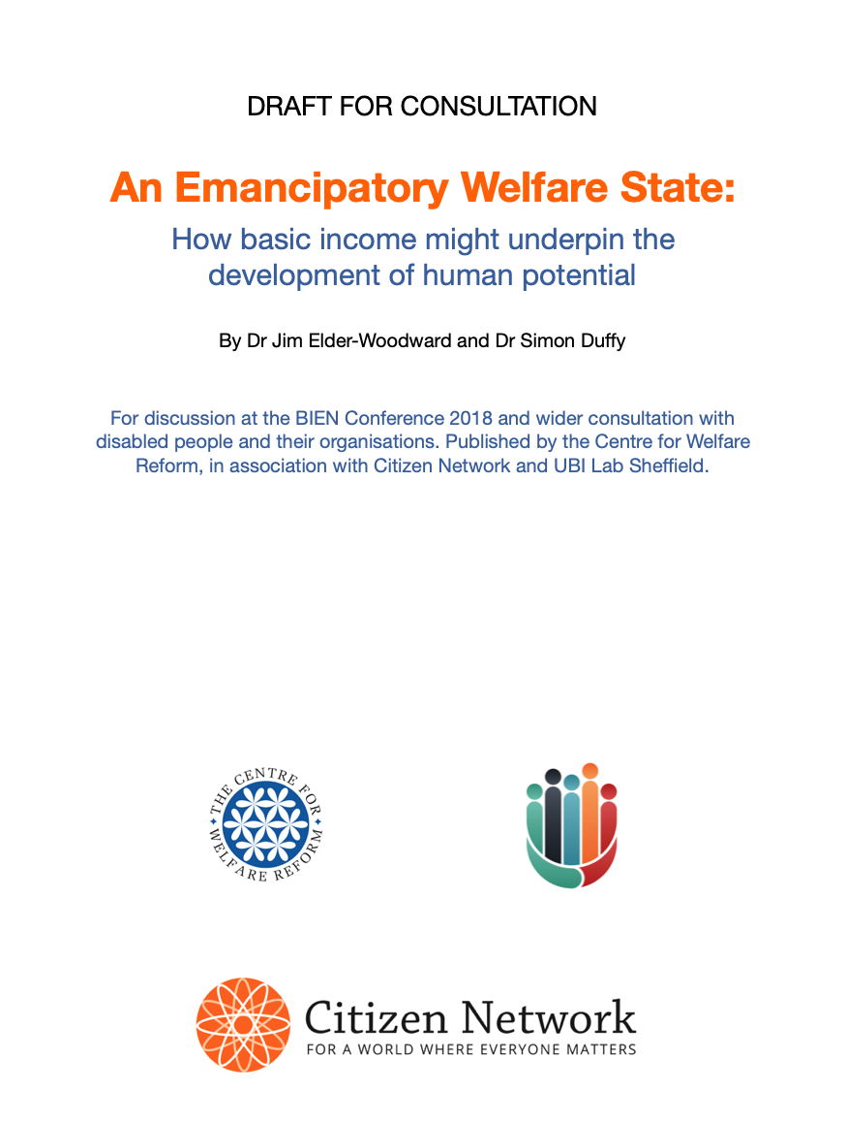
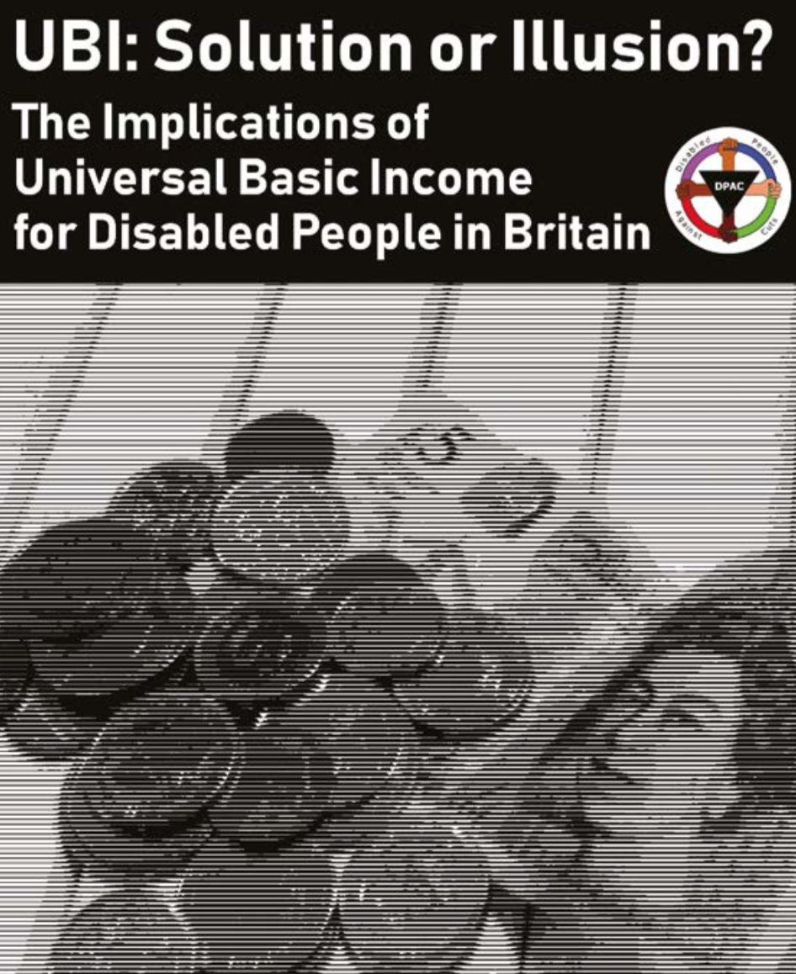
Some disabled people like the idea, some don’t
V

Slide 29
Basic Income would be good for disabled people because
1. It improves life for everyone
2. It creates a secure income for everyone
3. It makes family life better
4. It makes it easier to contribute
5. It unites disabled people with other groups

Slide 31
Some questions
1. Is it clear what basic income is?
2. Is basic income a good idea?
3. Should Inclusion Europe support it?

Slide 32
Possible actions
1. Discuss this when you get home
2. Fill in our online survey
3. Connect to Citizen Network

