Slide 1
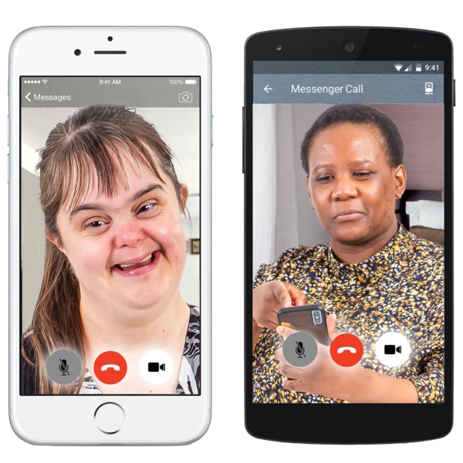
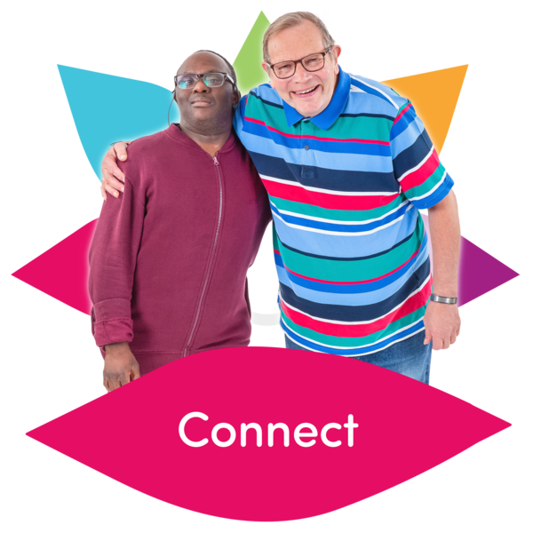
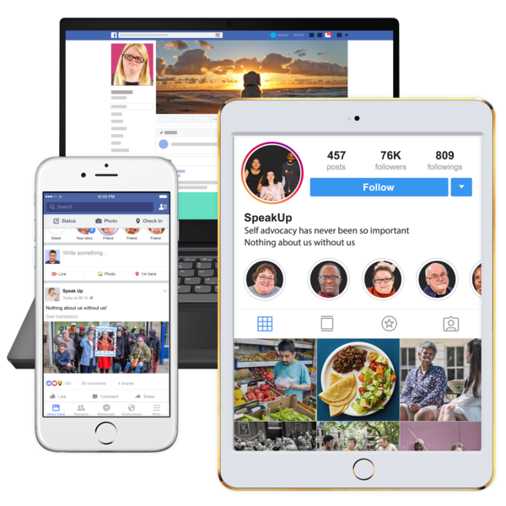
Self-advocacy activities during the coronavirus emergency

Slide 2
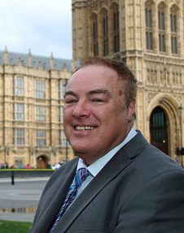
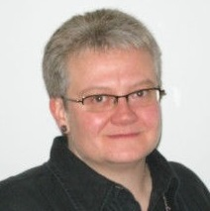
About Us
Gary
Membership and engagement lead at Learning disability England
Sam
Chief Executive at Learning Disability England

Slide 3
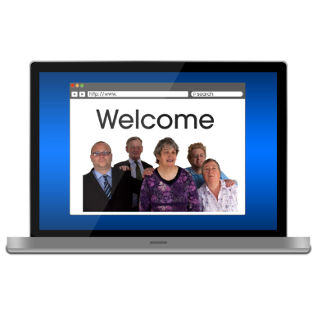
What is happening that people tell us is good?
Sharing and making accessible resources on the virus
Connecting with and supporting each other using technology
Hosting online events and suggesting activities
Campaigning on issues that relate to covid-19

Slide 4
Sheffield voices – online meetings

Slide 5
People first forum – Survival guide and coronavirus diary
Find here : https://issuu.com/peoplefirstforum/docs/diary_template_latest?fbclid=IwAR3_QTDqOcU4pzKoNH8ZQGAbUSy5mL3JWLL5eJdFHvbUJqgRWAYDoLbpIJM

Slide 6
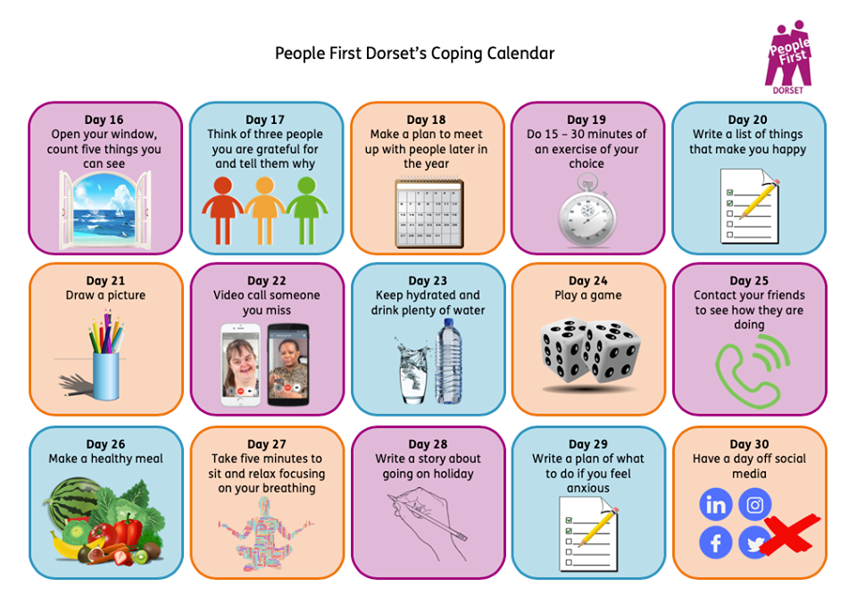
Dorset People First - coping calendar and activity board

Slide 7
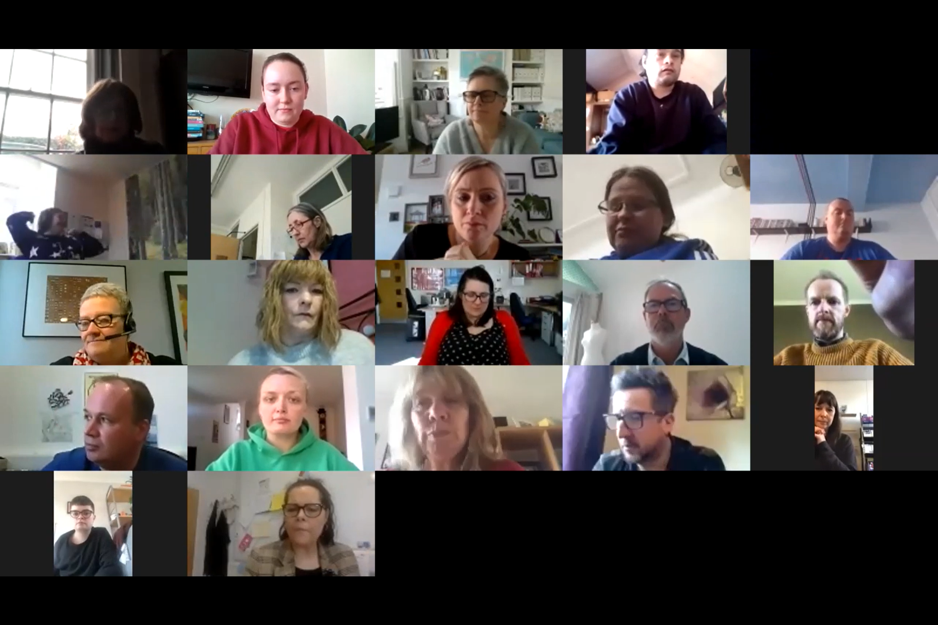
Supporting each other – just some examples
People First and Change
Zoom meetings every week
Speak Up – phone and on line check ins and activities
Learning Disability England Peer Support for groups and advocates

Slide 8
Campaigning
About rights under Covid
Changing the government rules on going out or hospital visiting
Treatment decisions
Checking services
Not forgetting important changes that are needed
Hospitals – Right to Home

Slide 9
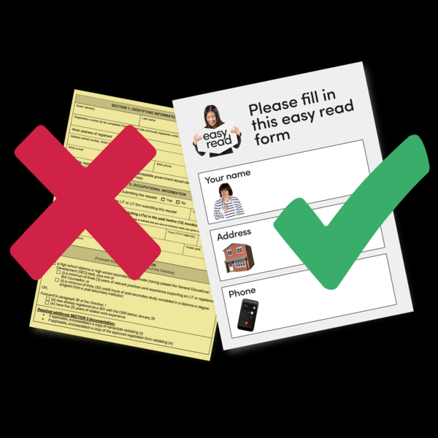
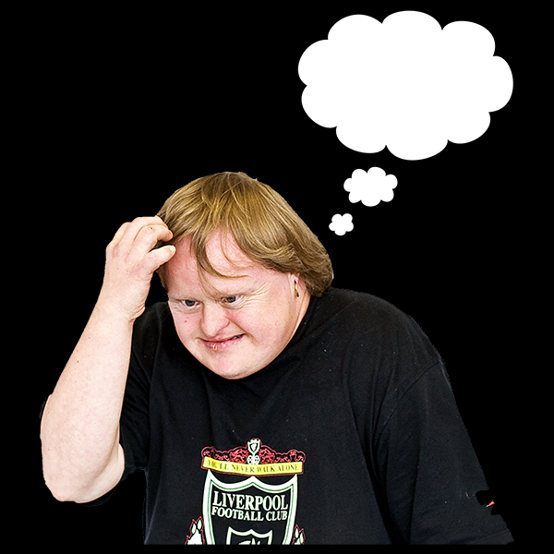
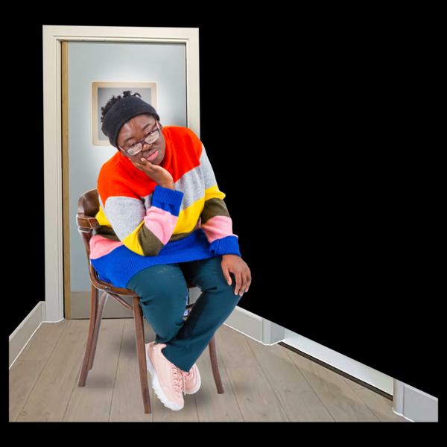
But there are big worries too
Not understanding what is happening
Not enough easy to understand information
A lot of people are not on line or find digital things hard
Feeling worried, or afraid
Not forgetting people
Some people or places are isolated

