Slide 1
Recommendations from the women’s movement
Claire Fourçans, Policy and Campaigns Director,
European Women’s Lobby
Notes:
EWL logo
Recommendations from the women’s movement Claire Fourçans, Policy and Campaigns Director,
European Women’s Lobby

Slide 2
The continuum of violence
Long-term systemic women’s rights violation, that precedes this COVID-19 pandemic crisis
Women with disabilities are particularly exposed to sexual violence, domestic violence, forced sterilization and forced abortion
Worsened in times of COVID-19, linked to lockdown measures:
Enabling environment for perpetrators
Seeking assistance gets harder
Notes:
The continuum of violence
Long-term systemic women’s rights violation, that precedes this COVID-19 pandemic crisis
Women with disabilities are particularly exposed to sexual violence, domestic violence, forced sterilization and forced abortion
Worsened in times of COVID-19, linked to lockdown measures:
Enabling environment for perpetrators
Seeking assistance gets harder

Slide 3
New commitments⇒ long term vision
Declare essential the services to protect all victims, and ensure accessibility of women with disabilities to helplines, support services and judicial system
Step up efforts in ratification & implementation of Istanbul Convention
Gender mainstream all responses to COVID-19 and long-term recovery measures.
Women’s organisations systematically consulted.
Notes:
New commitments: long term vision
Declare essential the services to protect all victims, and ensure accessibility of women with disabilities to helplines, support services and judicial system
Step up efforts in ratification & implementation of Istanbul Convention
Gender mainstream all responses to COVID-19 and long-term recovery measures.
Women’s organisations systematically consulted.

Slide 4
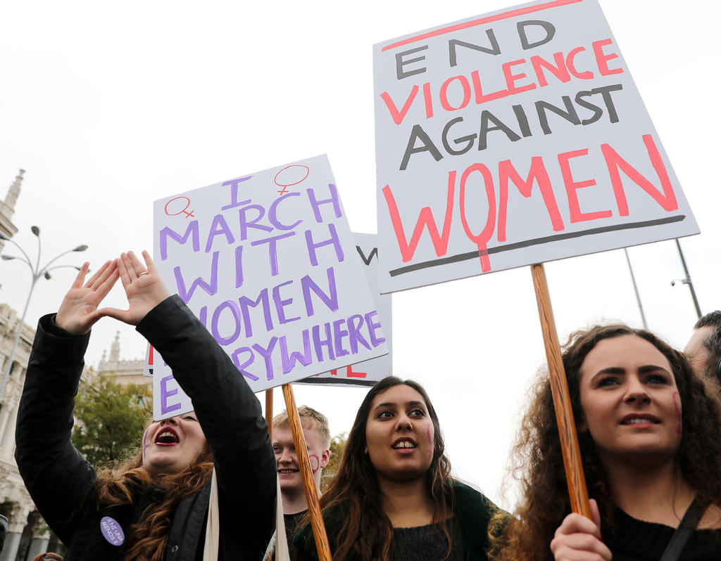
Coordinated EU action to #EndVAWG
EU to act in an united way to protect women and girls everywhere in Europe and to end all forms of male violence.
Accelerate the conclusion of the EU’s accession to Istanbul Convention
Implement the Istanbul Convention consistently everywhere in the EU at all times
Notes:
Coordinated EU action to #EndVAWG
EU to act in an united way to protect women and girls everywhere in Europe and to end all forms of male violence.
Accelerate the conclusion of the EU’s accession to Istanbul Convention
Implement the Istanbul Convention consistently everywhere in the EU at all times

Slide 5
Coordinated EU action to #EndVAWG
Recognise VAWG as a eurocrime which should be tackled jointly
Adopt an EU Directive on preventing and combating all forms of violence against women and girls, including forced sterilization, with provisions ensuring protection and accessibility of women with disabilities
Provide adequate funding to address the long-term & emergency situation, by funding women civil society organisations, through the MFF and the Next Generation EU
Notes:
Coordinated EU action to #EndVAWG
Recognise VAWG as a eurocrime which should be tackled jointly
Adopt an EU Directive on preventing and combating all forms of violence against women and girls, including forced sterilization, with provisions ensuring protection and accessibility of women with disabilities
Provide adequate funding to address the long-term & emergency situation, by funding women civil society organisations, through the MFF and the Next Generation EU

Slide 6
Thank you for your attention
The European Women’s Lobby
www.womenlobby.org
Twitter: @EuropeanWomen
Facebook: European Women’s Lobby
Notes:
Thank you for your attention
The European Women’s Lobby
www.womenlobby.org
Twitter: @EuropeanWomen
Facebook: European Women’s Lobby

