Slide 1
The Istanbul Convention: a fundamental instrument to eliminate violence
Rachel Eapen Paul
Member of GREVIO – CoE
24th November 2020
Notes:
EDF logo
Council of Europe logo
The Istanbul Convention: a fundamental instrument to eliminate violence
Rachel Eapen Paul
Member of GREVIO – CoE
24th November 2020

Slide 2
What is the Istanbul Convention and how is it relevant for women and girls with disabilities?
Notes:
Panel 2: What is the Istanbul Convention and how is it relevant for women and girls with disabilities?

Slide 3
Outline
I- The Istanbul Convention:
A comprehensive tool to tackle violence against All women and girls
II- The Istanbul Convention:
Its relevance to violence against women and girls with disabilities
Notes:
The presentation is in 2 Parts:
I- The Istanbul Convention: A comprehensive tool to tackle violence against All women and girls
II- The Istanbul Convention: Its relevance to violence against women and girls with disabilities
Image: the face of a young women covering her mouth with her hands. She looks worried and sad.

Slide 4
I- A comprehensive tool to tackle violence against All women and girls
The Istanbul Convention is a regional treaty adopted within the Council of Europe
Currently, 34 European countries have ratified it and must implement it.
Notes:
I- A comprehensive tool to tackle violence against All women and girls
The Istanbul Convention is a regional treaty adopted within the Council of Europe
Currently, 34 European countries have ratified it and must implement it.
Image: A Map of Europe which shows (1) the member states of the Council of Europe that have ratified the Istanbul convention (in blue); (2) those that have signed the Istanbul Convention (in red) and (3) those that have neither signed nor ratified it (in grey).

Slide 5
Main principles, scope, forms of violence and core definitions
Violence Against Women: acts of gender-based violence that result in, or are likely to result in physical, sexual, psychological, and / or economic harm to women
Gender-based violence against women: violence directed against women because they are women and that affects them disproportionally
Gender: the socially constructed roles, behaviours, activities and attributes that a given society considers appropriate for women and men
Notes:
Main principles, scope, forms of violence and core definitions
Violence Against Women : ‘acts of gender-based violence that result in, or are likely to result in physical, sexual, psychological, economic harm
Gender-based violence: violence directed against women because they are women and that affects them disproportionally
Gender: the socially constructed roles, behaviours, activities and attributes that a given society considers appropriate for women and men

Slide 6
The principle of non-discrimination
Article 4 of the Istanbul Convention ensures the protection of women without discrimination on the basis of their:
sex, gender, race, colour, language, religion, political opinion, national/social origin, sexual orientation, gender identity, age, disability, marital status, migrant or refugee status…
Notes:
The principle of non-discrimination
Article 4 of the Istanbul Convention ensures the protection of women without discrimination on the basis of their:
sex, gender, race, colour, language, religion, political opinion, national/social origin, sexual orientation, gender identity, age, disability, marital status, migrant or refugee status.

Slide 7
The Content of the Convention: An approach based on “4 Ps”
Prevention
Protection
Prosecution
the complaint
Integrated Policies
Notes:
The Content of the Convention: An approach based on “4 Ps”: Prevention, Protection, Prosecution and Integrated Policies

Slide 8
1. Prevention: awareness raising campaigns, education, training of professionals
2. Protection: provision of support services and information:
General services: health and social services
Specialized services for women victims of violence
Shelters
Support for victims of sexual violence
Protection and support for child witnesses
Notes:
1. Prevention: awareness raising campaigns, education, training of professionals
2. Protection: provision of support services and information:
General services: health and social services
Specialised services for women victims of violence
Shelters
Support for victims of sexual violence
Protection and support for child witnesses
Image: The following message is written: “Safe from Fear, Safe from Violence”.

Slide 9
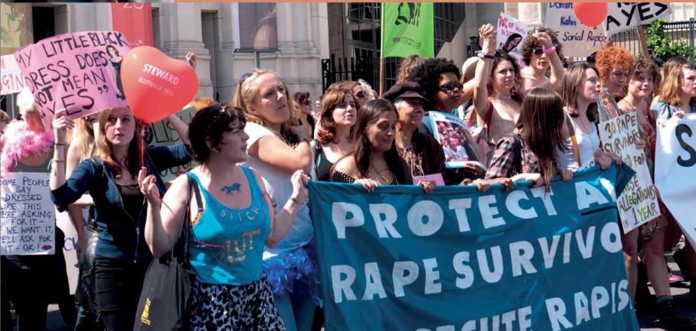
3. Prosecution and investigation: criminalization of forms of violence, custody and visitation rights, effective investigation and immediate response by law enforcement, special protection measures, judicial aid
4. Integrated Policies: allocation of appropriate funding, support of NGOs and civil society, national coordinating bodies, data collection and research
Notes:
3. Prosecution (and investigation): criminalisation of forms of violence, custody and visitation rights, effective investigation and immediate response by law enforcement, special protection measures, judicial aid
4. Integrated Policies: allocation of appropriate funding, support of NGOs and civil society, national coordinating bodies, data collection and research
Image: A group of women demonstrating in the street with signs. The following message is written on one of the sign: “Protect rape survivors”.

Slide 10
II. The Istanbul Convention: Its relevance to violence against women and girls with disabilities
Notes:
II. The Istanbul Convention: Its relevance to violence against women and girls with disabilities
GREVIO makes a point of meeting with women’s disability rights groups with respect to all its evaluation procedures
GREVIO often receives specific shadow reports from such groups, which it finds really helpful.

Slide 11
Regarding the rights of women and girls with disabilities, the IC calls for:
The need to develop integrated and gender sensitive measures on violence against women with disabilities
- States’ duty to support and appropriately fund NGOs representing women with disabilities in dealing with violence against women, and to cooperate with them
- States’ obligation to develop data collection and research on the situation of women with disabilities
Notes:
Regarding the rights of women and girls with disabilities, the IC calls for:
The need to develop integrated and gender sensitive measures on violence against women with disabilities
- States’ duty to support and appropriately fund NGOs representing women with disabilities in dealing with violence against women, and to cooperate with them
- States’ obligation to develop data collection and research on the situation of women with disabilities

Slide 12
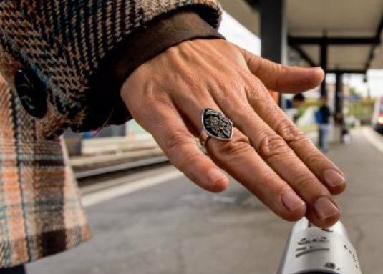
Further the IC calls on,
- the requirement to train professionals (health staff, police, judges) to detect and handle situations of violence against women with disabilities
- States’ duty to encourage companies and media to handle violence against women with disabilities
Victims’ right to information on legal remedies
Victims’ right to be able to access support services sensitive to the human rights and needs of women with disabilities
Notes:
Further the IC calls on,
- the requirement to train professionals (health staff, police, judges) to detect and handle situations of violence against women with disabilities
- States’ duty to encourage companies and media to handle violence against women with disabilities
Victims’ right to information on legal remedies
Victims’ right to be able to access support services sensitive to the human rights and needs of women with disabilities
Image: the hand of a blind women, which is touching a blind handrail.

Slide 13
The Convention also calls for -
- Criminal offences sanctioning violence against women: sexual violence and forced sterilization
- Effective response to violence against women with disabilities by law enforcement and judicial services
- Assistance, support and protective measures for victims during legal proceedings
Notes:
The Convention also calls for -
- Criminal offences sanctioning violence against women: sexual violence and forced sterilisation
- Effective response to violence against women with disabilities by law enforcement and judicial services
- Assistance, support and protective measures for victims during legal proceedings
Image: a picture of a statue of the “Lady Justice” which is a symbol of judicial systems.

Slide 14
Some GREVIO findings and recommendations regarding women and girls with disabilities in Serbia and Finland
Notes:
Some GREVIO findings and recommendations regarding women and girls with disabilities in Serbia and Finland

Slide 15
In Serbia, GREVIO identified a number of priority issues requiring further action by the authorities to comply fully with the convention’s provision - in particular regarding women with disabilities:
to ensure the provision of specialist women’s support services with a gendered approach and to expand the provision of shelters. None of the existing shelters were equipped to accommodate women with disabilities.
Notes:
In Serbia, GREVIO identified a number of priority issues requiring further action by the authorities to comply fully with the convention’s provision - in particular regarding women with disabilities:
to ensure the provision of specialist women’s support services with a gendered approach and to expand the provision of shelters. None of the existing shelters were equipped to accommodate women with disabilities.

Slide 16
Further, to ensure heightened respect among legal guardians and medical professionals for women’s informed and free decision-making in relation to medical procedures such as abortion and sterilisation.
Notes:
Further, to ensure heightened respect among legal guardians and medical professionals for women’s informed and free decision-making in relation to medical procedures such as abortion and sterilisation.

Slide 17
- Where women with disabilities had been raped, the offence primarily used by prosecutors and law-enforcement agencies is that it is an offence of sexual intercourse with a helpless person - instead of rape.
Notes:
- Where women with disabilities had been raped, the offence primarily used by prosecutors and law-enforcement agencies is that it is an offence of sexual intercourse with a helpless person - instead of rape.

Slide 18
In Finland, GREVIO identified a number of issues requiring further action by the authorities, in particular for women with disabilities.
Regarding preventive measures, Article 12, paragraph 3, requires that states shall take into account and address the specific needs of persons made vulnerable by particular circumstances, including women with disabilities. Article 12 further requires programmes and activities for the empowerment of women and girls, including women and girls from these specific groups.
GREVIO found a lack of general awareness of the needs of women with disabilities.
Notes:
In Finland, GREVIO identified a number of issues requiring further action by the authorities, in particular for women with disabilities.
Regarding preventive measures, Article 12, paragraph 3, requires that states shall take into account and address the specific needs of persons made vulnerable by particular circumstances, including women with disabilities. Article 12 further requires programmes and activities for the empowerment of women and girls, including women and girls from these specific groups.
GREVIO found a lack of general awareness of the needs of women with disabilities.

Slide 19
Although measures seek to ensure the availability of places in shelters, disability rights groups point to a number of barriers that persist for disabled women seeking shelter from domestic violence.
These include the lack of timely transport to shelters, inaccessible sanitary facilities and the fact that most shelters do not admit personal disability assistants.
Notes:
Although measures seek to ensure the availability of places in shelters, disability rights groups point to a number of barriers that persist for disabled women seeking shelter from domestic violence.
These include the lack of timely transport to shelters, inaccessible sanitary facilities and the fact that most shelters do not admit personal disability assistants.

Slide 20
Prevalence data point to the heightened exposure to violence against women with disabilities. Yet, GREVIO observed no particular effort in addressing this.
Notes:
Prevalence data point to the heightened exposure to violence against women with disabilities. Yet, GREVIO observes no particular effort in addressing this.

Slide 21
Although the National Action Plan to Reduce Violence against Women 2010-2015 included measures to protect women with disabilities from violence, it seems that shelters and other counselling services (particularly those online), are often inaccessible to women with disabilities.
Notes:
Although the National Action Plan to Reduce Violence against Women 2010-2015 included measures to protect women with disabilities from violence, it seems that shelters and other counselling services (particularly those online), are often inaccessible to women with disabilities.

Slide 22
Link to information leaflets:
https://www.coe.int/en/web/istanbul-convention/leaflets1
Notes:
I thank you on behalf of GREVIO for sending us shadow reports, as I said earlier, we find these very useful in doing our evaluations.
I encourage you to continue doing so and to use our reports, and please consider the GREVIO evaluation as an opportunity for you to share your concerns.
Link to information leaflets: https://www.coe.int/en/web/istanbul-convention/leaflets1

Slide 23
Thank you for your attention ☺
Notes:
Thank you for your attention ☺

