Slide 1
Inclusion Europe: How we work with European Parliament and Commission Milan Šveřepa director, Inclusion Europe

Slide 2
Inclusion Europe makes sure that European policies include the needs of people with intellectual disabilities and their families.

Slide 3
European policies can change the lives of people with intellectual disabilities and their families for the better.
We work on the policies that are important to our members.
We develop policy papers.
We organize events for EU officials to learn about the needs of people with intellectual disabilities and their families.
We make sure important documents reflect the voice of people with intellectual disabilities and their families.

Slide 4
European Union started as a group of 6 countries in 1951: Maintain peace after World War II.
Now – political and economic union with 28 members
Work is based on important treaties
Run by different institutions
Decides on laws
European law is more powerful than the laws in the member states!

Slide 5
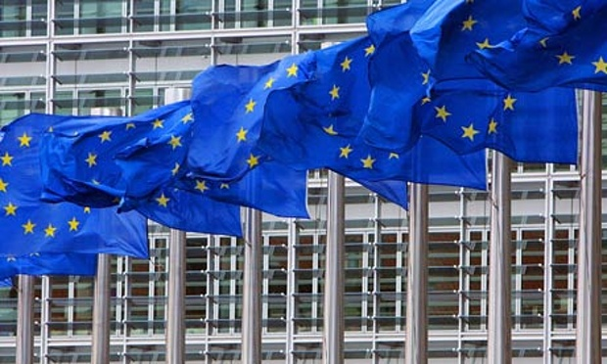
The main EU institutions are:
The European Commission
The European Parliament
The European Council
The European Court of Justice
The European Court of Auditors
The European Central Bank

Slide 6
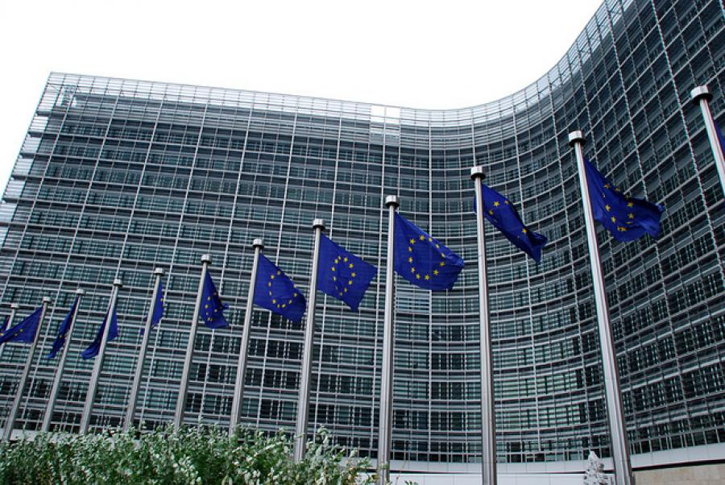
The European Commission
- Works a bit like a government
- Main roles - to come up with new laws
- to make sure the principles of the EU are respected

Slide 7
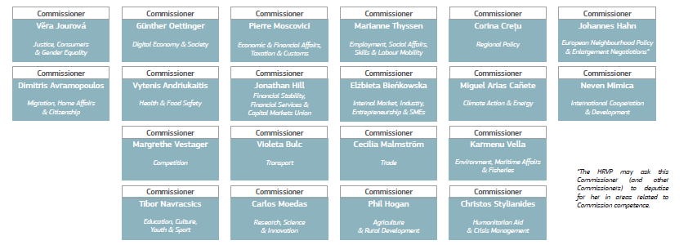
The European Commission
28 Commissioners – one from each member state
Each commissioner works on a different area, like health or transport

Slide 8
The European Commission
33,000 people work in the European Commission
They are split into different departments
The departments are called Directorate Generals (in short, DG)
College of Commissioners meets every week, usually on Wednesdays to take decisions on new laws

Slide 9
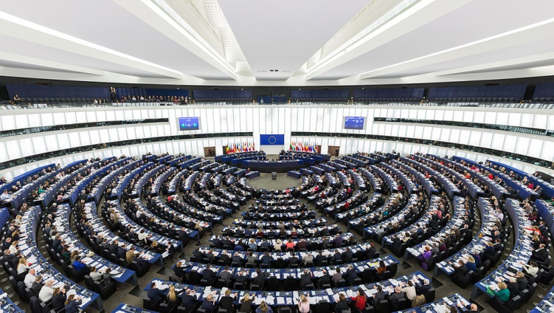
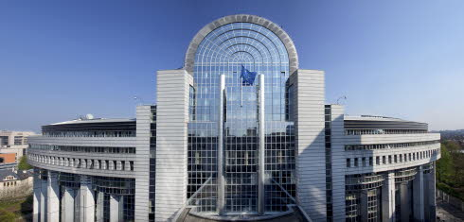
The European Parliament
751 Members of the European Parliament
Elected every 5 years
Different political groups

Slide 10
The European Parliament
Political groups:
European People’s Party (EPP)
Alliance of Socialists and Democrats (S&D)
European Conservatives and Reformists (ECR)
Alliance of European Liberal and Democrats (ALDE)
European United Left / Nordic Green Left
The Greens
Europe of Freedom and Direct Democracy Group
Europe of Nations and Freedom

Slide 11
The European Parliament
Committees:
Human Rights
Development
Employment and Social Affairs
Civil liberties, Justice and Home Affairs
Women’s Rights and Gender Equality
Fisheries
Transport and Tourism
And more

Slide 12
The European Parliament
Passes laws, together with Council
Meets in plenary once a month, usually in Strasbourg for 4 days
Decides on EU budget
Approves the European Commission

Slide 13
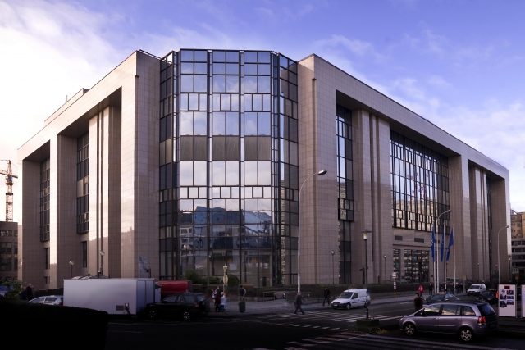
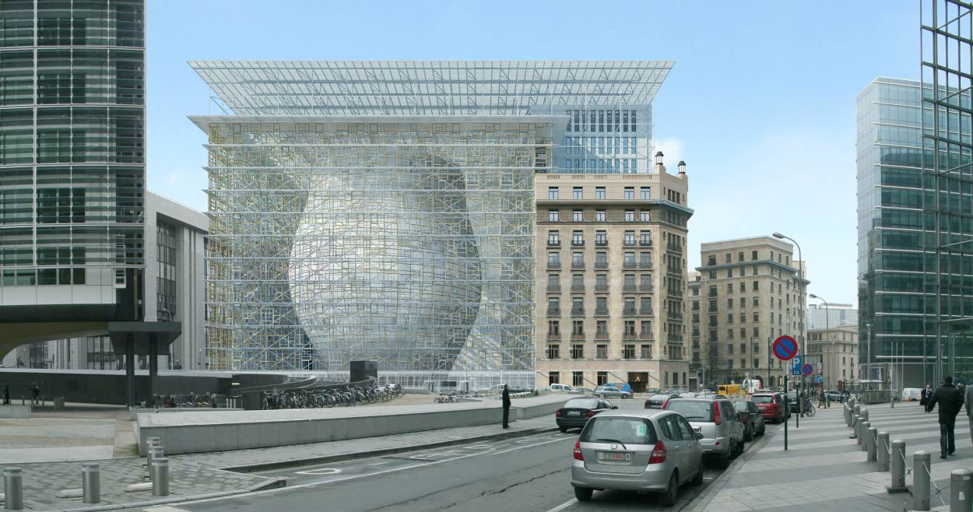
The European Council
Ministers of different member states
Decides on laws together with the European Parliament

Slide 14
The Council of the European Union
Meets in 10 different configurations
Environment Council
Foreign Affairs Council
Employment, Social Policy, Health and Consumer Affairs Council (EPSCO)
Education, Youth, Culture and Sports Council

Slide 15
Member states take turns to be the President of the Council. The Presidency changes every 6 months.
January – June 2016: The Netherlands
July – December 2016: Slovakia
January – June 2017: Malta
July – December 2017: United Kingdom Estonia

Slide 16
What can the European institutions decide on?
exclusive competence (only the EU can act)
shared competences (the member states can act only if the EU has chosen not to)
competence to support, coordinate or supplement the actions of the member states

Slide 17
What can the European institutions decide on?
exclusive competence
- customs
- competition
- fisheries
- commercial policy
- international agreements

Slide 18
What can the European institutions decide on?
shared competence
- social policy
- consumer protection
- public health
- development aid

Slide 19
What can the European institutions decide on?
competence to support, coordinate or supplement
- health
- education
- civil protection

Slide 20
Types of EU law
Regulation – legally binding, applies immediately to all Member States.
Directive - legally binding, but Member States have a time frame in which to include it in their national law.
Decision – linked to a specific case only, binding only to the institution it is addressed to (for example a particular member state, or an individual company).

Slide 21
What you can do
European Commission:
- take part in Consultations
- write letters, press releases, contact them on social media
- apply to projects, go to conferences
European Parliament
- choose your MEPs (see who has an interest in disability)
- contact them, meet with them
- work with Inclusion Europe to submit amendments
Council:
- follow what is going on
- contact your national ministries
- get involved in Presidency events

Slide 22
Inclusion Europe makes sure that European policies include the needs of people with intellectual disabilities and their families.

Slide 23
Comment – Ask - Engage
www.inclusion-europe.org
Twitter – Facebook – Newsletters – Youtube
Milan Šveřepa
m.sverepa@inclusion-europe.org

