Slide 1
Peer-Support
A model of supported decision-making for people with intellectual disabilities
Training Opportunities
for Peer Supporters
with Intellectual Disabilities
in Europe

Slide 2
TOPSIDE and TOPSIDE+
TOPSIDE (2011-2013): develop a new component in informal adult education
Develop the capacity of adults with intellectual disabilities to provide support and training to their peers.
Supported by the EU Life Long Learning Programme
Notes:
TOPSIDE and TOPSIDE+
Many adults with intellectual disabilities in Europe cannot participate as active citizens in their societies, because of the many barriers they are facing, starting with restrictions to their legal capacity, or limited education opportunities.
Since most people with intellectual disabilities have only limited access to formal or informal adult education and training, one of the main challenges lies in providing them with the appropriate training needed to take their own decisions, to take control over their lives and to perform their role as active citizens. Recognising this need, the firstTOPSIDE project in 2011-2013 set out to develop a new component in informal adult education for this group of citizens: peer support and peer training, i.e. to develop the capacity of adults with intellectual disabilities to provide support and training to their peers. That project was supported by the EU Life Long Learning Programme.
On the basis of an inventory of the necessary skills, the project partners developed and tested a training curriculum for adult peer supporters and trainers. The TOPSIDE Curriculum was complemented by Methodological Guidelines for adult education trainers. To test, improve and validate these deliverables, adult education courses for future Peer Supporters and Trainers were organized in the Czech Republic, Finland, the Netherlands, Romania, Scotland, and Spain. A European version of the Deliverables was also created for the transfer to other EU countries.
The TOPSIDE partners got recognition of the project and its work by the leading organisations of and for people with intellectual disabilities in Europe. They presented them at local, national and European level to promote the qualification as Peer Supporter and Trainer as new educational and eventually even employment opportunity for the target group. The Peer Supporters indeed used their skills in different settings: in self-advocacy organisations, in counselling services, or in organisations of guardians/supporters.
Ultimately, this project contributed to reinforcing the capacity of people with intellectual disabilities to live and work as active citizens in society.
However, the project partners also realised one shortcoming: people with intellectual disabilities themselves were involved only as trainees and not as equal trainers. Thus a continuation of the project was sought with co-financing of the Erasmus+ programme of the European Union under the title „TOPSIDE+: Training Opportunities for Peer Supporters with Intellectual Disabilities in Europe – New Horizons“. Running from 2014 to 2016, TOPSIDE+ had three main objectives:
To extend the TOPSIDE training to four new countries: Germany, France, Lithuania and Portugal.
To make the curriculum accessible to persons with intellectual disabilities so that they can work as trainers in cooperation with the non-disabled trainers.
To develop Policy Recommendations at national and European level as a basis for further dissemination and use of this innovative concept.
All of these objectives were reached and its results have been published at www.peer-support.eu. The present Policy Recommendations have been launched at the European Parliament and have found much support.
Inclusion Europe and all TOPSIDE partners are fully committed to continue with this innovative concept in their efforts to achieve more independence and inclusion of citizens with intellectual disabilities.

Slide 3
TOPSIDE and TOPSIDE+
TOPSIDE+ (2014 to 2016):
  Four new countries: Germany, France, Lithuania and Portugal.
  To make the curriculum accessible to persons with intellectual disabilities so that they can work as trainers
  To develop Policy Recommendations at national and European level
Co-financing from Erasmus+ of the European Union

Slide 4
Peer Support
The supporter is a “peer” with similar life experiences.
Support relationship is one of equality.
Exchange practical advice and suggestions for strategies that professionals may not offer or even know about.
Offers more authentic empathy and support.
New and empowering experience.
Notes:
Peer support is a concept that is known in many domains, such as (mental) health, schools, education, disability, etc. It occurs when people provide knowledge, experience, emotional, social or practical help to each other. The supporter is a “peer” who has similar life experiences and thus the support relationship is one of equality. People with similar life experiences may exchange practical advice and suggestions for strategies that professionals may not offer or even know about.
Peer support is also used when members of self-help organizations and others meet, in person or online, as equals to give each other support on a reciprocal basis. The worldwide Inclusion movement is founded on this concept, originating from family members of persons with intellectual disabilities organising themselves to provide mutual support.
It is a consequence of the developments of concepts such as self-advocacy, empowerment, inclusion and independent living that peer support now is also explored for support relationships between people with intellectual disabilities themselves. It is clear that people who have similar experiences of living with an intellectual disability can better relate and can consequently offer more authentic empathy and support.
Peer support is frequent, ongoing, accessible and flexible. Peer support can take many forms – phone calls, text messaging, group meetings, home visits, going for walks together, and even shopping. It complements and enhances other support services by creating the emotional, social and practical dimensions of support that other services may be lacking. Through empathetic listening and encouragement, peer supporters can motivate and encourage individuals to take decisions and empower them to lead a more self-determined life.
For people with intellectual disabilities, peer support proved to be a new concept that was at the beginning difficult to understand. This is the legacy of current support arrangements, where support comes exclusively from people without an intellectual disability and where own life experiences are not a valued resource at all. For many people with intellectual disabilities it was a new and very empowering experience that their lives are valued and that they were able to support other people.
The TOPSIDE+ project developed the following definitions of Peer and Peer Support in easy to understand language:
www.inclusion-europe.org and www.inclusion-international.org

Slide 5
What is a „Peer“?
The word “peer” is not used very often.
In our project it means a person who has some of the same life experiences as you.
Peers often understand you better because they share the same experiences.
They often understand better how you feel.
You often feel more comfortable to talk with them than with other people.

Slide 6
What is „Peer-Support“?
“Peer support“ is about getting support from people you can trust,
getting support from people you can understand.
It is about support from people with intellectual disabilities
who share common experiences with you.
Peer support is about being included in your community.
To give the support in the best way,
people need some training.

Slide 7
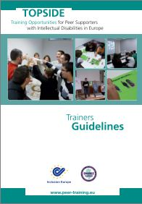
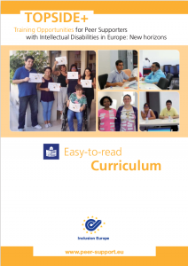
TOPSIDE Materials
The TOPSIDE Methodological Guidelines
for Trainers guide trainers through
planning and preparing the training.
The TOPSIDE Curriculum in Easy-to-Read Language supports trainers with
intellectual disabilities to run the
TOPSIDE training.

Slide 8
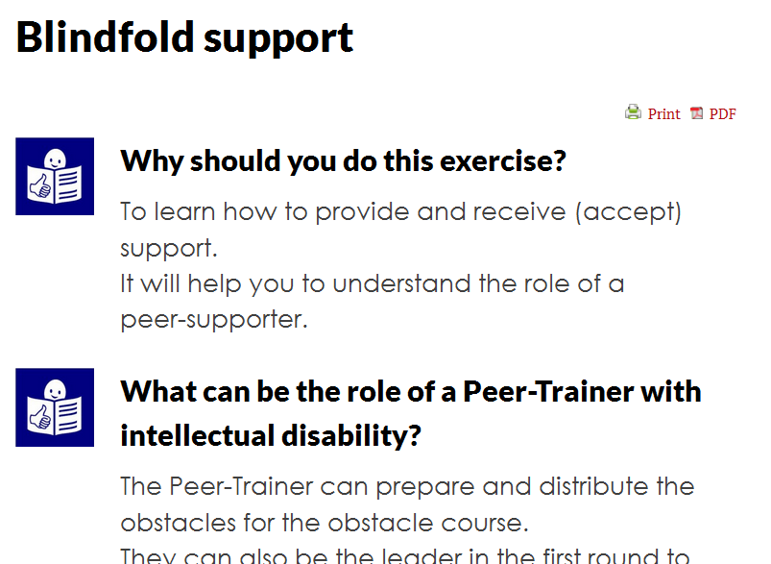
TOPSIDE Materials
The TOPSIDE Curriculum, which is composed of a database of exercises with easy-to-read summaries to
train people
with intellectual
disabilities to
become peer
supporters.

Slide 9
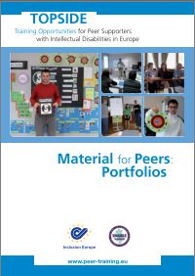
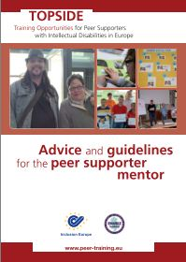
TOPSIDE Materials
The TOPSIDE Material for Peers, which
contains examples of portfolios
and materials peers will keep.
The TOPSIDE Guidelines for Mentors,
which should advise and direct the
activities of mentors to peer supporters

Slide 10
Supported Decision-Making
States Parties shall take appropriate measures to provide access by persons with disabilities to the support they may require in exercising their legal capacity. (Art. 12 CRPD)
States parties must […] provide persons with disabilities access to the support necessary to enable them to make decisions […]. (General Comment No. 1)

Slide 11
CRPD Concluding Observations
“The Committee notes with deep concern that across the European Union, the full legal capacity of a large number of persons with disabilities is restricted.
The Committee […] recommends that the European Union step up efforts to foster research, data collection and exchange of good practices on supported decision-making […].”

Slide 12
Peer support in decision-making
TOPSIDE has demonstrated that peer support is effective and appropriate to help people with intellectual disabilities to take decisions.
However, „the type and intensity of support to be provided will vary significantly from one person to another owing to the diversity of persons with disabilities” (GC No. 1)

Slide 13
Peer support in decision-making
Peer support cannot replace other support systems.
It is not suitable for every individual.
Peer support can provide social support, but it is not suitable for treating existing mental health problems.
Peer support will require regular assistance and mentoring, sometimes even the presence of a mentor or tutor .

Slide 14
Peer support in decision-making
Peer support is not the one and only solution for the support needs of citizens with intellectual disabilities.
It is absolutely necessary to develop, create and maintain a number of different flexible options that can be used in different situations, e.g.
  Universal design and accessibility
  Empowerment through education and training
  Informal or formal support arrangements
  Assistance in communication

Slide 15
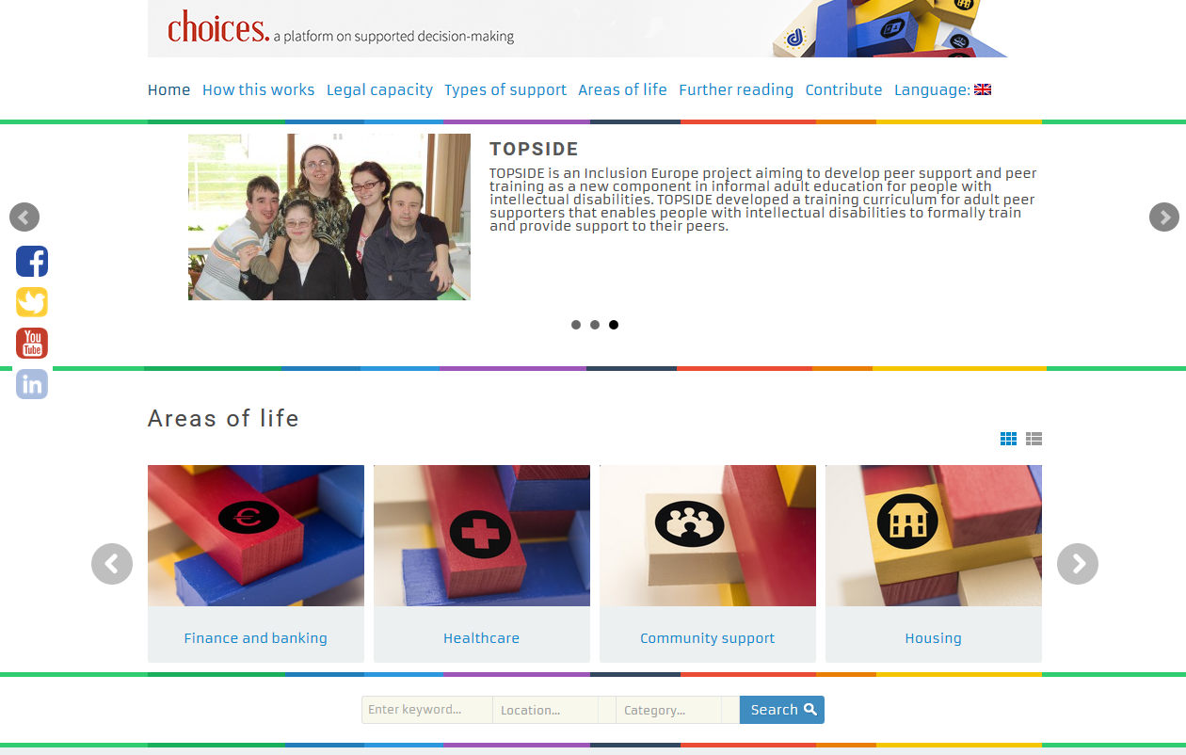
www.right-to-decide.eu

Slide 16
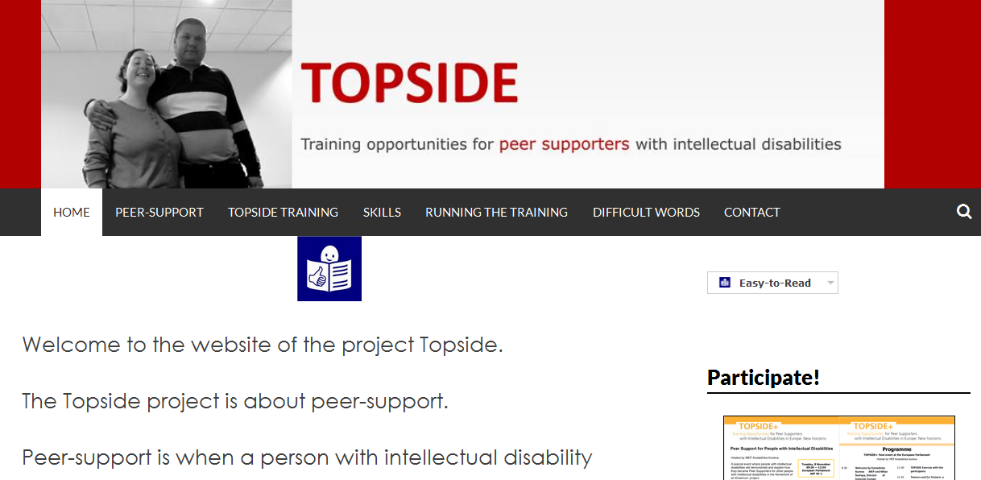
www.peer-support.eu

