Slide 1
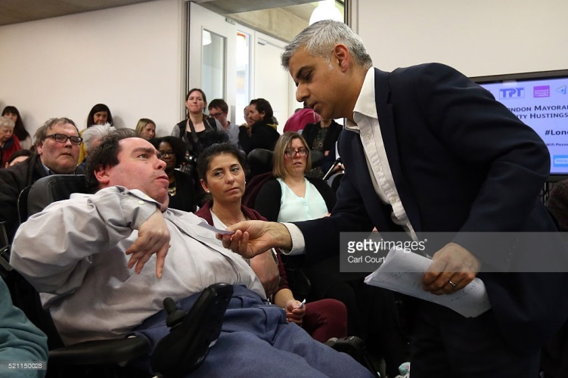
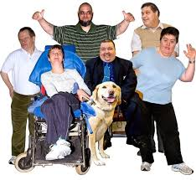
Ideas about working with politicians & officials
Rebecca Irvine

Slide 2
Let’s talk about your experience
How do you work with politicians?
How do you work with civil servants?
How do you work with government committees?
How do you work with lobby groups?
Other agencies?

Slide 3
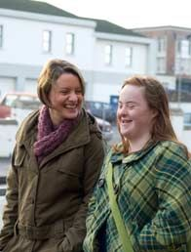
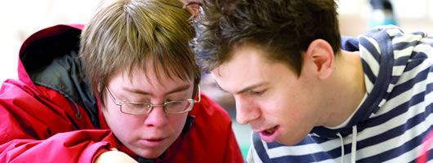
Tips for a Successful Meeting with your Member of Parliament (I)
Be prepared
Share your story
Stay on your point
Know both sides of the story

Slide 4
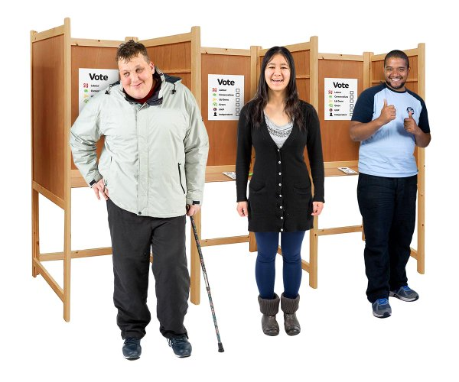
Tips for a Successful Meeting with your Member of Parliament (II)
Don’t argue
Make clear what you want to happen
Follow up
Tell others

Slide 5
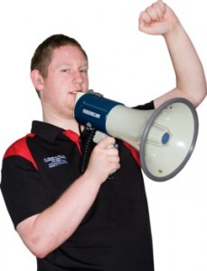
Think about how you communicate
Be polite
Stay calm and focused
Be clear in what you want
Listen to what others say
Say if you do not understand

Slide 6
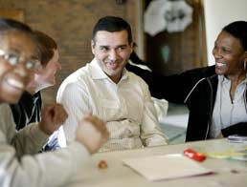
This is only the start…
Let’s keep learning from each other

Slide 7
Working together to achieve change

Slide 8
Michigan State University
Queen’s University Belfast

Slide 9
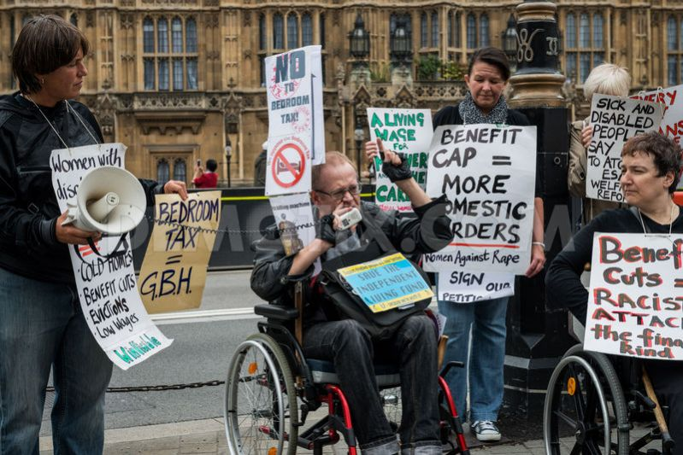
Current Events
UN: 'Grave' disability rights violations under UK reforms
“While the government continues to improve and build on the support available to disabled people, it stands by and is proud of its record.”

Slide 10
Current Events

Slide 11
Projects Related to Political Participation
Mencap’s campaigns on political participation
The All-Party Group on Learning Disability
Recent Research
Notes:
I don’t want to spend a lot of time on each project but just to make you aware of them. Please let me know if you are interested to learn more on any of these projects.

Slide 12
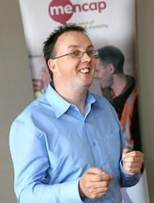
Mencap works in partnership with people with a learning disability and their families and carers.
All of their services support people to live life as they choose.
This includes campaigning for the changes that people with a learning disability want.
Notes:
Campaigns Manager in NI
-speaking in front of Committees, preparing policy documents & organizing others to campaign and lobby

Slide 13
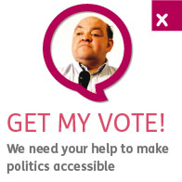
Get my vote aimed to:
Help people get involved
Make information about voting more accessible
Show best practice for accessible communication
Make politicians more aware of learning disability
Notes:
Results:
Political party manifestos were made available in Easy-read
More people with a learning disability registered to vote than ever before
Over 130 MPs signed a motion in Westminster to support making politics more accessible
Approximately 33% of people with a learning disability voted compared to 16% in the previous election

Slide 14
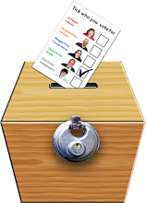
Get my vote
We asked candidates in the election to sign and return a postcard committing to:
Equal citizenship for disabled people
Early childhood intervention and support for children to grow, develop and have fun
Equal access to health care, employment, lifelong learning opportunities, and housing
More and better support for families
An end to bullying and hate crime

Slide 15
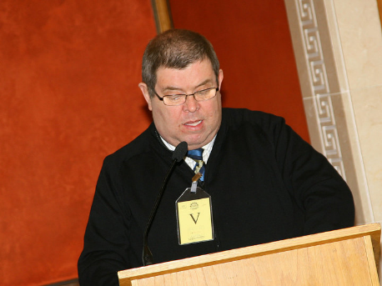
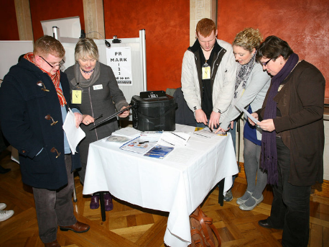
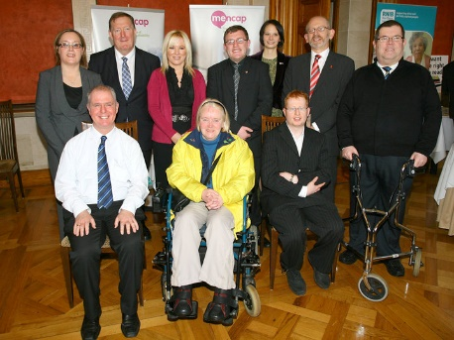
Access to Democracy event
at the NI Assembly, February 2010
Self-advocates spoke about their involvement with politics
We talked about how to vote and people could register to vote
People could talk to representatives from all of the political parties

Slide 16
Changing Places in Parliament

Slide 17
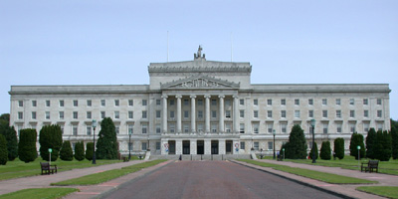
All-Party Group on Learning Disability
Aims:
to promote better understanding of the issues facing people with a learning disability and their families
influence policy, legislation and service developments to improve the lives of people with a learning disability and their families in Northern Ireland
Notes:
Identified members through monitoring questions etc.
All 7 parties
Social media ‘bullying’
6 organizations + 7 parties + 2 independent self-advocates + 2 independent parents
4 themed meetings per year
Standing room only (open to public)
Selected as most successful APG

Slide 18
Research Projects
Monitoring the Implementation of the CRPD (Article 29 available)
Experiences of People with Intellectual Disabilities in Influencing Public Policy
Comparative International Disability Policy

Slide 19
www.right-to-decide.eu
Models of support for decision-making;
Living in the community for people with complex needs;
Participation of children in decision-making; and
Analysis of structural support for self-advocacy in Europe

Slide 20
Resources available from Inclusion International
http://inclusion-international.org/category/programme/accessing-the-ballot-box/
My Voice Matters!: Easy-Read Guide on Inclusive Civic Engagement
Inclusive Civic Engagement: Information Toolkit for Families and People with Intellectual Disabilities
Accessing the Ballot Box: An information Toolkit for Governments

Slide 21
Additional Resources
Inclusion-Europe.eu
Self-advocacy.eu
peer-support.eu
https://www.google.be/search?q=partners+for+better+policies+a+manual+mainstreaming&rlz=1C1LENP_enUS544US544&oq=partners+for+better+&aqs=chrome.0.69i59j69i57j0l2j69i60j0.3606j0j4&sourceid=chrome&ie=UTF-8
http://www.tbcoalition.eu/wp-content/uploads/2012/03/Tips-for-a-successful-meeting-with-your-MP.pdf
https://fra.europa.eu/sites/default/files/fra_report_on_right_to_vote_as_easy_to_read.pdf
http://www.ohchr.org/Documents/Issues/Disability/SubmissionThematicStudy/OHCHR_study_ETR_easyversion.pdf
Access to and Accessibility of Citizenship and Political Participation of People with Disabilities in Europe: Introduction to Two Related 2013 ANED Reports
https://www.c-q-l.org/resource-library/resource-library/all-resources/self-advocacy-and-leadership
https://bookshop.europa.eu/en/bundles/easy-reading-about-the-eu-cbj5eep2IxilAAAAEuIFphS1Kn/
https://europa.eu/european-union/documents-publications_en
https://europa.eu/european-union/about-eu/eu-in-brief_en

Slide 22
Rebecca Irvine
rirvine@msu.edu
@rshea_irvine
/rebecca.shea.irvine

Slide 23
Building on Experience
What are the different ways you can influence decisions about policies or programmes?
What is your issue?
Who can make the changes you want?
What information do they want or need?
How do they want that information?

Slide 24
What skills do you think are important in influencing political decisions?

Slide 25
Learning to work together
How can we learn from one another?
How do we continue to build relationships?

Slide 26
Working Together to Achieve Change
Sharing your stories at national level is very important
We can learn that other countries may have similar issues (think peer-training)
They may also have solutions
We can work together to make our voices louder at the European level

